Slide 1
Palliative care and substance use: the social care perspective
Dr Sam Wright and Prof Sarah Galvani
Department of Sociology
Manchester Metropolitan University
This project is funded by the national institute for health research (NIHR) under its research for patient benefit (RFPB) programme (grant reference number NIHR275107). The views expressed are those of the author(s) and not necessarily those of the NIHR or the department of health and social care.

Slide 2
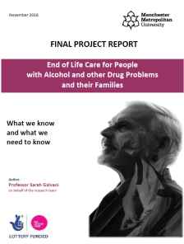
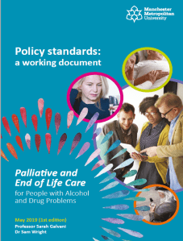
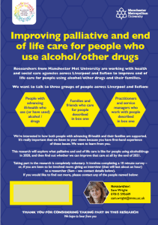
Our research (2016-2021)
Available at: endoflifecaresubstanceuse.com
Notes:
Next steps
Dissemination – especially good practice guidance
Encourage national / local policy development
Need for policy reflections at national and local levels – developed a set of policy standards to support practice development
Build practitioner and policy networks to stimulate ongoing development of services
Continue to plug huge gaps in the research evidence

Slide 3
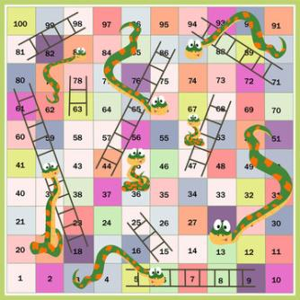
What does EoLC look like for people using substances?
Not knowing how ill you actually are
Little / no professional input
Unsupported family carers
Feeling lucky to meet practitioners who do not judge you harshly
Notes:
Compared against ‘the gold standard’ of what PEoLC should look like, for example:
Clarity of EoL diagnosis
Timely practical assistance
Recognising family need
Regular emotional support
Compassion

Slide 4
… mostly it’s about absence:
Primary care
Substance use services
Self-referral
Hospitals or acute care

Slide 5
How are people identified?
Do they have a diagnosed cancer?
Do they have assertive and persistent family/friends?
Are they in touch with a GP who does not assume SU is their only health problem?
Do they have a key worker who will go the extra mile for them?

Slide 6
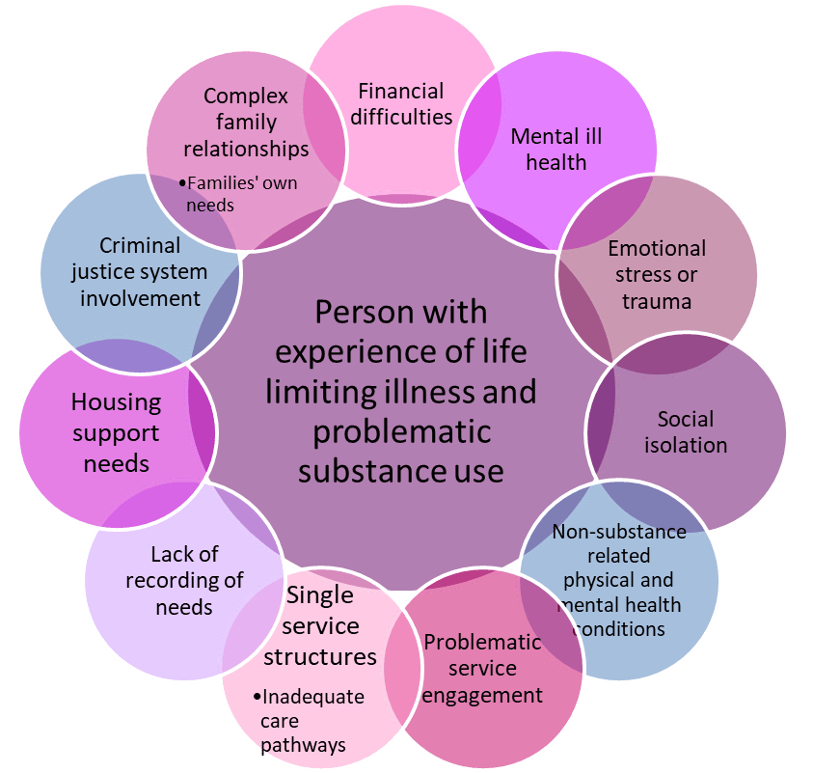
Main themes across the research
People with multiple complex needs
Complex symptom and pain management
Need to counter stigma and stereotyping
Non-judgemental, empathetic care is essential
Good communication is critical

Slide 7
Symptom/pain management
How to alleviate pain safely for people using substances (especially opioids)?
Prescribed drugs may be misused by family / friends or sold on.
ACTUALLY: People in recovery often refuse medication, due to fear of dependence and withdrawal.
Notes:
(1) This can result in a vicious circle whereby people receive inadequate pain relief, and start topping up their medication with street drugs. Unpredictable use of street drugs then makes health practitioners even more concerned, which leads to more restrictive prescribing.
Very common concern among health practitioners - how to alleviate pain safely with people using substances
‘Chemical coping’ – substance topping up their medication due to inadequate pain relief
Drug diversion by family members or friends
Safes and locked boxes used to counteract this
People with historic substance use refusing medication based on opioids
Guidance needed – balances adequate pain relief with a person’s choice to continue using

Slide 9
Non-judgemental, empathetic care
The GP … used to say to him, “If you need more [painkillers], just tell me and I’ll give you more. … I don't think you're using enough.” Because he [GP] knew how much he was against using it. …
He [Partner] wasn’t bothered about the addiction, it was the withdrawal he was so scared of. … When you've gone through that much withdrawal in your life, it’s an absolute terror of going through it.
Ex-partner
Adequate pain relief is needed even where people want to continue using substances

Slide 10
Compassionate communication
Many practitioners lack confidence in addressing painful, sensitive topics.
Need to undo entrenched stigma and stereotypes around people who use substances.
“The thing that makes it work....people that genuinely care and that what they’re doing doesn’t come out of a professional information scientific statement, they genuinely commit and love you and care for you and you can sense and feel that.”
Friend
Notes:
Lack of communication at the core of the project’s findings
Practitioners feeling they lack competence – but perhaps more a lack of confidence in addressing painful, sensitive topics
Poor communication is keeping people in need from engaging with services and getting good EoL care
Talking about communication – between the person at EoL and their family, professionals (including with each other), with policymakers and commissioners.
Entrenched stigma and stereotypes around people with problematic substance use - Requires a paradigm shift to maximise engagement with care providers.
Fear of disclosing SU at EoL or to social care or health practitioners.
Health problems not addressed and attributed to substance use.
National anti-stigma campaign is needed.

Slide 11
The support needs of family caregivers
Long-term and intensifying burden of care
Reality of life-shortening condition often unknown
Lack of formal support (absence of external, objective insight)
Lack of recognition of family caregivers’ own support needs
Families’ self-protective boundaries to care can be misinterpreted by health practitioners as neglect - resulting in non-inclusive practice.
Notes:
2 re: substance use, paraphernalia and drug dealing.
5 - balancing emotional support needs with administration responsibilities.
6 - Talking about substance use regularly with colleagues helped to normalise the topic and share information/knowledge gaps.
7 - Goodwin, N., Curry, N., Naylor, C., Ross, S. and Duldig, W. (2010) Managing people with long-term conditions. London: The King’s Fund. https://www.kingsfund.org.uk/sites/default/files/field/field_document/managing-people-long-term-conditions-gp-inquiry-research-paper-mar11.pdf [Accessed 26/03/19]

Slide 12
Key messages for practice
Make links across the substance use and palliative/EoLC fields
Develop confidence to comfortably ask about both substance use and life-shortening health problems
Ask family caregivers how their relative’s substance use affects their caring roles, their decision-making and their own support needs
Ensure sufficient support for yourself and your colleagues

Slide 13
How can health and social care be more accessible for highly stigmatised people/families at, or near, the end of their lives?
How can we provide support to highly isolated people?
How can we respond to the emotional burden of caring for, or supporting, people using substances at, or near, the end of life?
Notes:
Developing a new model of care for people at, or near, the end of life who use, or have used, substances.
A new study to work with people with lived experience
and practice experience in co-producing and assessing
the impact of a new model of care.
(October 2019 – April 2021, Liverpool and Sefton)

Slide 14
Thank you
s.galvani@mmu.ac.uk
Tel: 07775 680418
Twitter: @SarahGalvani
sam.wright@mmu.ac.uk
Tel: 07815 595609
Website: endoflifecaresubstanceuse.com
Twitter for research group: @SUABManMet

