Slide 1
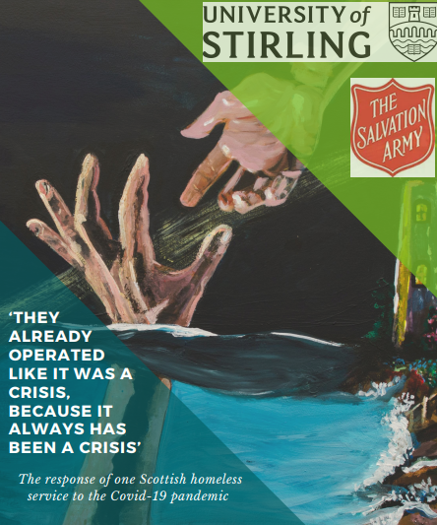
Danilo Falzon, Research Assistant, Salvation Army Centre for Addiction Services and Research, University of Stirling
Wendy Masterton, PhD student and Research Assistant, Salvation Army Centre for Addiction Services and Research, University of Stirling
Notes:
D to welcome

Slide 2
Today’s presentation:
About the Wellbeing Centre
Background and aim of the study
Methods
Findings
Takeaway messages
Notes:
D

Slide 3
About the study
Data collected at the Wellbeing Centre
Ran between April and August 2020
Conducted by SACASR in collaboration with TSA:
Prof. Tessa Parkes (UoS) Josh Dumbrell (UoS and TSA)
Dr Hannah Carver (UoS) Susan Grant (TSA)
Wendy Masterton (UoS) Iain Wilson (TSA)
Danilo Falzon (UoS)
Notes:
W

Slide 4
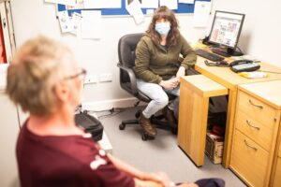
Notes:
W

Slide 5
Methods
We interviewed 20 people:
10 clients
5 staff
5 professionals outside of the centre but who know the centre well
Interviews were either face-to-face or by phone and lasted approximately 33 minutes
Service documents were also analysed, including service posters, team meeting notes and staff training. We used these to create a timeline of changes that occurred in the Wellbeing Centre.

Slide 6
Findings – the ‘whirlwind’
The initial lockdown period was described as a time of confusion and uncertainty, particularly in terms of what support was available.
Staff were concerned about how to continue supporting clients, with particular concerns around people’s mental health, wellbeing and substance use.
Some clients felt isolated and angry that services were shutting, as if they no longer mattered
Changes to phone and online support was made easier by being able to provide smartphones with data.
Notes:
D

Slide 7
There are a lot of individuals that we work with who are not involved with other agencies. And there was a real consensus, a real concern, that these guys were really vulnerable and could slip through the net. It wasn’t just one or two people, there was thirty, forty people. (Kate, staff)
Unlike anything else that I’ve ever experienced, to be honest, you know an organisation phoning up checking on your wellbeing twice a week and, you know, it doesn’t really happen. (Andrew, client)
Notes:
D
A few quotes from a staff member and two clients highlight first the concerns and then the benefits of providing phone/online support.

Slide 8
Findings – changes to service provision
Practical and emotional support provided by phone and online, via groups and one-to-one, including one-to-one in-person support
Finding a balance between COVID-19 and other risks
Food provision via food parcels and hot food takeaway
Scaling up harm reduction such as IEP and naloxone in the Centre
Notes:
D

Slide 9
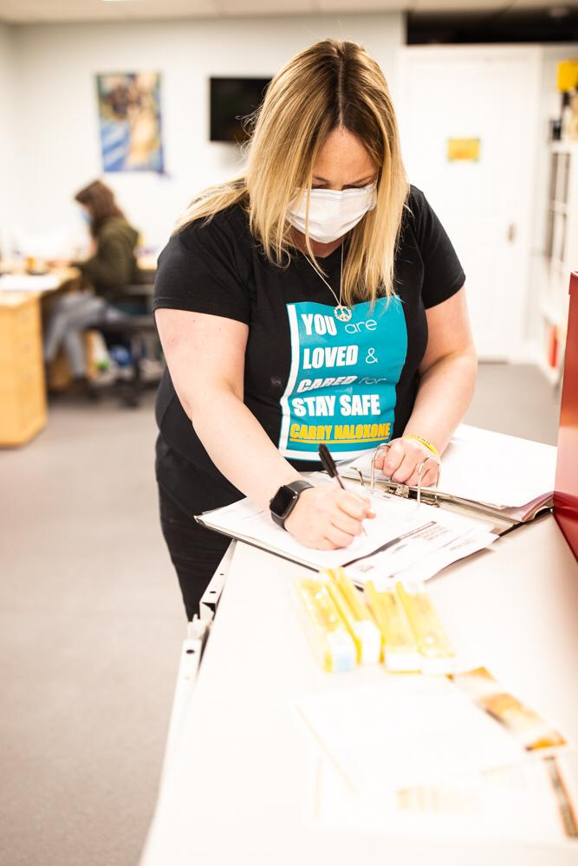
Notes:
This was a poster that was developed to encourage the carrying of naloxone. This was put up around the wellbeing centre.

Slide 10
There is still a fear factor, there is a massive fear factor from, not us contracting it from the guys, it’s us giving it to the guys, because they are the ones with the underlying health issues. They have all got COPD and asthma and blood clots, DVTs [Deep vein thrombosis], alcoholism and drug use and so, they catch it, it could kill them, we catch it, 99% of us are going to come through it unscathed.
(Jack, stakeholder)
Notes:
D

Slide 11
Findings – what difference did the WC make?
The Wellbeing Centre was a vital source of support and there was confusion and feelings of isolation when services were disrupted at the start of the pandemic
Pandemic was a huge learning curve for all, with the need for constant change
May provide long lasting changes to service provision
Creation of a ‘culture of care’ even in times of crises
Notes:
W

Slide 12
I mean it from the bottom of my heart [Centre staff] are the only people that have been helping me over the last few months and it’s keeping me going. (Frank, client)
I love each and every one of yous, I really do. I cannae imagine my life without any of yous, especially without some of you, and just with the support that I get, although I get it from everybody, I know who to go to for what. (Jacqui, client)
Notes:
W

Slide 13
What is important about these findings?
Harm reduction services are important within third sector homelessness services
Telephone/online support feasible and helpful
Staff training, support and reflective practice is essential
Services have to work together
Rapid rehousing of people who are homeless was a huge change that many benefited from and shows how fast big decisions can be made
Notes:
W

Slide 14
Takeaway messages
The aim of this study was to explore how the Wellbeing Centre responded to the pandemic.
The study highlighted the loss, confusion and isolation experienced by people who were homeless, and the essential support provided to them when many other services literally closed their doors.
Practical and emotional support was continued using new ways such as telephone and online groups, and harm reduction services were made more available, providing much needed support.
Those using the Centre described the stability that this created for them during an intense time of disruption
There are many important findings that are important for service developers and providers, and policy makers to know so that we don’t lose some of the benefits, but we also know how to better respond in future

Slide 15
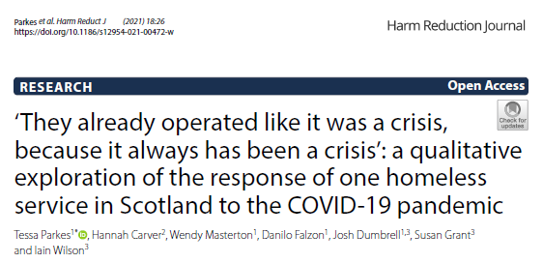
For more information
sacasr@stir.ac.uk
@SACASRStir
Wendy Masterton
Wendy.masterton@stir.ac.uk
@WendyMasterton
Danilo Falzon
d.c.falzon@stir.ac.uk
Papers available from: https://harmreductionjournal.biomedcentral.com/articles/10.1186/s12954-021-00472-w
https://harmreductionjournal.biomedcentral.com/articles/10.1186/s12954-021-00508-1
Notes:
W
The findings I have presented are from a paper published in Harm Reduction Journal. We have another sister paper that has also been published which looks at the wider landscape of Edinburgh and how partnership working in particular grew across the pandemic. Both papers have been shared on Twitter so I have provided the SACASR twitter handle.

Slide 16
QUESTIONS?

