Slide 1
Assessing the impacts of novel coronavirus outbreaks on people who use drugs, drug-related deaths and the effectiveness of service responses to COVID-19 (in Scotland)
Alison Munro¹ (presenting),
Hazel Booth², Nicola Gray¹, Joan Love¹, Andrea Mohan^{1,} Jason Tang² and Steve MacGillivray¹
1 University of Dundee; 2 University of Stirling

Slide 2
Background
Call for research from Scotland’s Drugs Death Task Force
Some months into the current pandemic
Early awareness of similarities between those being affected by COVID-19 and ill-health/ inequalities experienced by PWUD
Question over whether there was any prior learning from previous coronavirus pandemics as well as current one
“Persons with a substance use disorder are likely to be at increased risk of contracting SARS-CoV-2 because of their higher rates of homelessness, having overcrowded living conditions or being incarcerated, and having poor access to health care (1). In addition, given the virus’s impact on the respiratory, cardiovascular, and immune systems—which can be impaired by opioids, tobacco, and abuse of other substances—persons with substance use disorders are at increased risk of COVID-19 complications, including acute respiratory distress syndrome (ARDS), renal failure, and death (1, 2).”
Ref - The Impact of Substance Use Disorder on COVID-19 Outcomes
Jacques Baillargeon, Efstathaia Polychronopoulou, Yong-Fang Kuo, and Mukaila A. Raji
Psychiatric Services 2021 72:5, 578-581

Slide 3

Review Aim and Questions
What evidence exists regarding the impacts of any of the novel coronavirus outbreaks of the 21st Century, including COVID-19, on PWUD, drug-related deaths and other harms and what is the quality of evidence?
How have services who provide support for PDU and policy makers responded to any of the 21st Century outbreaks, including COVID-19, and what is the quality of evidence supporting their responses?
What are the gaps in evidence and what are the future research questions of importance in responding to any future outbreaks?
What are the implications of past responses to coronavirus epidemics/pandemics to inform future service and policy responses?

Slide 4
Methods
(Brief)
Systematic Review using EPPI-C approach
Key Databases searched including emerging COVID-19 databases
Scoping searches used to define search terms
Inclusion and Exclusion Criteria
Data Extraction
Quality Assessment

Slide 5
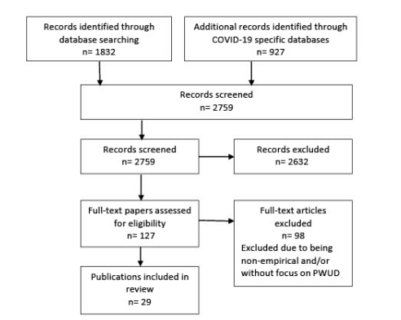
Papers identified, screened and included
(PRISMA Flowchart)

Slide 6
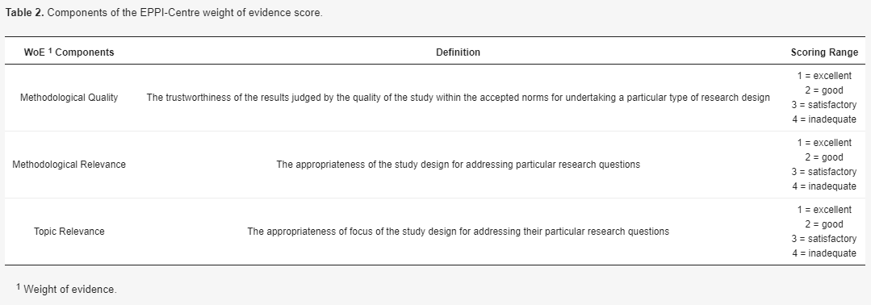
Quality Assessment

Slide 7
Results: Overview of Studies
29 papers located (2 were reviews)
27 primary studies included T
The studies were conducted in the following
North America (14)
Spain (2)
1 each in Australia, Finland, India, Italy, Netherlands, Nigeria, Norway, Poland, UK and Ukraine,
1 study involved participants from multiple countries.
25 of the primary studies were quantitative and two were qualitative.
ZERO studies related to SARS-CoV-1 or MERS.

Slide 8
Results: Study Settings
Analysis of studies indicated that they were best categorised with regard to their focus on treatment setting/services. Seven
treatment settings were identified:
Treatment services/treatment/recovery (8 studies);
Emergency medical services (5 studies);
Low threshold services/shelter/homelessness (3 studies);
People who use drugs/with diagnosis of SUD (7 studies);
People with SUD and HIV (2 studies)
‘Sexual minority’ (MSM) CIS men (1 study)
Prison (1 study)

Slide 9
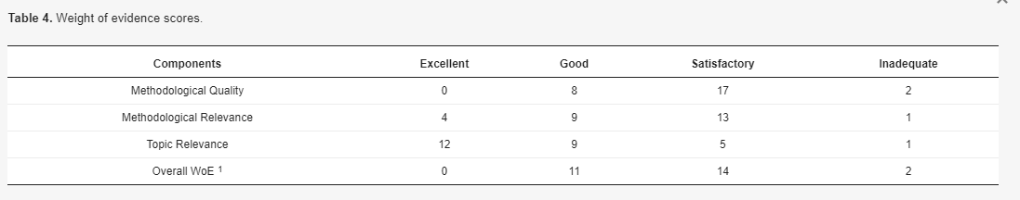

27 primary papers - WoE

Slide 10
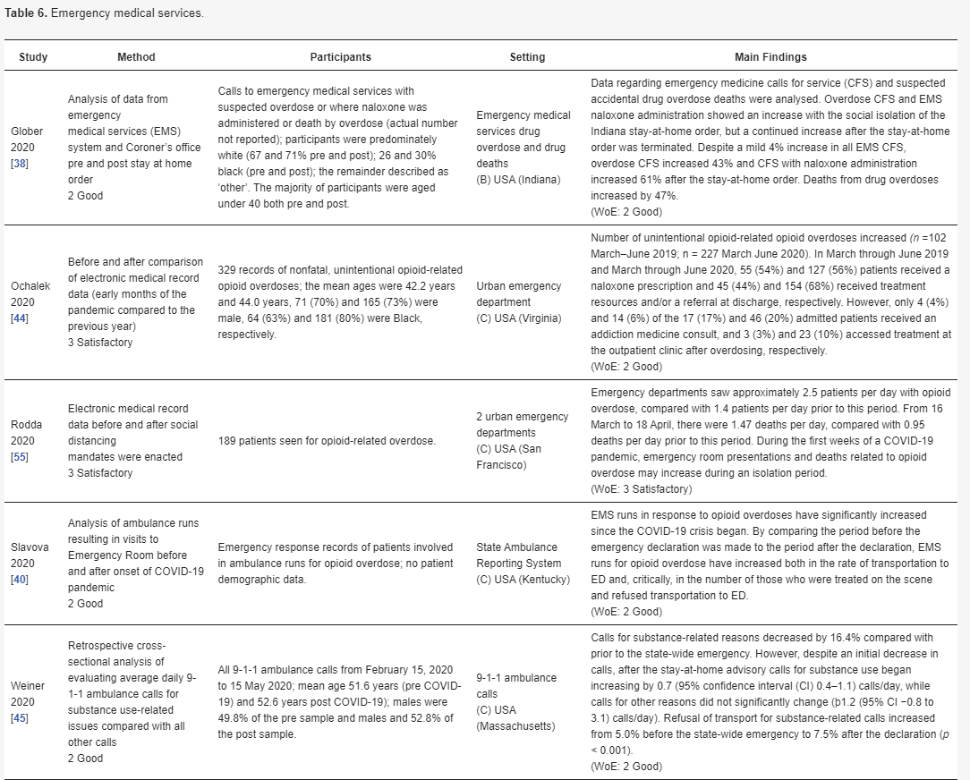
‘Best quality’ grouping of studies

Slide 11
Discussion Points
Overall, quality of evidence was not good
Themes picked up in the discussion:
Physical and Psychological Wellbeing
Vulnerable/Marginalised groups (eg people who are homeless, BAME and MSM)
Reduced Access to Harm Reduction Services
Drug-Related Deaths
Drug use patterns

Slide 12
Conclusion
Di”
’the empirical evidence is generally not of sufficient quality to inform future responses to further COVID-19 outbreaks or indeed other novel coronavirus outbreaks’
‘where consideration may be given to some interventions such as maintaining access to evidenced based interventions (e.g., MAT and naloxone) as well as a need for additional supports for more vulnerable PWUD such as people who are homeless, who have additional comorbidities and from BAME groups. There remains a large gap in knowledge that is necessary to inform future responses.’
Requirement for further robust researchPointsDiscussion Points

Slide 13
Acknowledgements and Thank you
Di
”
Scottish Drug Death Taskforce
DRNSP
Paper link and citation:
https://www.mdpi.com/1224396//
Munro A, Booth H, Gray NM, Love J, Mohan ARM, Tang J, MacGillivray S. Understanding the Impacts of Novel Coronavirus Outbreaks on People Who Use Drugs: A Systematic Review to Inform Practice and Drug Policy Responses to COVID-19. International Journal of Environmental Research and Public Health. 2021; 18(16):8470. https://doi.org/10.3390/ijerph18168470www.mdpi.com/1224396
Points

