Slide 1
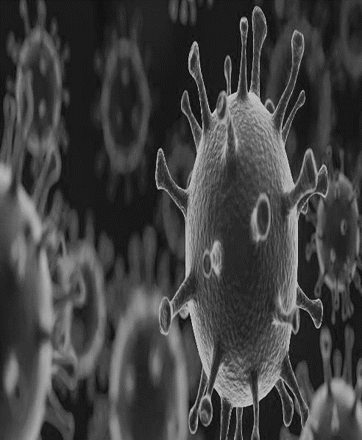
The Team
Catriona Matheson
Tessa Parkes
Joe Schofield
Tania Browne
Josh Dumbrell
Angus Bancroft
Idil Galip
Understanding the health impacts of the COVID-19 response on people who use drugs in Scotland (PWUD): implications for COVID-19 infection and transmission among this group and impacts on harm reduction, treatment and recovery

Slide 2
Introductions
Aims and method
Findings
Conclusions
Outline of the project
Overview
Notes:
So what did we know? As researchers and practitioners
People who use drugs (PWUD) are especially vulnerable to COVID-19 because of their social circumstances, comorbidities, and substance use. PWUD are more likely to experience economic and social disadvantage, homelessness, and housing insecurity (Neale, 2001; Parkes et al., 2021a; Schulte & Hser, 2014) , imprisonment (Fazel et al., 2017), and often face significant barriers to accessing health services, including discrimination and stigma from healthcare professionals (van Boekel et al., 2013). PWUD are disproportionately affected by comorbidities that increase the risk of developing severe disease or COVID-19 mortality .They can be immunocompromised because of untreated HIV or hepatitis C infection, liver disease, or as a result of substance use.
PWUD are also more vulnerable due to having undiagnosed or poorly managed chronic health conditions such as diabetes, cardiovascular, pulmonary, and respiratory disease (Bambra et al., 2020; Farhoudian, 2020). The social nature of drug use also places PWUD at increased risk of being exposed to COVID-19, for example, p. Purchasing and consuming drugs are social activities that can involve visiting other peoples’ homes, using drugs in groups or in crowded settings, and the sharing of substances and paraphernalia. (EMCDDA, 2020; Vasylyeva et al., 2020; Walters et al., 2020).

Slide 3
Background
Vulnerabilities of people who use drugs to severe infection and COVID-19 mortality
Chronic health conditions
Co-morbidities
Immunocompromised
Homelessness
Deep social exclusion
R I S K
Notes:
So what did we know? As researchers and practitioners
People who use drugs (PWUD) are especially vulnerable to COVID-19 because of their social circumstances, comorbidities, and substance use. PWUD are more likely to experience economic and social disadvantage, homelessness, and housing insecurity (Neale, 2001; Parkes et al., 2021a; Schulte & Hser, 2014) , imprisonment (Fazel et al., 2017), and often face significant barriers to accessing health services, including discrimination and stigma from healthcare professionals (van Boekel et al., 2013). PWUD are disproportionately affected by comorbidities that increase the risk of developing severe disease or COVID-19 mortality .They can be immunocompromised because of untreated HIV or hepatitis C infection, liver disease, or as a result of substance use.
PWUD are also more vulnerable due to having undiagnosed or poorly managed chronic health conditions such as diabetes, cardiovascular, pulmonary, and respiratory disease (Bambra et al., 2020; Farhoudian, 2020). The social nature of drug use also places PWUD at increased risk of being exposed to COVID-19, for example, p. Purchasing and consuming drugs are social activities that can involve visiting other peoples’ homes, using drugs in groups or in crowded settings, and the sharing of substances and paraphernalia. (EMCDDA, 2020; Vasylyeva et al., 2020; Walters et al., 2020).
As an aside I was also working as a harm reduction practitioner in one of the data collection sites and we were

Slide 4
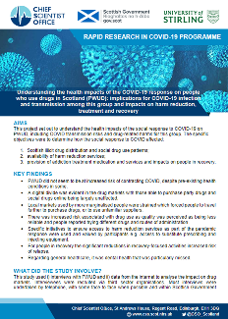
Aim
To understand the health impacts of the social response to COVID-19 on PWUD
Research questions
The specific objectives were to determine how the social response to COVID-19 affected:
1. Scottish illicit distribution
2. availability of harm reduction services
3. provision of addiction treatment medication and services and impacts on people in recovery
Method
A Research Advisory Group (RAG) was established
Quantitative data was compiled from multiple data sources about changing drug markets
29 people who used drugs and/or were in recovery took part in semi-structured interviews
Interviews were audio recorded, transcribed and analysed thematically
Notes:
Understanding the health impacts of the COVID-19 response on people who use drugs in Scotland is a research project that aims to understand the longer-term health impacts of the social response to COVID-19 on people who use drugs. The project involves researchers from the Universities of Stirling and Edinburgh. Some of our team looked at online drug markets, and some of us spoke to people who use drugs across Scotland.
A Research Advisory Group (RAG) was established consisting of members of the research team, representatives from Crew 2000 and Scottish Drugs Forum (national voluntary sector drugs organisations), and officers from Police Scotland with a remit for strategic issues relating to drug markets and harms across the country. The RAG met twice during the project to review progress against the project plan and provide intelligence on emerging evidence of changes in supply of both drugs and services for PWUD.
quantitative data shared by Crew2000(a national organisation that conducted surveys of PWUD over the pandemic period), Police Scotland (monitoring data), WEDINOS (drug checking data), and transaction data from the darknet cryptomarkets
29 people who used drugs and/or were in recovery took part in semi-structured interviews
This included 13 women (33– 44years) and 16 men (28–56years). Sixteen were recruited via a homeless hostel in Edinburgh, two from a recovery community in Clackmannanshire, eight from a stabilisation service in Glasgow, and three from a Dundee support service.
An interview topic guide covered: changes to drug use since the start of lockdown, access to and use of drug-related services (harm reduction, opiate substitution and recovery services), other health and support services, and impacts on physical and mental health.
Interviews were audio recorded, transcribed in full, and analysed thematically.

Slide 5
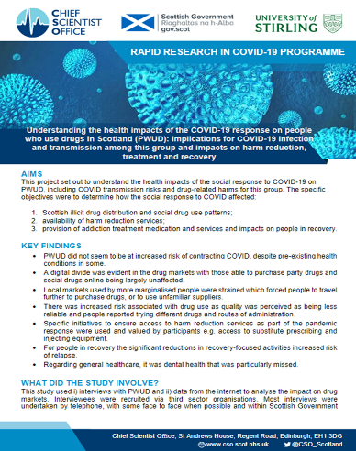
The impact of COVID-19 on access to harm reduction, substance use treatment and recovery services in Scotland: a qualitative study
Upcoming paper
Notes:
PWUD did not seem to be at increased risk of contracting COVID, despite pre-existing health conditions in some.
A digital divide was evident in the drug markets with those able to purchase party drugs and social drugs online being largely unaffected.
Local markets used by more marginalised people were strained which forced people to travel further to purchase drugs, or to use unfamiliar suppliers.
There was increased risk associated with drug use as quality was perceived as being less reliable and people reported trying different drugs and routes of administration.
Specific initiatives to ensure access to harm reduction services as part of the pandemic response were used and valued by participants e.g. access to substitute prescribing and injecting equipment.
For people in recovery the significant reductions in recovery-focused activities increased risk of relapse. Regarding general healthcare, it was dental health that was particularly missed.

Slide 6
Our Team
Upscaling harm reduction
naloxone coverage was high across sites
targeted outreach for those at risk of overdose
home delivery of IEP and naloxone
Substance use treatment services
rapid access to a wider range of OST prescribing
changes to dispensing for OST and other meds
positive, negative
variable contact with prescribers/support staff
General health and care services
Participants reported a range of co-existing health conditions
dental issues were common
lack of access to general health and care services under COVID-19.
“
…that’s one of the things that they do ask you, ‘have you got a naloxone?’, ‘have you done the training?’ No, well listen, we could help you with that, and they offer places where you can go to get it done. (M, 38)
You get them in here, aye, I just take them just in case. (M, 31)
Yeah, well actually, there’s lots of posters up about it … Yeah, you just tell them and they can post it [naloxone and IEP] out to you. (F, 43)
Notes:
Across the interviews, there were several reports of services upscaling their harm reduction provision, often with a strong focus on people at risk of overdose. Developments included targeted outreach and home delivery of injecting equipment and naloxone for those at risk of harm. These efforts were enabled by the softening of legal and policy environments, including the temporary relaxation of laws concerning the supply of naloxone in a wider range of settings during the pandemic.
I was also on the ground working as a specialist support worker in Edinburgh during the entire study period. I remember getting straight on the phone to Tessa and Catriona in the first days of lockdown asking what is to be done – would there be repercussions for frontline staff handing out naloxone from non-drug treatment services? I just remember feeling assured that this was being looked at with urgency, and word about a letter of comfort from the lord advocate came shortly after.
Speak to the quotes

Slide 7
Our Team
Upscaling harm reduction
targeted outreach for those at risk of overdose
home delivery of IEP and naloxone
Substance use treatment services
rapid access to a wider range of OST prescribing
changes to dispensing for OST and other meds
positive, negative
variable contact with prescribers/support staff
General health and care services
Participants reported a range of co-existing health conditions
dental issues were common
lack of access to general health and care services under COVID-19.
“Aye, there was a few of us that got rapid prescribed, the same day … [a friend] was sitting begging, and she [prescriber] give him a drug test … and started him on a prescription that day … that stopped him begging … he’s doing alright now. (M, 44)
It’s a bit of trust she’s gave me as well, you know, because I could just skelp the lot or save it up or whatever, but what’s the point in doing that (M, 44)
some days I was swallowing the whole 4 days, and then just go to my bed (M, 42)
Key Findings
Notes:
Several participants spoke of the speed with which they, or people they knew, had been able to initiate ORT since the start of the pandemic, often taking days to have a prescription in place when previously it could have taken several weeks. This was the result of service developments, planned pre-COVID and designed to reduce risk of drug-related deaths, whose introduction was accelerated due to the pandemic. These developments, especially noted by participants in Edinburgh , included longer opening hours and more flexible service delivery e.g. support staff were able to liaise with General Practitioners (GPs) by text message and the GPs would provide outreach, seeing clients at the hostel or another service.
ORT dispensing arrangements also changed in response to the pandemic and several participants reported a shift from daily dispensing and observed consumption of their medication to being given several doses for them to take away and manage their own consumption. This shift was introduced to reduce interpersonal contact and opportunities for COVID-19 transmission within Community Pharmacies. Some participants spoke favourably of this change, feeling more trusted to manage their own medication and avoiding the need for more frequent pharmacy attendance. The dispensing of large quantities of ORT also posed challenges and some participants reported taking all their methadone in one day or observing their peers being approached outside the pharmacy and pressured to sell or give away their medication.
Face-to-face contact with some workers in the community was disrupted and several participants reported cessation of contact with their healthcare team.
Consultations, where they took place, were generally conducted over the telephone or via online video calls.
There was a mixture of feelings, ranging from frustration and confusion to understanding and compassion for staff. Several participants expressed their understanding of the significant pressures affecting NHS staff during the pandemic. Though, I recall feeling that catchphrases such as we’re all in this together were a little hard to swallow while working alongside people experiencing such challenges. These sentiments pointed to participants’ resilience
For some perceived by services to be at high risk contact with their prescriber actually increased, albeit via phone consultations and check-ins.

Slide 8
Our Team
Upscaling harm reduction
targeted outreach for those at risk of overdose
home delivery of IEP and naloxone
Substance use treatment services
rapid access to a wider range of OST prescribing
changes to dispensing for OST and other meds
positive, negative
variable contact with prescribers/support staff
General health and care services
Participants reported a range of co-existing health conditions
dental issues were common
lack of access to general health and care services under COVID-19.
“
Well I’ve no been back for my scan to the hospital, my breathings knackered, I know that there’s problems with my heart, I’ve not got, they’ve no had me back to the hospital for that yet, well obviously my kidney, my kidney’s been knackered for ages, that worries me because my ma was on dialysis eh, for nearly a year … I have been worried sick about it, and I’ve no been able to see a doctor about it.
(F, 44)
I only knew one way to get, to get rid of the toothache and that was use … I used a lot, and then I eventually phoned the dentist, and I got put, I got emergency appointments, but they were only taking teeth out
(M, 32).
I’m no a phone person, you know … it’s hard to let people in, you know, especially over the phone (M, 55)
Key Findings
Notes:
Almost all participants reported experiencing a range of health problems during the pandemic, including long-term conditions associated with poverty and substance use, and many with multiple coexisting problems. These included chronic pain, diabetes, weight loss and skin problems due to poor diet, hepatitis C infection and treatment side effects, respiratory and cardiovascular problems including breathing difficulties and chronic obstructive pulmonary disorder.
Several people reported problems caused by reduced access to healthcare services in community and hospital settings.
A key concern for several participants was access to dental care, particularly for some who had long-term problems. One participant attributed their increased drug use to coping with tooth pain.
Although some participants welcomed the opportunity for telephone and online engagement, the dominant theme was a stark lack of access to general health and care services under COVID-19. Remote consultations were not appropriate for people with more severe mental health problems. Dental care was a key issue for several people, including those who extracted their own teeth or considered relapsing into substance use to seek relief from pain.

Slide 9
Loss of support
Evidence of Successful contingency planning and innovation
Inequitable responses across Scotland and digital exclusion
Lessons learnt?
worsening mental health and relapse
Conclusions
Notes:
Conclusion
This study aimed to understand the impacts of COVID-19 on PWUD in Scotland. Qualitative interviews indicated that many people experienced significant challenges resulting from the loss of access to key harm reduction, treatment, recovery and general health and care services and therapeutic relationships. In some cases, this loss of support led to relapse into substance use and exacerbation of pre-existing physical and mental health problems. Early in the pandemic, policy makers, service planners and providers noted the importance of ensuring continuity of access where possible, and several examples of contingency planning and innovation in delivery were apparent. Clients appreciated nimble and rapid introduction of improved access to ORT and the expansion of IEP and naloxone into new settings, although such developments were not equitably distributed across the areas included in our study. Providers attempts to ensure continuity of care through telephone and online consultations were welcomed by some clients, but digital exclusion and discomfort with impersonal channels were a barrier for others. Several participants reported a complete loss of ways to contact their care providers. The inaccessibility of general health and care provision, especially dental care, was a common challenge and reduced quality of life for many.
Policy makers, service planners and providers should review the experiences of PWUD under COVID to understand and address the harms caused to some. Learning from the experience of rapid access to ORT, remote clinical care and peer-led recovery support could be applied to reduce barriers to care post-COVID, but issues of digital exclusion and personal preference should be considered.

