Slide 1
Impact of the first wave COVID-19 and associated control measures on interventions to prevent blood-borne viruses among people who inject drugs in Scotland
Kirsten Trayner
PhD Candidate, Glasgow Caledonian University
Honorary Healthcare Scientist, Public Health Scotland
Email: Kirsten.Trayner@phs.scot
Twitter: @KirstenTrayner
Co-authors: Andrew McAuley, Norah Palmateer, Alan Yeung, David Goldberg, John Campbell, Carole Hunter, Fiona Raeburn, Julie Craik, Trina Ritchie, Stuart McTaggart, Lee Barnsdale, Rory Gunson, Kate Templeton, Paul McIntyre, Sharon Hutchinson

Slide 2
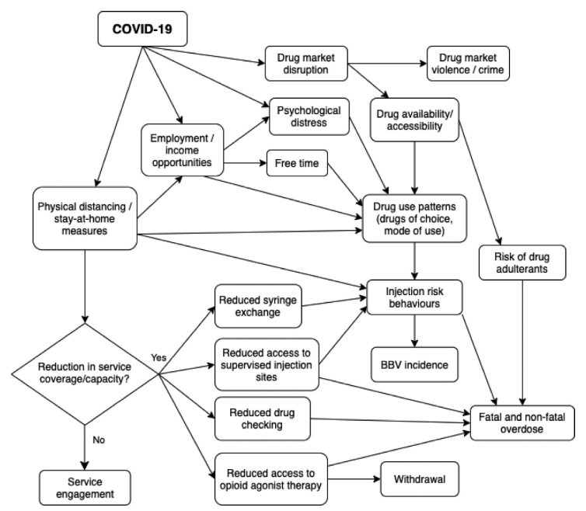
How might have people who inject drugs been affected by the COVID-19 pandemic?
Image taken from Zolopa et al 2021, IJDP

Slide 3
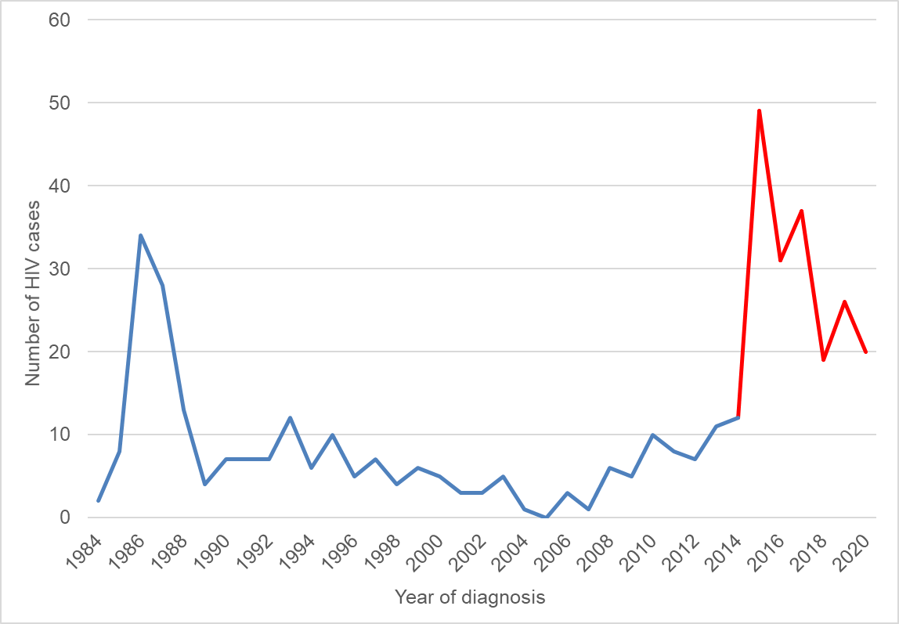
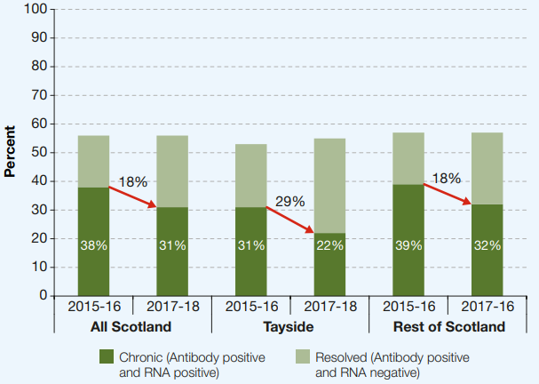
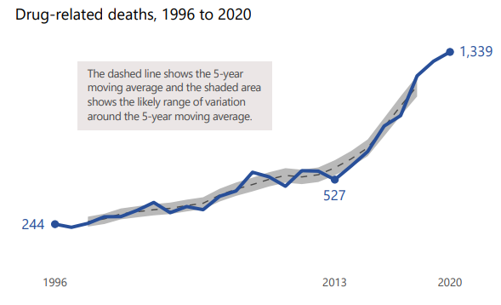
People who inject drugs in Scotland are currently experiencing a syndemic of drug-related harm…..
Largest outbreak of HIV in the UK in over 30 years ongoing in Glasgow
Historically high prevalence of HCV – reduced in recent years due to increased access to therapy
Any disruptions to the coverage/delivery of key interventions could have serious consequences relating to the transmission of BBVs and exacerbation of other drug-related harms among people who inject drugs in Scotland
Drug-related death epidemic

Slide 4
Aims and objectives
Explore the effects of COVID-19 and associated control measures on BBV prevention among people who inject drugs, through assessing changes in the provision of key harm reduction services during the first wave of COVID-19 in Scotland, focussing specifically on:
Needle and syringe provision (NSP)
Opioid substitution therapy (OST)
BBV testing (HIV and HCV)

Slide 5
Methodology
Interrupted time series study design:
Allowed for comparison of changes in service provision before and after the start of the pandemic (key date: first national lockdown, 23rd of March 2020)
Four routine data sources analysed (representing each intervention – NSP, OST, HIV test and HCV test)
Region: NHS Greater Glasgow and Clyde, NHS Lothian, NHS Grampian and NHS Tayside were included:
Represents 63% of the population of people who use drugs problematically in Scotland
Time period: September 2018 – August 2020
Included six months of data after the first COVID-19 case in Scotland (1st of March 2020)
Region and time period varied depending on data availability
Qualitative information was also collated on how the provision of interventions were impacted during the first wave of COVID-19 through consultation with public health, addiction and harm reduction leads

Slide 6
Results

Slide 7
Impact of COVID-19 on service provision and mitigation measures introduced
Intervention | Impact of COVID-19 on service delivery | Mitigation measures introduced/enhanced
Needle and syringe provision (NSP) | Closure, reduced opening hours and face to face services ceased/reduced Reduced footfall at NSP sites Increased waiting times/queues at NSP sites due to social distancing | Delivery, postal and ‘click and collect’ NSP Extended opening hours (in some services that remained open) Individuals encouraged to take a 14 day supply at each transaction Secondary NSP distribution encouraged Outreach
Opioid substitution therapy (OST) | Reduction in capacity to see patients in person at routine clinics/primary care in some services Reduced capacity to initiate new OST patients (including those released from prison) in some services Increased waiting/times queues in community pharmacies due to social distancing | Relaxing of dispensing policies and shift from supervised OST to take home (for those appropriate) Increase in dispensing instalment intervals (shift from daily dispensing to once/twice weekly) Phone appointments (face-to-face available for those deemed highest risk) Home visits introduced in some services to replace appointments Self-referral in some services Peer support and OST delivery for those shielding/isolating Additional clinics set up to offer OST to those not on prescription Introduction and trials of long acting injectable OST in some areas Shift towards buprenorphine prescribing in some areas
BBV testing | Dried blood spot testing (DBST) capacity reduced (due to laboratory capacity in some areas and staff sickness/shielding/reallocation) Third sector BBV testing suspended/reduced Reduced face-to-face contact and thus reduced testing opportunities | Self-sampling DBST Point of care testing Outreach

Slide 8
Impact of COVID-19 on service provision and mitigation measures introduced
Intervention | Impact of COVID-19 on service delivery | Mitigation measures introduced/enhanced
Needle and syringe provision (NSP) | Closure, reduced opening hours and face to face services ceased/reduced Reduced footfall at NSP sites Increased waiting times/queues at IEP sites due to social distancing | Delivery, postal and ‘click and collect’ NSP Extended opening hours (in some services that remained open) Individuals encouraged to take a 14 day supply at each transaction Secondary NSP distribution encouraged Outreach
Opioid substitution therapy (OST) | Reduction in capacity to see patients in person at routine clinics/primary care in some services Reduced capacity to initiate new OST patients (including those released from prison) in some services Increased waiting times/queues in community pharmacies due to social distancing | Relaxing of dispensing policies and shift from supervised OST to ‘take-home’ (for those appropriate) Increase in dispensing instalment intervals (shift from daily dispensing to once/twice weekly) Phone appointments (face-to-face available for those deemed highest risk) Home visits introduced in some services to replace appointments Self-referral in some services Peer support and OST delivery for those shielding/isolating Additional clinics set up to offer OST to those not on prescription Introduction and trials of long acting injectable OST in some areas Shift towards buprenorphine prescribing in some areas
BBV testing | Dried blood spot testing (DBST) capacity reduced (due to laboratory capacity in some areas and staff sickness/shielding/reallocation) Third sector BBV testing suspended/reduced Reduced face-to-face contact and thus reduced testing opportunities | Self-sampling DBST Point of care testing Outreach

Slide 9
Impact of COVID-19 on service provision and mitigation measures introduced
Intervention | Impact of COVID-19 on service delivery | Mitigation measures introduced/enhanced
Needle and syringe provision (NSP) | Closure, reduced opening hours and face to face services ceased/reduced Reduced footfall at NSP sites Increased waiting times/queues at IEP sites due to social distancing | Delivery, postal and ‘click and collect’ NSP Extended opening hours (in some services that remained open) Individuals encouraged to take a 14 day supply at each transaction Secondary NSP distribution encouraged Outreach
Opioid substitution therapy (OST) | Reduction in capacity to see patients in person at routine clinics/primary care in some services Reduced capacity to initiate new OST patients (including those released from prison) in some services Increased waiting/times queues in community pharmacies due to social distancing | Relaxing of dispensing policies and shift from supervised OST to take home (for those appropriate) Increase in dispensing instalment intervals (shift from daily dispensing to once/twice weekly) Phone appointments (face-to-face available for those deemed highest risk) Home visits introduced in some services to replace appointments Self-referral in some services Peer support and OST delivery for those shielding/isolating Additional clinics set up to offer OST to those not on prescription Introduction and trials of long acting injectable OST in some areas Shift towards buprenorphine prescribing in some areas
BBV testing | Dried blood spot (DBS) testing capacity reduced (due to laboratory capacity in some areas and staff sickness/shielding/reallocation) Third sector BBV testing suspended/reduced Reduced face-to-face contact and thus reduced testing opportunities | Self-sampling DBS testing Point of care testing Outreach

Slide 10
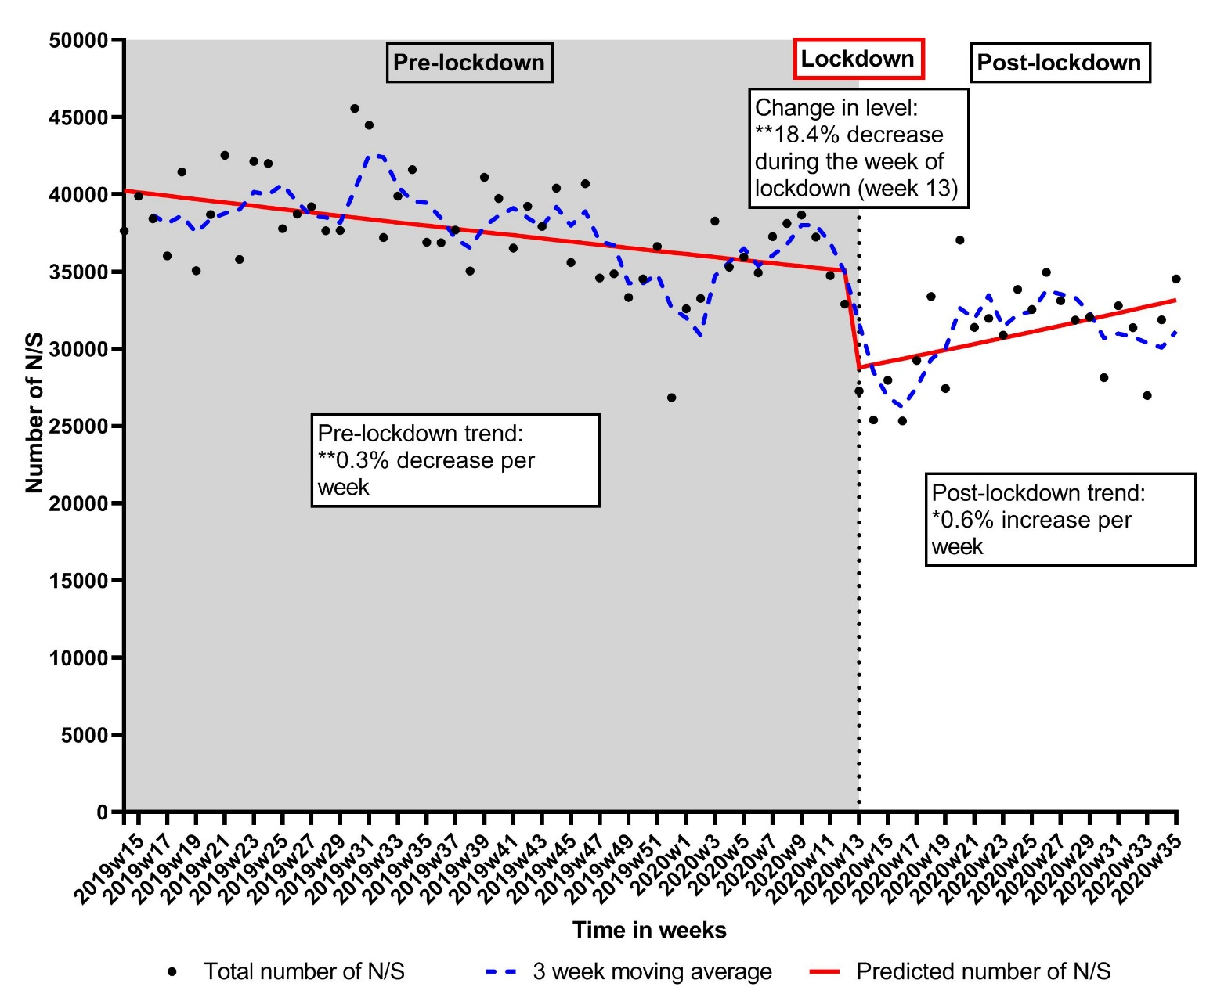
Needle and syringe provision: number of needles/syringes (N/S) distributed per week, April 2019 to August 2020 NHS Health Board: GGC, LO, GR and TY Key date: 23rd of March 2020 (first national lockdown) Data not included before April 2019 due to data quality issues
By the end of the study period (August 2020) the number of N/S distributed was 15% lower when compared to the equivalent period in 2019
Data source: NEO 360

Slide 11
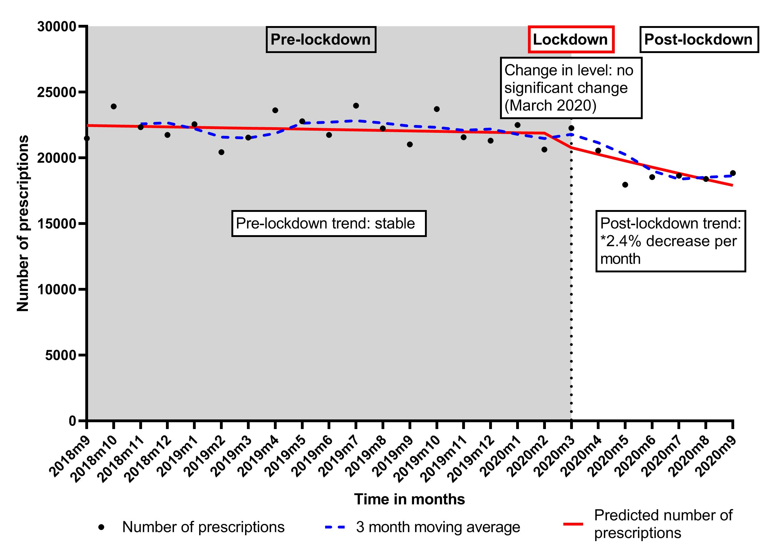
Opioid substitution therapy: number of methadone prescriptions distributed per month, September 2018 to September 2020 NHS Health Board: GGC, LO, GR and TY Key date: March 2020 (first national lockdown) Additional month of data (September 2020) included to account for data time lag
Change in methadone prescribing practice was observed
Decrease in the number of prescriptions prescribed each month post lockdown, combined with….
Data source: Prescribing Information System

Slide 12
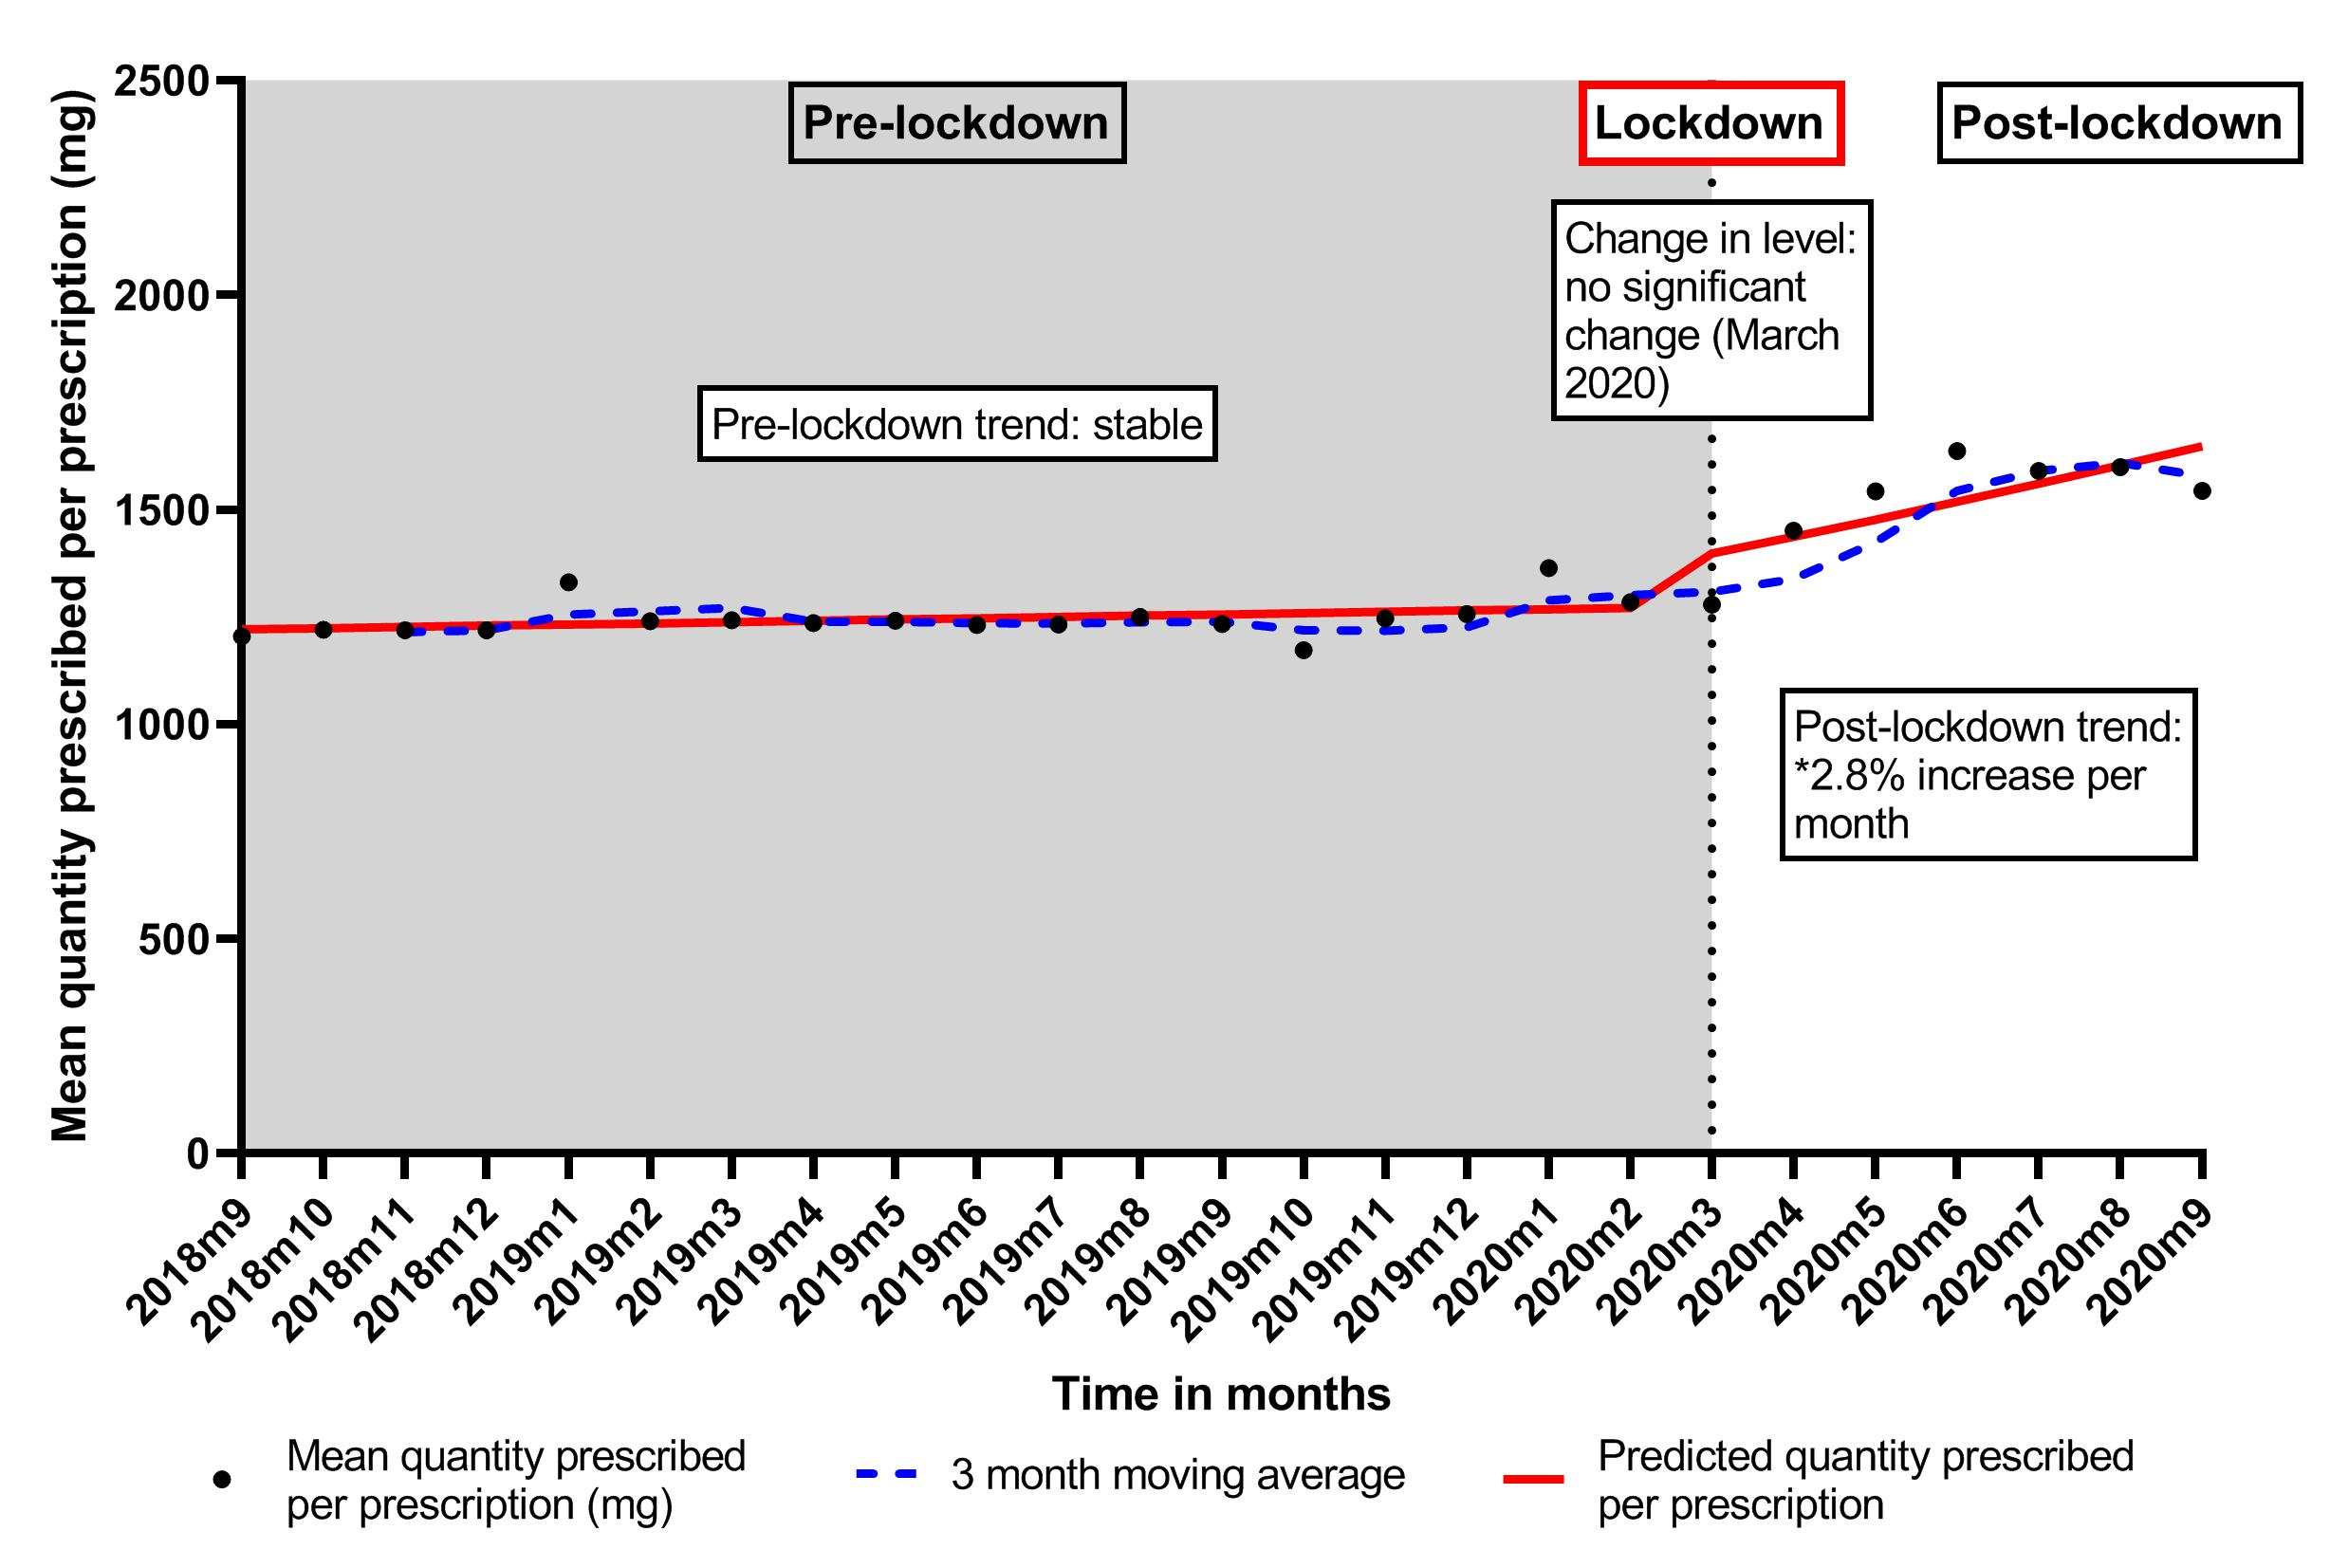
Opioid substitution therapy: mean quantity prescribed per methadone prescription per month, September 2018 to September 2020 NHS Health Board: GGC, LO, GR and TY Key date: March 2020 (first national lockdown)
Additional month of data (September 2020) included to account for data time lag
… an increase in the mean quantity prescribed per prescription each month post-lockdown
The total amount of methadone prescribed during the study period remained stable
Data source: Prescribing Information System

Slide 13
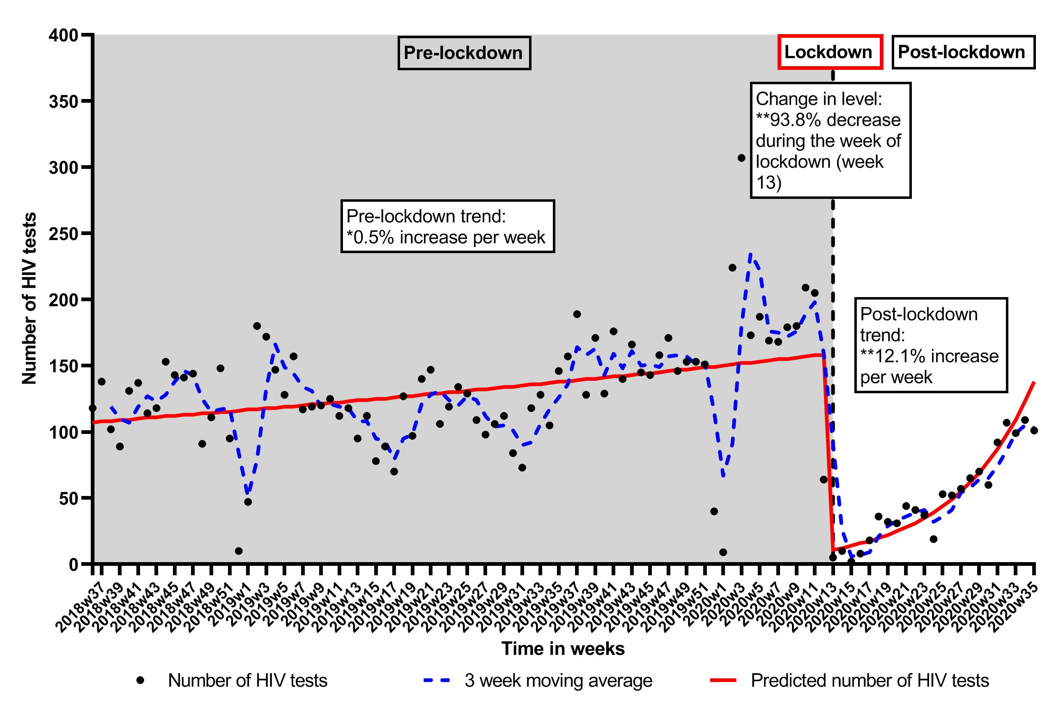
BBV testing: number of HIV tests in drug services and prisons per week, September 2018 to August 2020 NHS Health Board: GGC Key date: 23rd of March 2020 (first national lockdown)
By the end of the study period (August 2020) the number of HIV tests conducted was 18% lower when compared to the equivalent period in 2019
Data source: West of Scotland Specialist Virology Centre

Slide 14
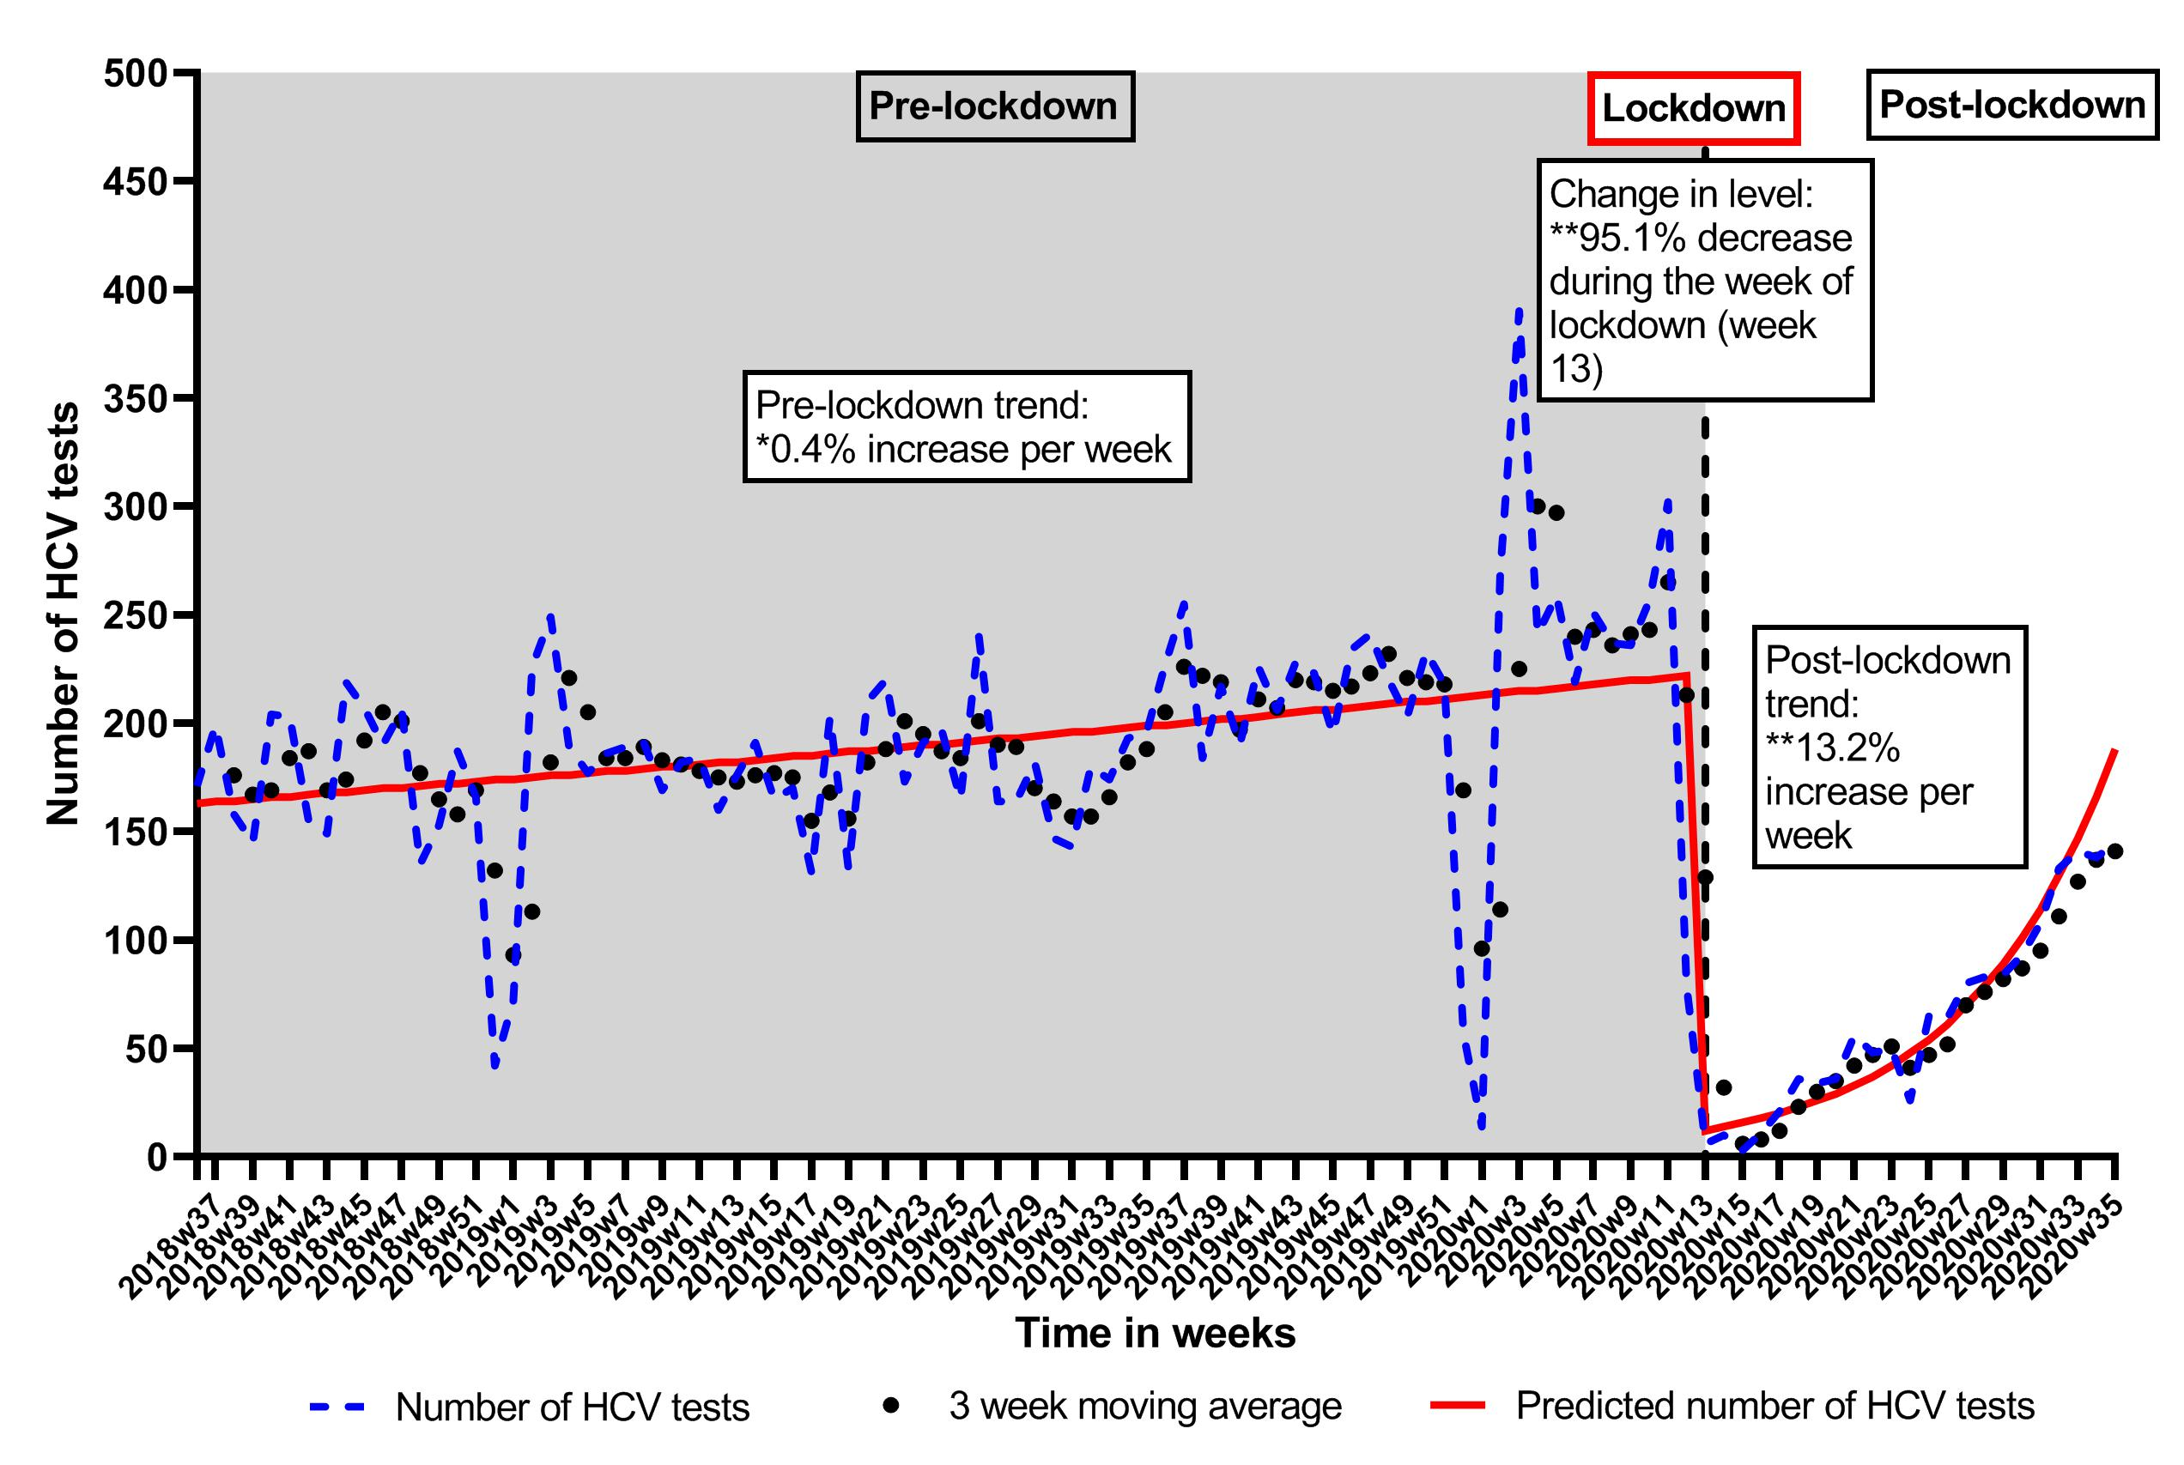
BBV testing: number of HCV tests in drug services and prisons per week, September 2018 to August 2020 NHS Health Board: GGC, LO, GR and TY Key date: 23rd of March 2020 (first national lockdown)
By the end of the study period (August 2020) the number of HCV tests conducted was 25% lower when compared to the equivalent period in 2019
Data source: ECOSS HCV test database

Slide 15
Take home messages….
First wave of COVID-19 severely impacted the delivery of key BBV prevention services for people who inject drugs in Scotland (most notably in relation to BBV testing)
Evidence of mitigation measures and recovery but some interventions (NSP and BBV testing) not yet returned to pre-COVID levels
Continued surveillance of intervention coverage is important in the context of subsequent waves of COVID-19 and to ensure previous gains in relation to the prevention of BBVs among PWID in Scotland are not reversed
Further intelligence is required to understand the impacts of the pandemic on injecting risk behaviours, BBV transmission and other drug-related harms in Scotland

Slide 16
Thank you!
Kirsten.Trayner@phs.scot @KirstenTrayner

