Slide 1
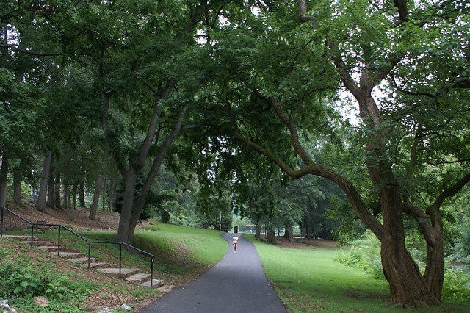
How might greenspace programmes be used to support reductions in problem substance use? Wendy Masterton, PhD Student & Research Assistant, Salvation Army Centre for Addiction Services & Research, University of Stirling Dave Barrie, Service Manager, We Are With You Dundee Robin Jeffery, Delivery Manager, Venture Scotland Dr Viola Marx, Green Health Partnership Co-Ordinator, Dundee Green Health Partnership

Slide 2
Today’s presentation:
What is greenspace and how does it affect health?
What are greenspace intervention programmes?
Building a framework for greenspace interventions for mental health and problem substance use
Inequalities and barriers in accessing programmes
Q&A for around 10 minutes
Presentations from Dave, Robin, and Viola
Q&A for around 20 minutes

Slide 3
What is greenspace?
Any type of natural or semi-natural, undeveloped land and is often used synonymously with the word ‘nature’?
Any type of vegetated land within, or on the immediate outskirts of, an urban area?
In the Scottish Government’s Planning Advice Note for Planning and Open Space (2008), ten separate types of open space were identified.

Slide 4
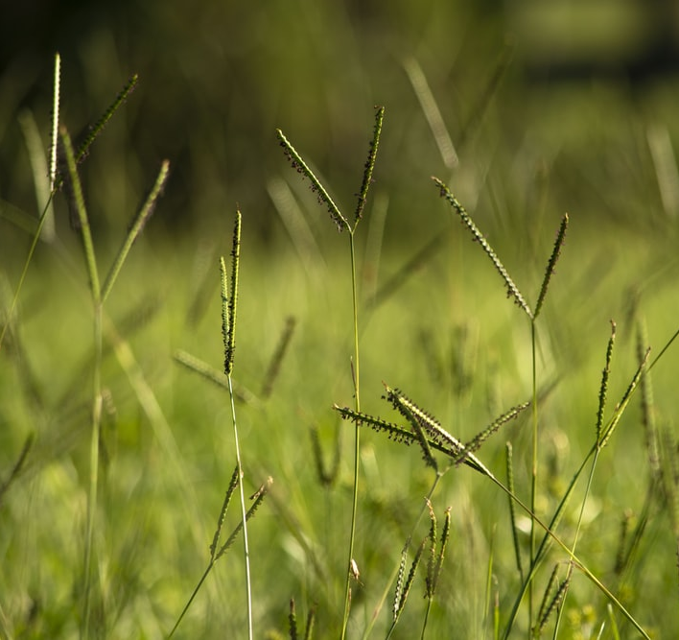
How does greenspace affect health?
Reducing harm to health through ecosystem services
Restoring capacities through attention restoration and physiological stress recovery
Building capacities

Slide 5
Greenspace and mental health
In a recent study by White et al. (2019), data collected from approximately 20,000 people in England showed that those who spent two hours in nature per week had consistently better health and wellbeing than those who spent less than two hours in nature.
Vast number of studies now showing a link between greenspace and mental health both in the UK, and internationally.
Research has explored the relationship between greenspace and mental health in many domains (Callaghan et al., 2020).
Greenspace appears to be more beneficial for people with poorer mental health compared to those with better mental health.
Integrating greenspace into mental health strategies could be important given the increasing numbers of people reporting concerns about their mental health.

Slide 6
Greenspace intervention programmes
Greenspace interventions are programmes typically undertaken outside in a green area
There are different types of greenspace interventions
Many settings have been used
From a mental health perspective, they incorporate many factors that allows a person to effectively build capacities in different factors
Programmes might be horticultural programmes, wilderness or adventure programmes, conservation programmes, care farming, health walks, and others.

Slide 7
Greenspace programme development
How can they be developed?
The question is ‘what are the mechanisms that lead to outcomes?’
This is where my work is situated.

Slide 8
Brief overview of Realist Evaluation
In comparison to many evaluations, theory-driven realist approaches are not about focusing on IF something works, instead researchers should develop programme theories about HOW interventions are meant to work.
Realist approaches hold that outcomes in complex interventions are achieved through underlying generative mechanisms which are present in the right contexts.
This relationship is referred to as a context-mechanism-outcome configuration and a number of these configurations will make up the ‘programme theories’.
Each programme/intervention made up of a number of programme theories which are refined through evidence provided in data.

Slide 9
Phase 1: Realist review to provide an initial programme theory
49 full text articles were synthesised in the realist review
Ongoing conversations with greenspace organisation staff were held throughout the search and appraisal process
Using the data, the contexts, mechanisms, and outcomes were combined into seven programme theories
The seven programme theories were then combined under three themes of Nature, Individual Self, and Social self to provide an overarching theory/framework

Slide 10
PT1 is “the feeling of escape and getting away from daily stressors”
PT2 is “having space to reflect”
PT3 is “increased physical activity”
PT4 is “increased self efficacy with new skills”
PT5 is “having a purpose”
PT6 is “relationships with the facilitators”
PT7 is “shared experiences with the group”

Slide 11
How does this relate to substance use?
What justification is there for exploring mental health and substance use together?
Proposed link between mental health and substance use
If greenspace can improve mental health, could it help support people with problem substance use?

Slide 12
How might greenspace programmes for substance use reduce inequalities?
Can be used with a prevention focus with young people who may have a higher risk of substance-related harm.
Can meet people where they are at.
Can reduce barriers to health services and provide things typical treatment does not.

Slide 13
Phase 2: A survey study
There were responses from 55 organisations from ten different regions of Scotland.
All programmes supported clients to improve or maintain their mental wellbeing.
Just under 36% of programmes supported people with problem alcohol and illicit drug use, and just over 39% did not support people with problem substance use of any kind.
23% used rural greenspace, 16% using urban woodland or forests, 35% using parks, gardens, or allotments, and 23% used various types of greenspaces.
Results showed a very high level of agreement overall with the framework in all organisations, including those that supported people with problem substance use.

Slide 14
Phase 3: Qualitative interviews
I conducted qualitative telephone interviews with staff on greenspace programmes, researchers, and wider stakeholders within the field.
I interviewed 17 participants across two stages
Unfortunately I was not able to interview clients of the programmes due to COVID-19 and restrictions on research.

Slide 15
Why do programmes “work”?
“Getting away” and having the physical space to “breathe”
Increased physical activity
Increased self efficacy and life skills
Improved relationships
Shared experiences and decreased isolation
Having a Purpose

Slide 16
What did participants say? What is important?
Community
“Some of that community stuff, feeling valued, feeling part of society again for the first time perhaps in twenty or thirty years. That is directly related to being outdoors and utilizing that greenspace down at the allotment.”
“To come from such a stigmatized sort of isolated lonely place of serious addiction to actually feeling just part of the community that you live in through the gardens is absolutely amazing to see.”
“Taking part in these types of things they then start to feel quite a bit of pride in their community. They feel as if they have got something to offer, they sort of value themselves a bit more than they originally did to begin with. They are feeling included, they actually feel like they belong to something so they feel like they matter all over again.”

Slide 17
What did participants say? What is important?
Relationships
“We don’t ask young people to do stuff, we do stuff with young people. So if we are building a raft, we are all building the raft. If we are going to jump off something, we are all jumping off it. It’s that equal, that level playing field where we try and level up the client facilitator thing.”
“…involving them as much as possible and allowing them just to take ownership of the actual journey that they are on, rather than just being, you know, kind of like a bootcamp type thing, where they are there, and they are kind of told what to do.”
“We come at it the wrong way, we try and get the person to stop doing something that they need to do without replacing it with something that might tick the same box. Whereas I guess the idea of greenspace programmes it’s like lets just do some stuff and get connected and build relationships, build huts, build bivouacs, do what you like, but fundamentally what you are really doing is building connections and building relationships to the point where if you do it long enough the substance use might take care of itself because other things have taken its place.”

Slide 18
What did participants say? What is important?
Access to services
“When you are outside, there is less agendas or less pressure. I think when you are sitting and you are talking in that setting when it’s a one to one setting and you’ve got two people sitting opposite each other, they are in a chair, they are in a room, it could sometimes be a bit daunting to open up.”
“I think part of that is about the garden being a non-medicalized environment where you are not using the labels that are given to people around whatever their mental health challenges are.”
“This is the other thing about gardening, they are all in it together, and we are all learning together. That kind of is a way of neutralizing power dynamics and I think is a really nice space for people that often feel like their voice isn’t heard a lot in their day to day.”
“In comparison with clinical appointments where I’ve met people in an office environment for around forty five minutes or an hour, it’s the natural setting, the reduced sense of the power balance really between the professional and the clients, it felt like a much more equal footing for the client to attend.”

Slide 19
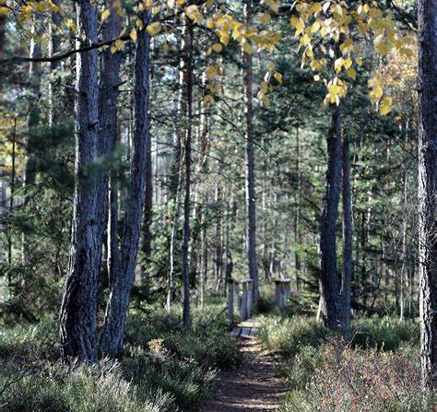
Inequalities in greenspace programmes
Access to the greenspace programme e.g. cost/travel
Equipment availability
Existing circumstances
Physical capabilities
Medication or treatment needs
Previous experience of nature
Previous experience of safeguarding

Slide 20
Key messages
Could address rising costs associated with treatment services
Could have a prevention role
Has the potential to meet people within communities and where they are at
Can run during COVID-19
Can reduce some inequalities
Fits into wider policy landscape, for example in regard to environmental policy

Slide 21
Takeaway message
“I like the idea of these programmes contributing to wider systems of care, so they are not seen as the thing you do now, and then something else will come up at the end. You know, they are part of a package of care to whatever degree they (clients) need, and it contributes to care rather than it is the only care option.”

Slide 22
Contact details and links
Email: wendy.masterton@stir.ac.uk
Twitter: @WendyMasterton
Realist review paper:
https://www.sciencedirect.com/science/article/pii/S1353829219310962
The Conversation article:
https://theconversation.com/parks-and-green-spaces-are-important-for-our-mental-health-but-we-need-to-make-sure-that-everyone-can-benefit-142322

