Slide 1
WELCOME!
www.venturescotland.org.uk

Slide 2
WHO ARE WE?
Over the past 30 years, we have become Scotland’s only provider of long term, outdoor-based, personal development for young people.

Slide 3
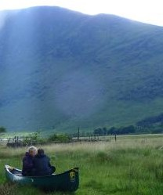
WHO IS THE PROGRAMME
FOR?
Anyone aged 16-30 who is struggling and wants the support to make positive changes to their mental, physical or emotional health.

Slide 4
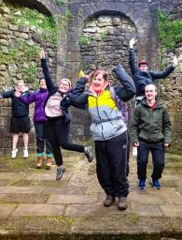
THE JOURNEY PROGRAMME
Personal development programme
Up to 12 months long
Weekly activity days
Regular development opportunities
Remote wilderness residentials
Free of charge

Slide 5
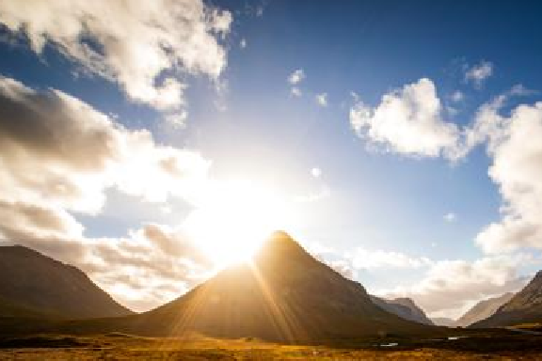
THE JOURNEY PROGRAMME
DISCOVER EXPLORE LEADERSHIP
CHALLENGE

Slide 6
TEAM bUILDING
CLIMbING
ORIENTEERING
ACTIvITy DAyS
hILL WALKING
GORGE WALKING
CANOEING
WEASELING
COASTEERING

Slide 7
DEVELOP
CHALLENGE
DISCOVER EXPLORE
LEADERSHIP
CONFIDENCE
POSITIVE RELATIONSHIPS
maintain positive relationships
EMOTIONS
COMMUNITY
EXPERIENTIAL
AWARENESS
LEARNING
through positively
engaging with us and
increase your knowledge
ability to learn from
challenging yourself
TRUST
in yourself and others
of your community
EMPATHY
experience
PLANNING SKILLS
The skills to plan
understand your
increase ability to show
emotions
COMMUNICATION
empathy
BELIEF
TEAMWORK
DEMONSTRATING
CHANGE
in the possibility to
grow your
increase your ability to
change
communication skills
work as part of a team
ability to make
changes in your life

Slide 8
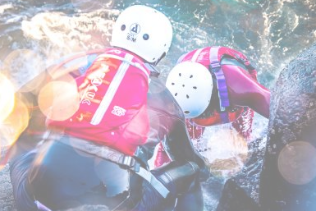
SQA QUALIFICATIONS - LEVELS 3, 4, 5, & 6
JOHN MUIR AWARD
SCOTTISH CANOE ASSOCIATION AWARDS

Slide 9
ACTIvITIES AND RESIDENTIALS
COVID-19
bLENDED DELIvERy
SAfETy MEASURES

Slide 10
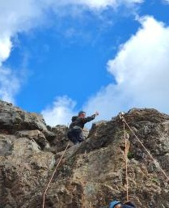
REfERRALS
1
Get in touch
₂ Presentation
3
Referral form
4
Suitability check & on-boarding process

Slide 11
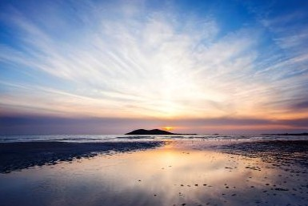
THANK YOU!
“One of the most valuable things I’ve gained is confidence. I no longer feel like my voice isn’t worth being heard and I have more self-compassion. VS has been a source of unwavering support and stability and I can’t begin to express what a massive difference that has made to my life.” Jo, 2019
"Venture Scotland made me want my future again, made me want to look after myself more, and gave me the skills to do that.” Jodie, 2019

