Slide 1

Dundee Green Health Partnership
Green Health for everything
Dr Viola Marx
Green Health Partnership Coordinator
Dundee City Council, Greenspace Team
NHS Tayside, Directorate of Public Health

Slide 2
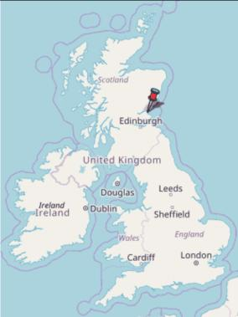
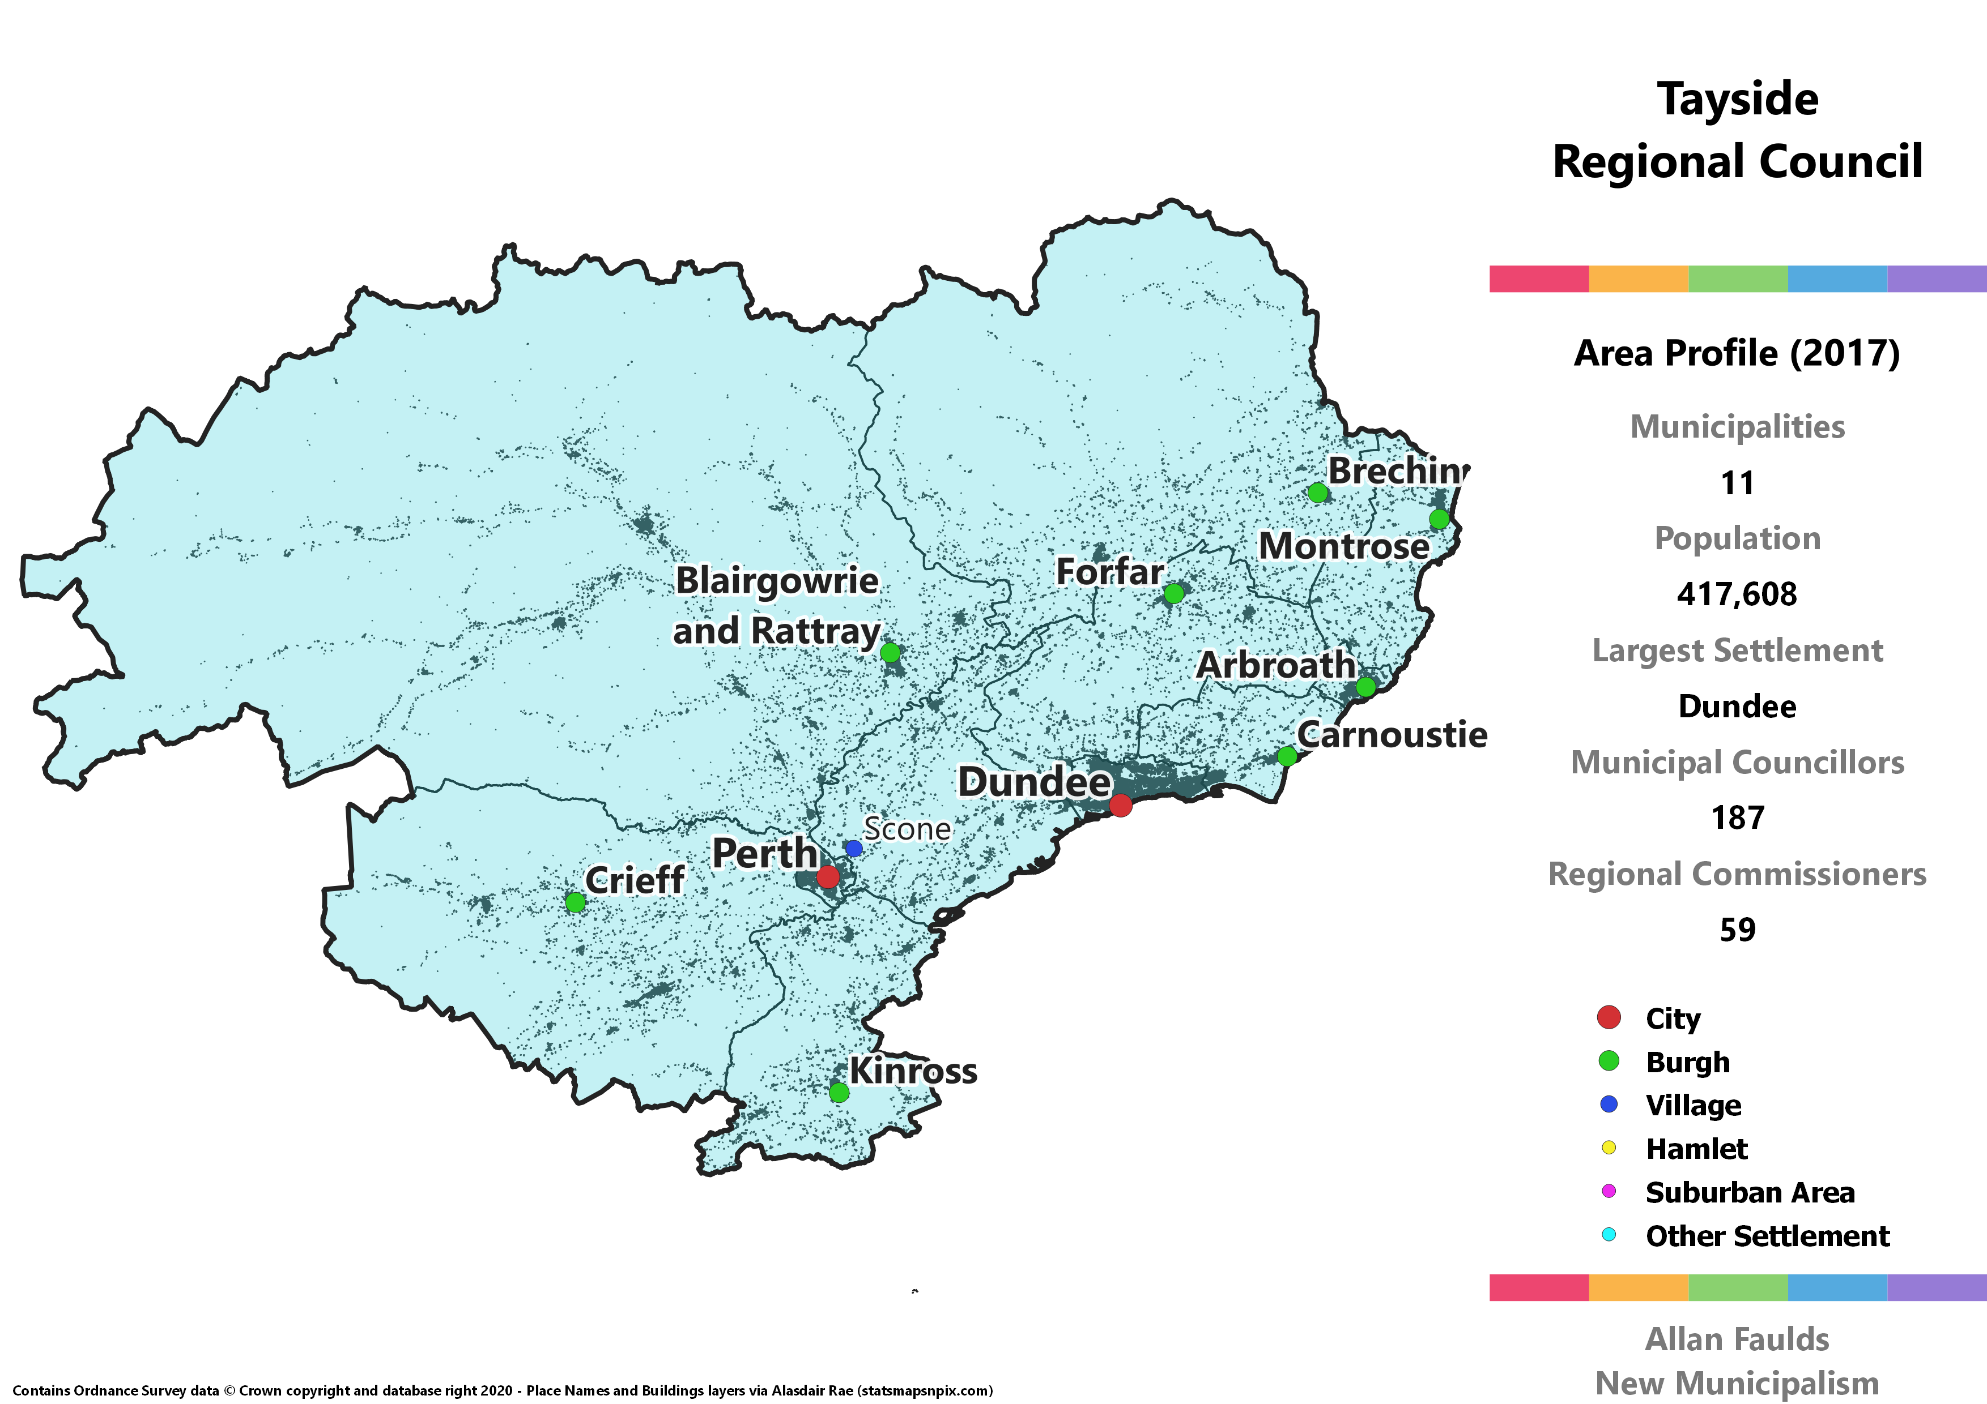
Background - Dundee
Population 149,320
Health board: Tayside
  Dundee
  Perth & Kinross
  Angus

Slide 3
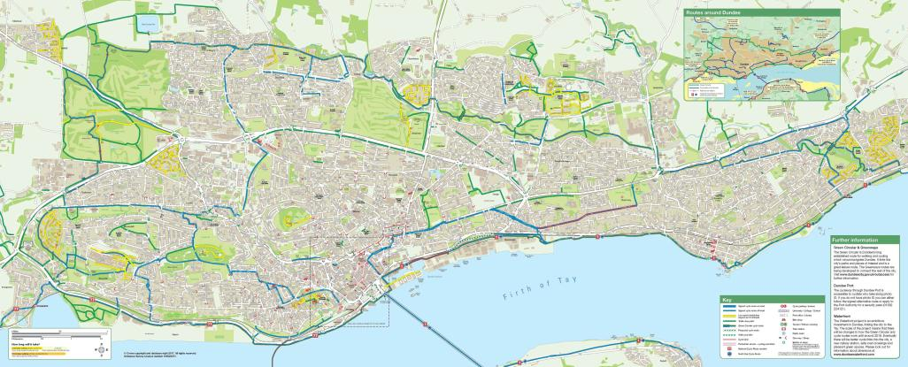

Slide 4

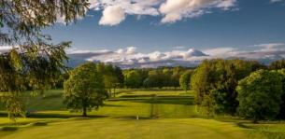



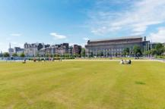



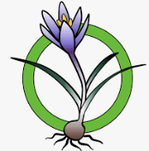





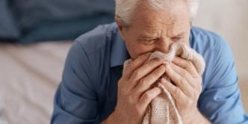




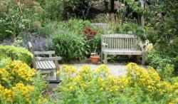
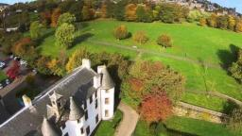






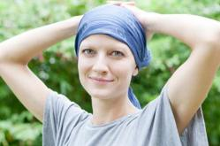



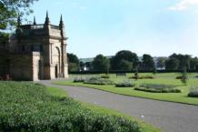
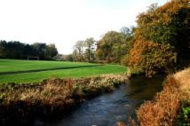
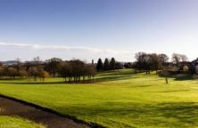









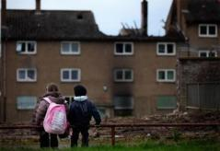
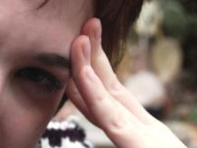

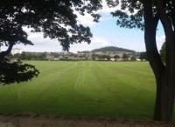
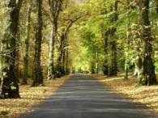
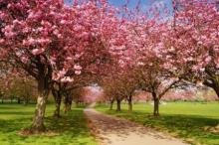
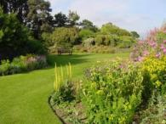



HEALTH
partnership
Green
The Dundee Green Health Partnership is helping to make more use of Scotland’s outdoors as Our Natural Health Service. Our Natural Health Service is a national initiative led by Scottish Natural Heritage and supported by national and local partners.
Notes:
The Green Health Partnership is about…
GREEN– spaces. These are all images taken of Dundee’s greenspaces. And we can use these for…
HEALTH- benefits. Spending time in nature has been shown to improve physical and mental health. It’s good for mental health/depression/anxiety/stress, loneliness, obesity, diabetes T2, resilient communities, helps cancer treatment and recovery.. And much more.
We need to work in partnership to make use of GREENspaces for HEALTH-benefits. Partnership between:
DDC – provide and maintain the majority of public greenspaces,
NHST – estates have some greenspaces (i.e. Ninewells Community Garden) and we want primary and secondary care to make use of greenspaces for health benefits, Third Sector organisation’s who deliver nature based interventions in local greenspaces,
ACADEMICS– research collaboration
And of course the local COMMUNITIES– who are the ones to benefit from all this.

Slide 5
HEALTH
partnership
Green
The Dundee Green Health Partnership is helping to make more use of Scotland’s outdoors as Our Natural Health Service. Our Natural Health Service is a national initiative led by Scottish Natural Heritage and supported by national and local partners.
Notes:
The Green Health Partnership is about…
GREEN– spaces. These are all images taken of Dundee’s greenspaces. And we can use these for…
HEALTH- benefits. Spending time in nature has been shown to improve physical and mental health. It’s good for mental health/depression/anxiety/stress, loneliness, obesity, diabetes T2, resilient communities, helps cancer treatment and recovery.. And much more.
We need to work in partnership to make use of GREENspaces for HEALTH-benefits. Partnership between:
DDC – provide and maintain the majority of public greenspaces,
NHST – estates have some greenspaces (i.e. Ninewells Community Garden) and we want primary and secondary care to make use of greenspaces for health benefits, Third Sector organisation’s who deliver nature based interventions in local greenspaces,
ACADEMICS– research collaboration
And of course the local COMMUNITIES– who are the ones to benefit from all this.

Slide 6
Green Health Partnerships
Lanarkshire
  Green Health Manager
    March 2018, employed by NHS Lanarkshire
Dundee
  GHP Coordinator
    June 2018, employed by DCC, jointly managed by NHS Tayside
North Ayrshire
  GHP Project Officer
    July 2018, hosted and managed by TCV and KA Leisure
Highlands
  GHP Development Officer
    November 2018, employed by HS Highland

Slide 7
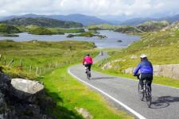
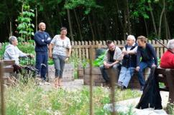
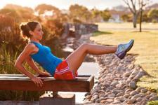
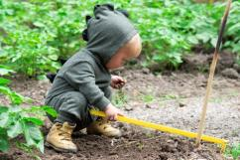
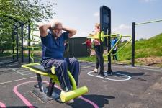
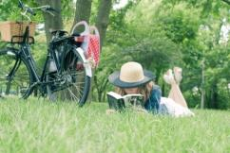
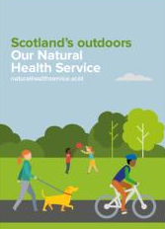

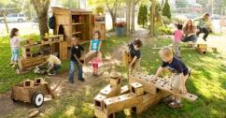
ONHS Scotland promotes
‘green health’
Active or passive engagement with greenspace/nature, which improves physical, mental and social health and wellbeing
Nature-based interventions
Walking and relaxation
Outdoor learning and play
Recreation and sport
Practical conservation
Gardening
Rehabilitation and recovery
Active travel
Looking at nature (incl. VR)
Notes:
What do I mean by ‘green health’?
-BOTH passive and active engagement with greenspace/nature improves physical, mental, social wellbeing
It includes:
Wakling
Lying in the park
Recreation and Sport
Practical conservation
Gardening
Active Travel
Outdoor Learning and play
Rehabilitation and recovery

Slide 8
Our Natural Health Service
The Concept.
Public Health
Health & Social Care
Designed to complement NHS
Reduces medication and costs
Long-term outcomes
Natural health service concept
Health benefits from being active and/or spending time in the natural environment
ONHS Action Programme
Step change in how the natural environment is used to improve people’s health & contribute to health outcomes
General population
(incl. groups within general population)
People with a defined need
Everyday contact with nature
Recreation
Pastimes
Volunteering
Learning
Active travel
Nature based health promotion initiatives
Health walks
Green gyms
Community growing
Nature based interventions with defined health or social outcome
Therapeutic & Exercise programmes as a treatment intervention
Scotland’s Natural Environment &
Green Infrastructure

Slide 9

Good quality greenspaces Health benefits
Mental health & wellbeing
  Stress – acute and long-term
  Fatigue
  Anxiety
  Low mood
  Depression
Healthy weight
  40% less likely to be obese
  helps tackle obesity endemic
Improved physiological outcomes
  Pain management
  Heart rate & blood pressure
  Lower prevalence of diabetes T2
Improves immune system
Reduces inflammatory diseases i.e. asthma
Increases recuperation
Reduces mortality
  Especially men, low SES, infants
Reduces loneliness
Healthier future generations
  Better maternal & foetal outcomes
Better childhood cognitive development
Higher self-rated health
Health and the natural environment: A review of evidence, policy, practice and opportunities for the future
The European Centre for Environment & Human Health 2018
Notes:
Being outside in fresh air is among the most important leisure activities for improving human wellbeing. During the pandemic research has shown that people were more keen to access greenspaces to go for a walk and stay active than before.
Greenspace is good for everything – lots of research out there. This is just an example from a recent meta analysis to highlight the main findings.
Also Good access to greenspaces leads to smaller SES inequalities. Thus important that we have beautiful greenspaces especially in our deprived communities.

Slide 10
Greenspaces and Substance misuse
Gardens/allotments & seeing greenspace associated with reductions in strength and frequency of cravings for alcohol, drugs, cigarettes and harmful foods
Martin et al. 2019
Exposure to greenspace helps reduce pain, stress, and impulsive decision-making.
Berry et al. 2021
Greenspace ties into alleviating some of the symptoms that often trigger cravings, i.e. depression and anxiety. While this is not a cure-all for dealing with cravings, greenspace is a free and easily available addition to a recovery toolbox

Slide 11
Dundee early 2018
Making greenspace activities accessible and referrable!
Fragmented, uncoordinated, opportunistic
Limited impact
Untargeted
Unsustainable
Notes:
So apart from encouraging people to access greenspaces on their own the Dundee Green Health Partnership developed a pathway for and with NHS healthcare professionals to refer patients to greenspace activities! Before this was in place we had many local activities happening across the city delivered for free, by the third sector, however this was a rather untargeted and unsustainable approach with no direct route in.

Slide 12
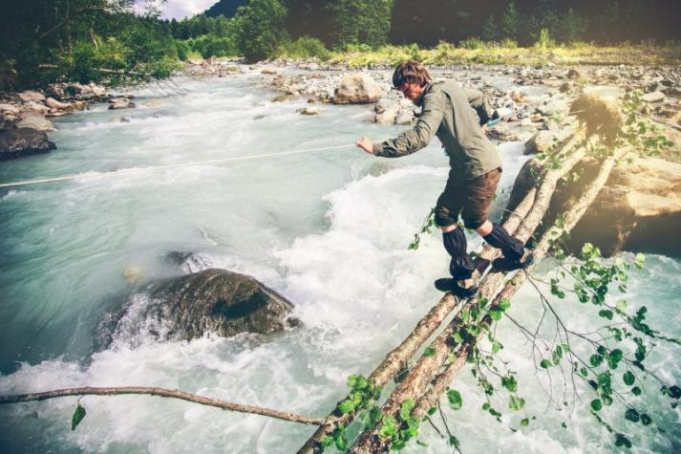
Prevention
Purpose
Routine
Social connectedness
Tackles boredom
Fun
Keep us happy, resilient & healthy able to manage life

Slide 13
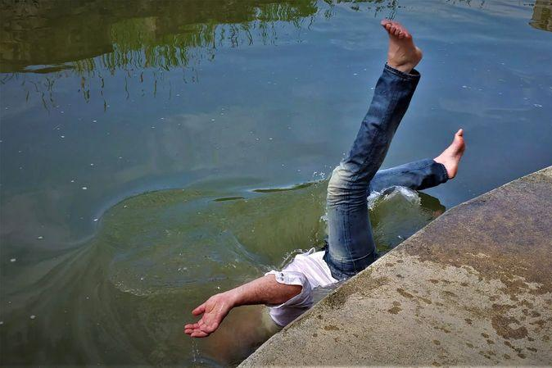
Just in…
Struggling with:
Mental health
Approaching low mood
Stress
Isolation
& more
Get us back on track, keep us from getting worse

Slide 14
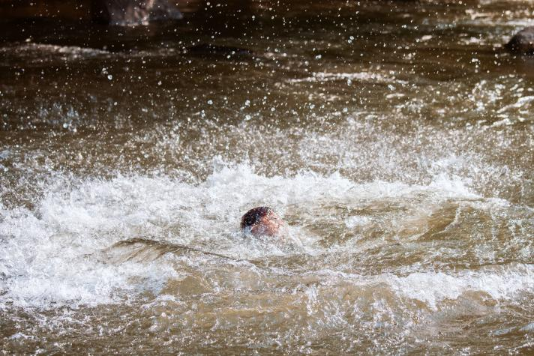
Recovery
Conducting recovery in a natural environment
Using nature-therapies for recovery
Natural environment reduces narcotics possession
People with poor mental health benefit the most

Slide 15
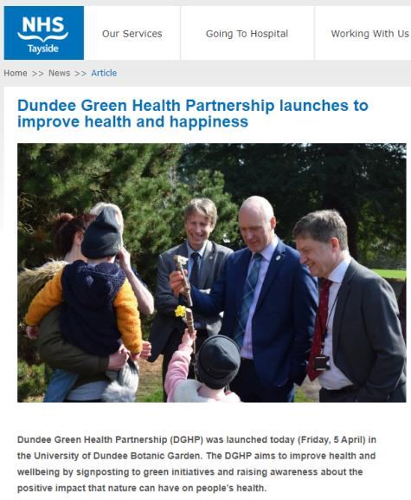
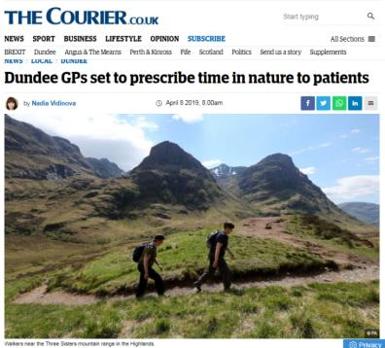
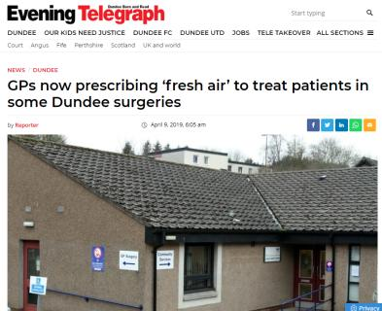
April 2019

Slide 16
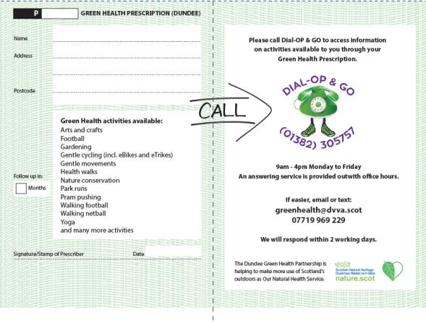
All activities are free to join!

Slide 17
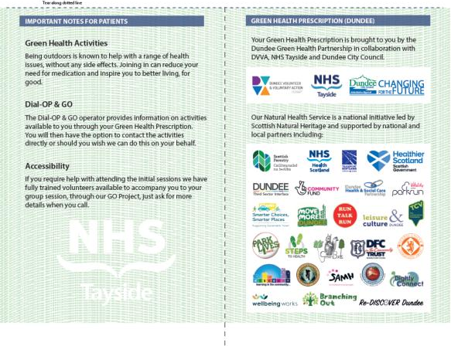

Slide 18
Who refers?
Primary care (GP surgery incl. staff)
Secondary care (pain clinic, occupational health, health psychology, weight management services, physiotherapists, mental health nurses, link workers, vascular surgery, integrated substance misuse services, cancer journey, locality pharmacists, rheumatology, Parkinson’s recovery, brain lesions, COVID recovery, and more…)
‘Community’ prescribers (Job Centre, third sector partners)

Slide 19


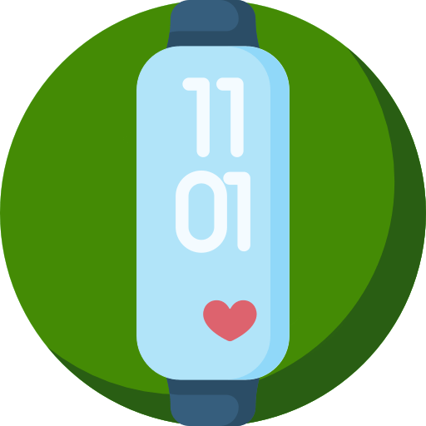



Green
Health
Buddy
Create new groups
Further support referrals
Bring a
friend/ carer
REFER PATIENT
CONSULTATION
with Green Health
Development Worker
Dundee’s Third Sector Interface
PARTICIPATE
Nature-based interventions
Online classes
Self-led activities
Self-refer

Slide 20
How can existing programmes benefit?
Move the group outside (parks, community gardens, woodland etc)
Include nature-based green health activities into sessions
Work with local partners who offer nature-based interventions

Slide 21

Thank you viola.marx@nhs.scot
Dr Viola Marx
Green Health Partnership Coordinator
Dundee City Council/ NHS Tayside Directorate of Public Health
For more information visit www.GreenHealth.scot
HealthDundee

