Slide 1
Dundee Recovery Service
East Dundee

Slide 2
Outdoor Recovery Programme
Outdoors Hill Walking – Ancrum Outdoor Centre
Allotment Project – Albert St Hub/ Signpost Garden of Hope
Cycling group
Fitness groups – Street Soccer
Woman's walking Group – NHS Keep well team - Whitfield

Slide 3
Hill Walking – Ancrum Outdoor Centre
Pilot in Lochee with NHS keep well nurse team and Hubv 1year
Extended into year two
Applied for ADP moneys
Successful
Roled out for Dundee wide
Skilled out door leaders, all equipment, groups 12, risk assess, Naloxone
Local outdoors – building up to Munroe
Partnership working WRWY / Ancrum / Hill Crest / Lochee Hub

Slide 4
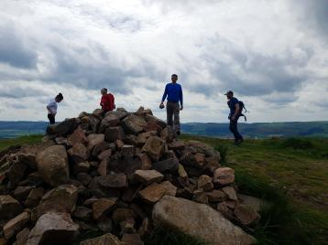
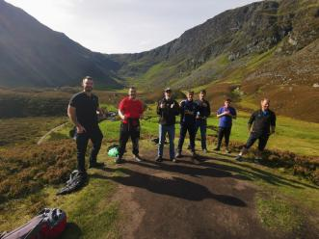
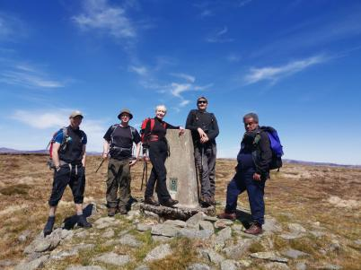
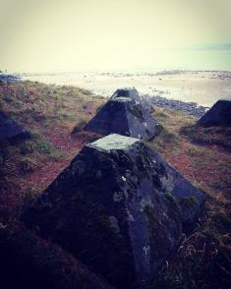

Slide 5
Allotment Projects
Albert St Hub – Tayview allotment
Part of local community – full integration
Weekly allotment slot 2 hours – WRWY staff
Opportunity to potter about through week
Develop garden skills
Build confidence social skill
Links with local recovery community / hub
Positive impact on stigma / inclusion

Slide 6
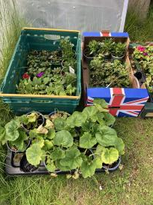
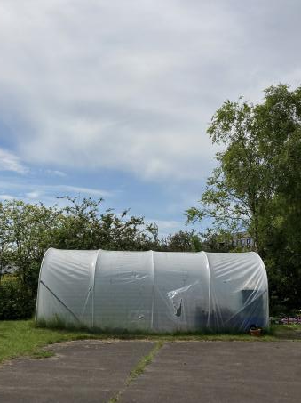
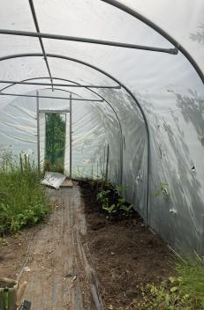
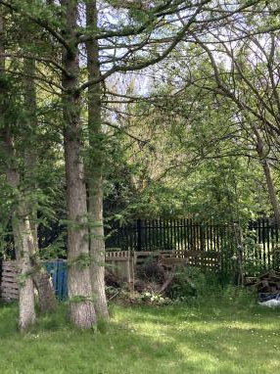

Slide 7
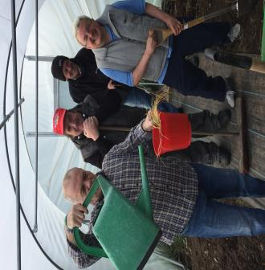
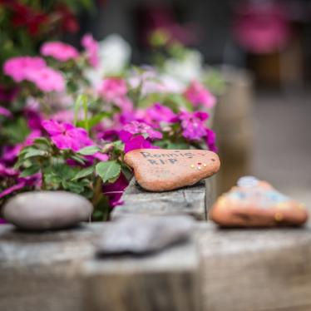
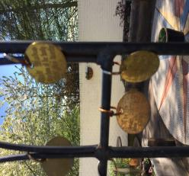
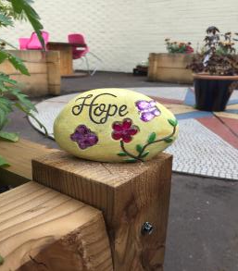
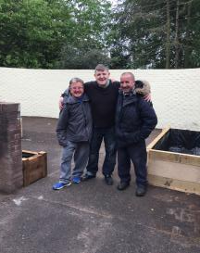

Slide 8
WRWY – Cycling group
Keen staff member- skilled cyclist
Completed cycle leadership qualification – two volunteers one staff
Induction / risk assessment before cycle
Local easy routes round Dundee
Further afield routes – Co planned with group
All have helmets and own bikes
Managed to supply over 20 bikes
Confidence / outdoors / excersise / fun

Slide 9
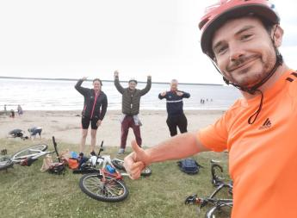
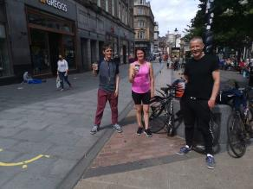
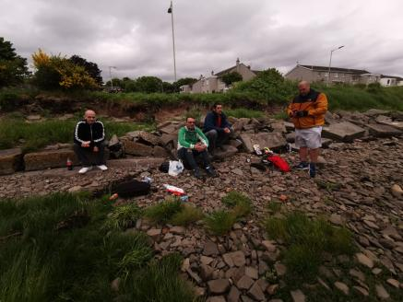
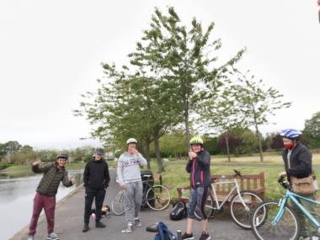

Slide 10
Fitness – Street Soccer
Weekly events with choice
Football
Exercise
Woman's groups ( gender informed )
Keep fit sessions
Outdoor friendly – indoors
Lynch Centre changing into

Slide 11
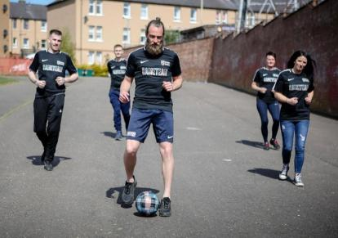
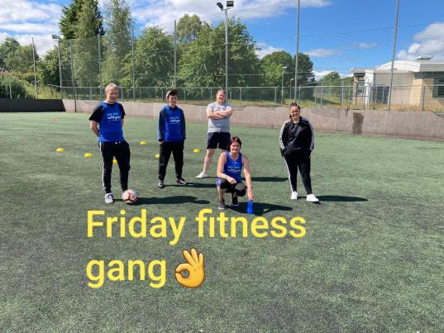
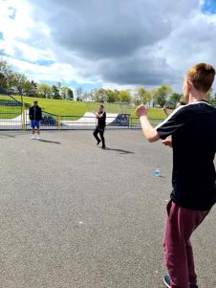

Slide 12
Women’s Walking Group
Gender focussed groups important
Trauma informed
NHS Keep well team – Positive partnership
Safe , supportive, local ( No males )
Free service no cost other than staff time
Encourages outdoor time- positive routine
Builds confidence and self esteem
Local walk leadership training

Slide 13
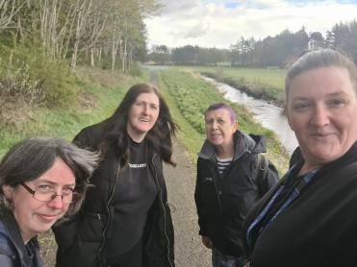
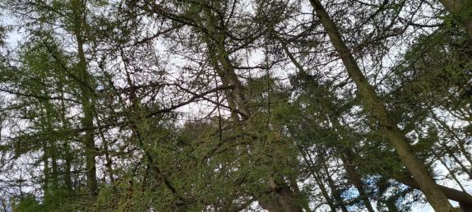
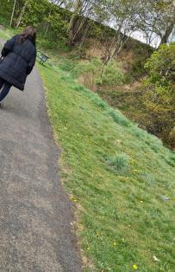
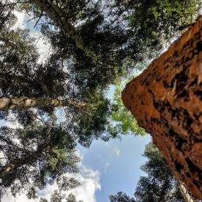

Slide 14
Conclusion
Very different experience being out doors
Positive recovery support
Build social confidence
Connecting with nature – bigger picture
Group connections / support / influence
Creates routine / structure to the week
Risk assessed for maximum safety
Choice of activity
Requires funding and commitment
Creates partnerships

