Slide 2
Exploring the potential of long-acting depot buprenorphine injections for people who use drugs and are homeless
Tania Browne, Prof Catriona Matheson, Dr Rebecca Foster, Joe Schofield, Dr Trina Ritchie
Salvation Army Centre for Addiction Services and Research
Funded by Camurus AB

Slide 3
Ethics approval granted October 2020
First focus group took place November 11th 2020
So far we have interviewed 16 participants from 2 third sector organisations that provide hostel accommodation for people who are homeless, or at risk of homelessness (The Simon Community, The Salvation Army)
9 participants in small focus groups in Glasgow
11 men and 5 women
7 participants from Dundee interviewed individually
Age range approximately 30 – 50
Exploring the potential of long-acting depot buprenorphine injections for people who use drugs and are homeless

Slide 4
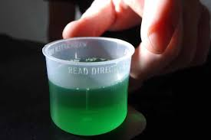
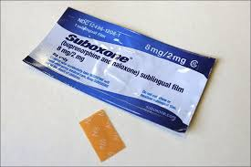
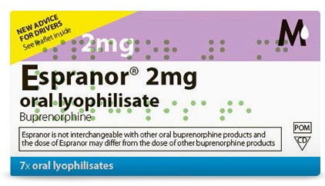
Currently all-but-one were on daily doses from their pharmacist:
10 used methadone
3 used Subutex
2 used Espranor
One participant had successfully completed OST in the last 2 months
Exploring the potential of long-acting depot buprenorphine injections for people who use drugs and are homeless

Slide 5
Participants prescribed methadone reported that they had been using it between 1 and 25 years
Dosage ranged from 40ml to 110ml daily, with one participant reporting that they used heroin and cocaine in addition to methadone
“As soon as I wake up I need my methadone and it’s maybe the routine I’ve got myself into but … I go to the chemist when I wake up”
“Not long after you took your methadone, it makes you sleepy … you sometimes fall asleep, or if you have had anything on top of it that is you gone for the rest of the day”
“When you are on methadone you don’t really ken … you think you are normal, but when you actually do see a picture … you look out of it, it’s not a nice picture”
The effects of current medication - methadone

Slide 6
Participants prescribed buprenorphine reported that they had been using it between 5 months and 2.5 years (none specified dosage)
Participants who had taken both forms of OST had noticed a distinct difference between methadone and buprenorphine in the way the drugs made them feel emotionally
“Some people don’t like [subbies], because they don’t want to face reality, at the end of the day you’ve got to face reality at some point in your life, do you know what I mean? … You need to sort your own feelings out in your own head that and deal with what you used to … before we start having to come off it”
“When you first start taking it it’s like a reality check and I would imagine people who have like serious mental health issues and stuff would really struggle with that”
“It’s hard work because it’s like your head goes … double time like over thinking and over analysing and stuff and I managed to get through that”
The effects of current medication - buprenorphine

Slide 7
15 of 16 participants were on daily pick-up from their pharmacist. Most walked (between 5 and 15 minutes each way), 2 participants reported a journey that required a bus trip
“It depends on what time you go at, if you go on like bang on the beginning time like nine or half nine then yes there is a crowd of people there, but I avoid that time”
“I basically hate it … everybody is talking at the chemist, always the same old shite … Who’s selling this and then whoever is on the methadone queue they will be punting Valium … or they see me come out with my script and they are like, oh are you not wanting to part with any of that?”
4 reported that they had learned to attend the pharmacy at quieter times so they could be seen quickly
13 of 16 participants reported being regularly offered illicit drugs on their way to the chemist or in the queue
Experiences at the pharmacy

Slide 8
4 participants expressed the same fear – that the effects of the buprenorphine would wear off before they were due their next injection. They couldn’t comprehend the idea of a slow release drug:
“I think it’s just in my head I think to myself … it is just not feasible … I cannae surmise how it’s going to produce the amount of sub you are on a day … You know every day for a month … I just think that’s too far fetched”
“The week before or halfway before does it not, is there anything been said about it starts to wear off at that point? The worry is … the time of release on it”
Most others said that they would certainly try it, as long as someone they knew and trusted had tried it first and recommended it:
“No if it was tested on somebody I knew and they said it was alright yes I’d got for it aye, a hundred percent aye”
“Well I’d rather wait until like other people do it first, so I can see the side effects that they get … Then I’d think about it”
Attitudes to the concept of depot buprenorphine

Slide 9
Other participants were far more optimistic about the concept of trying something new, especially those who were on a form of buprenorphine currently, or who had used it I the past.
“I don’t know what it is, what this new one will do but, it can only be better for it, do you know what I mean? … It’s worth a chance isn’t it?”
“Aye if it was tested and it works aye I’d do it aye … Definitely, if it was going to help save having to go to the chemist every day, do you know what I mean?”
“I’d obviously like to know a bit more about it, see how the trials go … I think people should try it … It’s worth looking into”
One participant could see the value of a variety of treatments for others, but didn’t feel it was for them:
“See that one about a month thing, that sounds really good because not having to go to a chemist or whatever for a month, that would be amazing for certain people, but for me … because I wake up and I know I need something every day … you need to get into a pattern obviously you could get used to it, but I’m not at a stage where it would be something that I could do”

Slide 10
We have spoken to people in Scotland who are not currently using depot buprenorphine…
Next we hope to speak to people who are using it about their experiences
NHS Ethics delays in the current context have meant we need to seek other sources
We have contacts at some centres in the rest of the UK, where some people are already on depot injections
Next steps….

Slide 11
Thank you! Any questions?
@SACASRStir
tania.browne@stir.ac.uk

