Slide 1
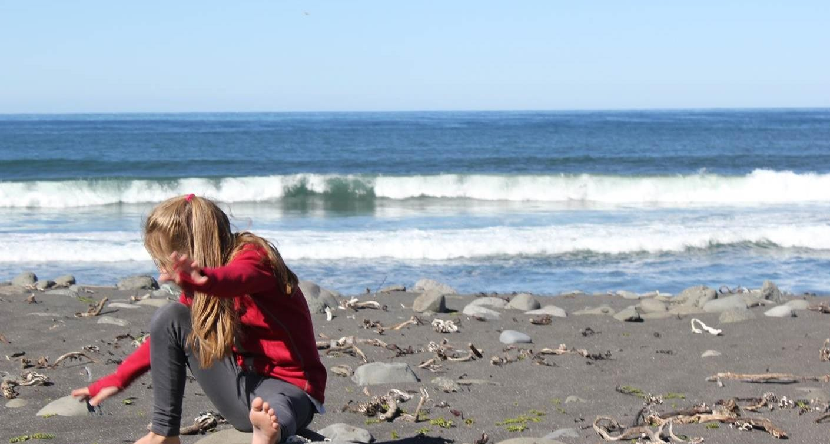

Planet Youth
General introduction
Margrét Lilja Guðmundsdóttir
ICSRA and Reykjavík University

Slide 2
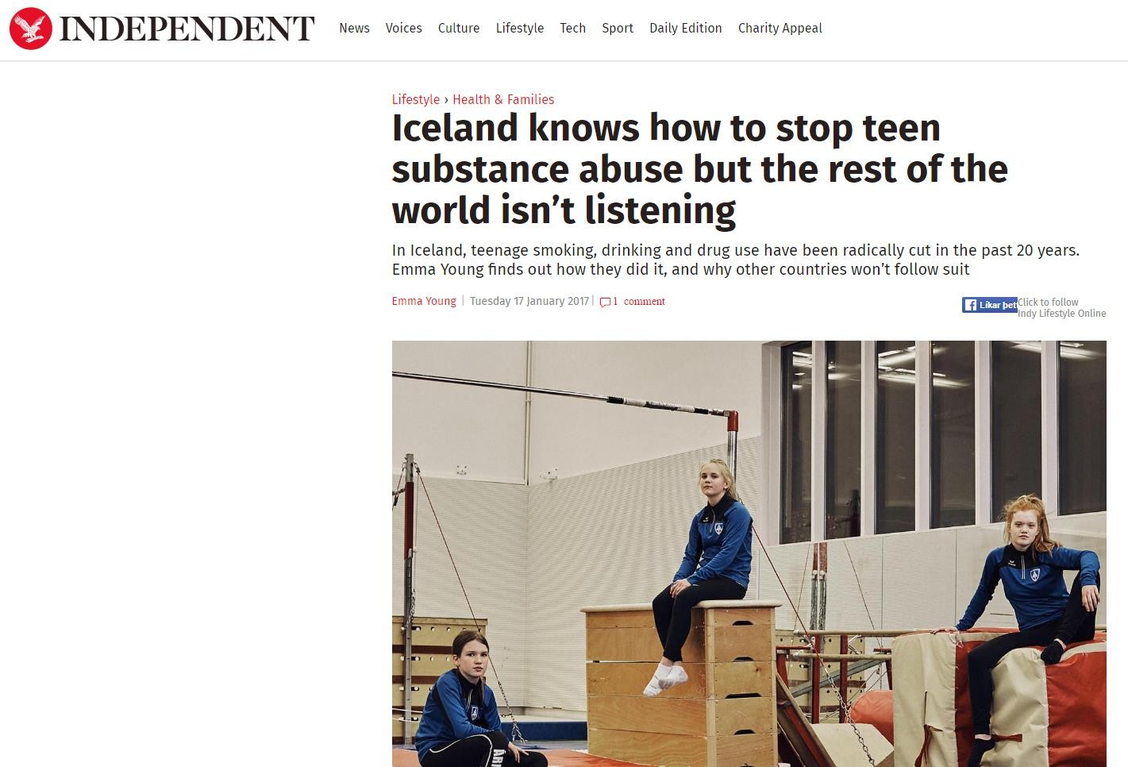

Independent
The Atlantic
AFP
Guardian
BBC
Mosaic
Huffingtonpost

Slide 3
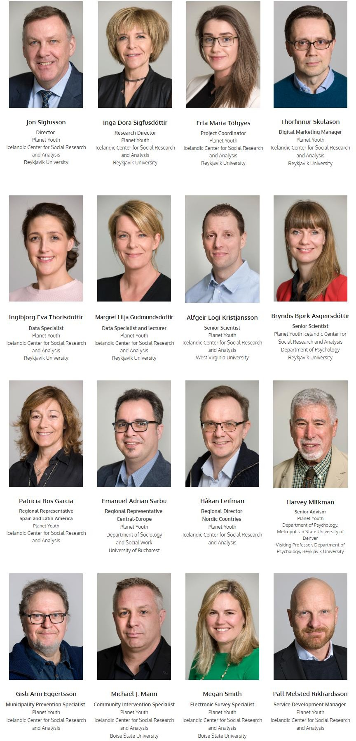
Our team
Group of 16
Sociologists, psychologists, criminologists, public health
Representatives in: Spain and Latin America, Romania for CEE, Sweden for Nordic countries
Three working in the US

Slide 4
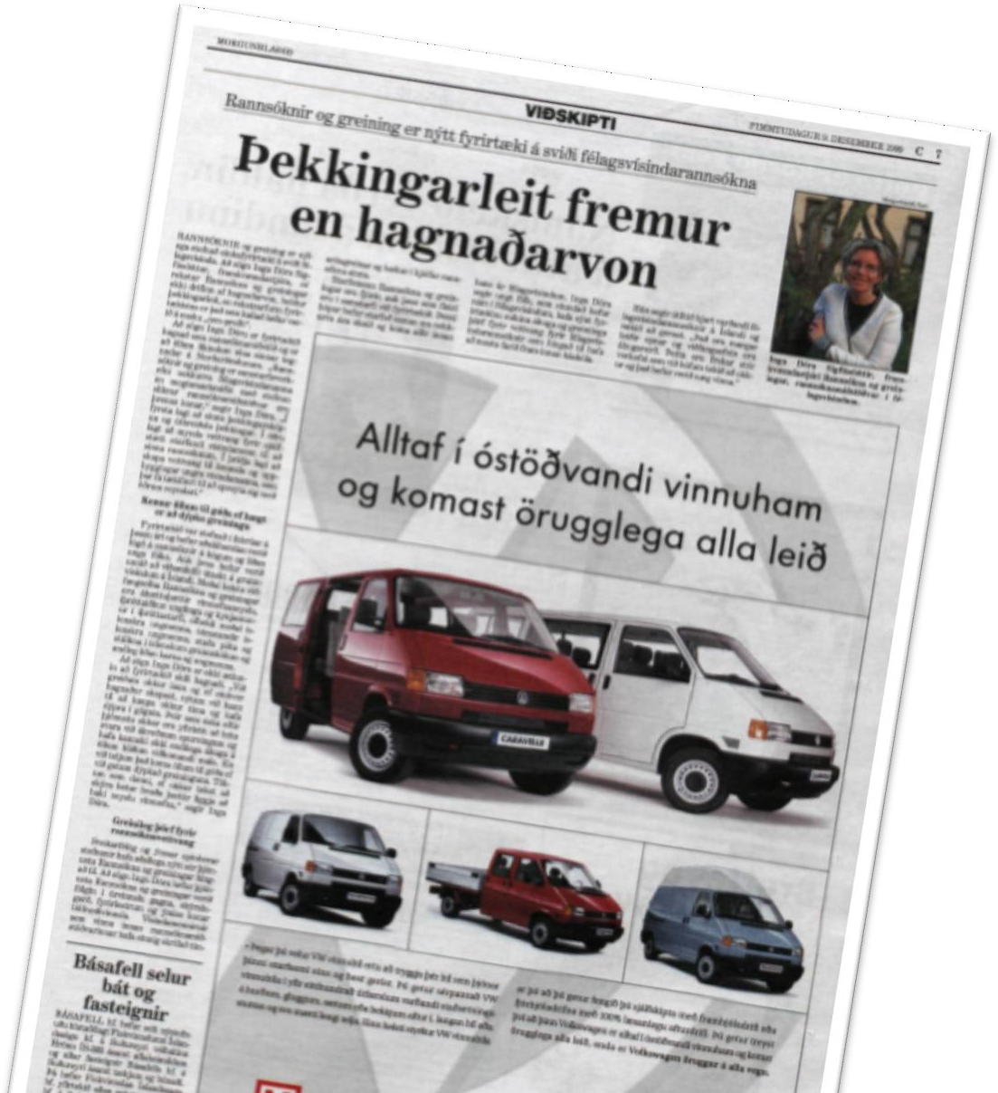
History of ICSRA
ICSRA founded 1999
The big scientific question was:
what factors are connected to substance use of youth
Field of knowledge
risk of substance use, violence amongst young people, leisure and sport activities, mental health and more
First municipality: Reykjavik

Slide 5
Youth in Iceland database 1992 - 2019
Data collections in schools
10 – 13 year old (since 2000) Primary school
14 – 16 year old (since 1992) Primary school
16 – 20 year old (since 1992) High-school
Population based – not sample
84% response rate

Slide 6
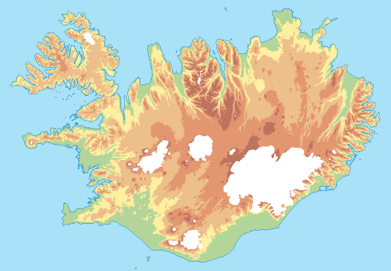







Our reach in Iceland
16 municipalities in Iceland contain 90% of the total population*
Reykjavik,
Hafnarfjodur,
Gardabaer,
Kopavogur,
Mosfellsbaer,
Reykjanesbaer,
Selfoss,
Hofn,
Isafjordur
Akureyri
9. Isafjordur,
Fljotsdalsherad
Borgarbyggd,
Akranes,
Fljotsdalsherad,
Fjardabyggd,
Akureyri,
Seltjarnarnes
Grindavik
Borgarbyggd
Fjardabyggd
Reykjavik, Hafnarfjodur, Seltjarnarnes Gardabaer, Kopavogur, Mosfellsbaer, Akranes
Hofn
Reykjanesbaer
Selfoss
Grindavik
* Icelandic National registry: October 1, 2018

Slide 7
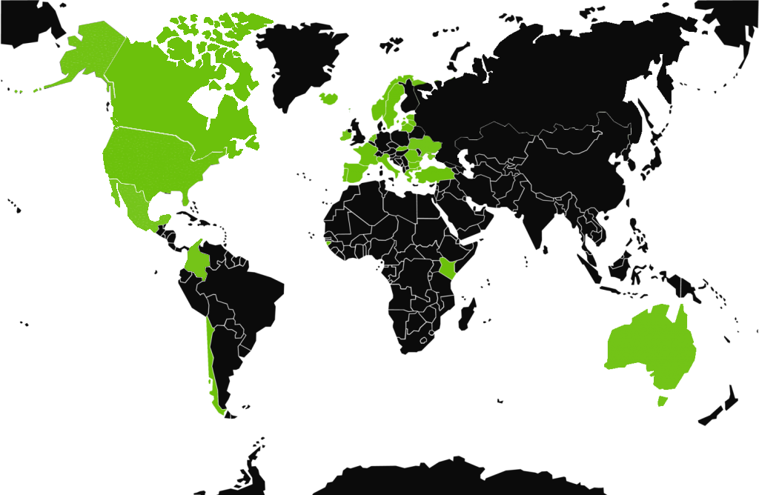
Countries we have been working with
In 2020 The method has been introduced in 32 countries in:
Chile, Portugal, Spain, France, Malta, Italy, Greece, Turkey, Slovakia, Romania, Moldova, Bulgaria, Lithuania, Latvia, Estonia, Russia, Finland, Sweden, Norway, Faeroe Islands, Netherlands, Ireland, Australia, Ukraine, South- Korea, Kenya, Guinea-Bissau, Mexico, Colombia, USA, Canada and Iceland.

Slide 8
Based on the Icelandic Prevention Model
From highest to lowest in substance use – 15/16 year old students
50
45
42
Drunk past 30 days
Daily smoking
Trend Cannabis
40
35
35
32
33
30
26 26
%
25
25
23
22
19
20
19
20
18
16
15
15
14
14
17
12
11
12
15
10 10 10
9
9
6
10
12
11
12
8
7
7
7
6
7
6
7
6 ₆
1
5
5
5
5
9
9
9
8
5
3 2
6
7
7
7
5
5
3
3
2 3
2
0
1998 1999 2000 2001 2002 2004 2005 2006 2007 2008 2009 2010 2011 2012 2013 2014 2015 2016 2017 2018 2019

Slide 9
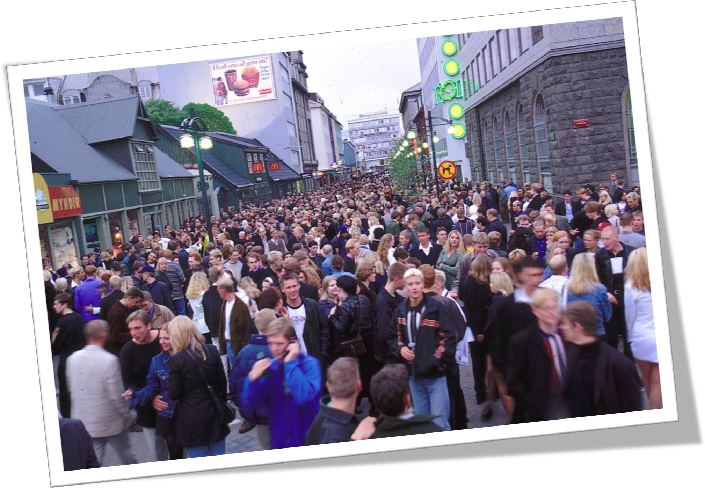
Reykjavik in the summer of 1997

Slide 10
The year is 1998
At this point in time research had already showed us that certain circumstances and behaviour in the lives of adolescents were strongly connected with substance use
We tried to establish the risk and protective factors

Slide 11





Strong connection between drinking alcohol and time spent with parents
100
90
80
70
60
%
50
42
40
30
27.8
20
17.6
12
10.4
10
0
Girls who have become drunk last 30 days
Seldom Sometimes Often
Almost never
Almost always

Slide 12



Strong connection between smoking and participation in sports
50
40
30
24.9
20
10
9.9
3.5
0
Girls who smoke daily
Up to 3 times pr. week
Almost never
4 times or more often

Slide 13
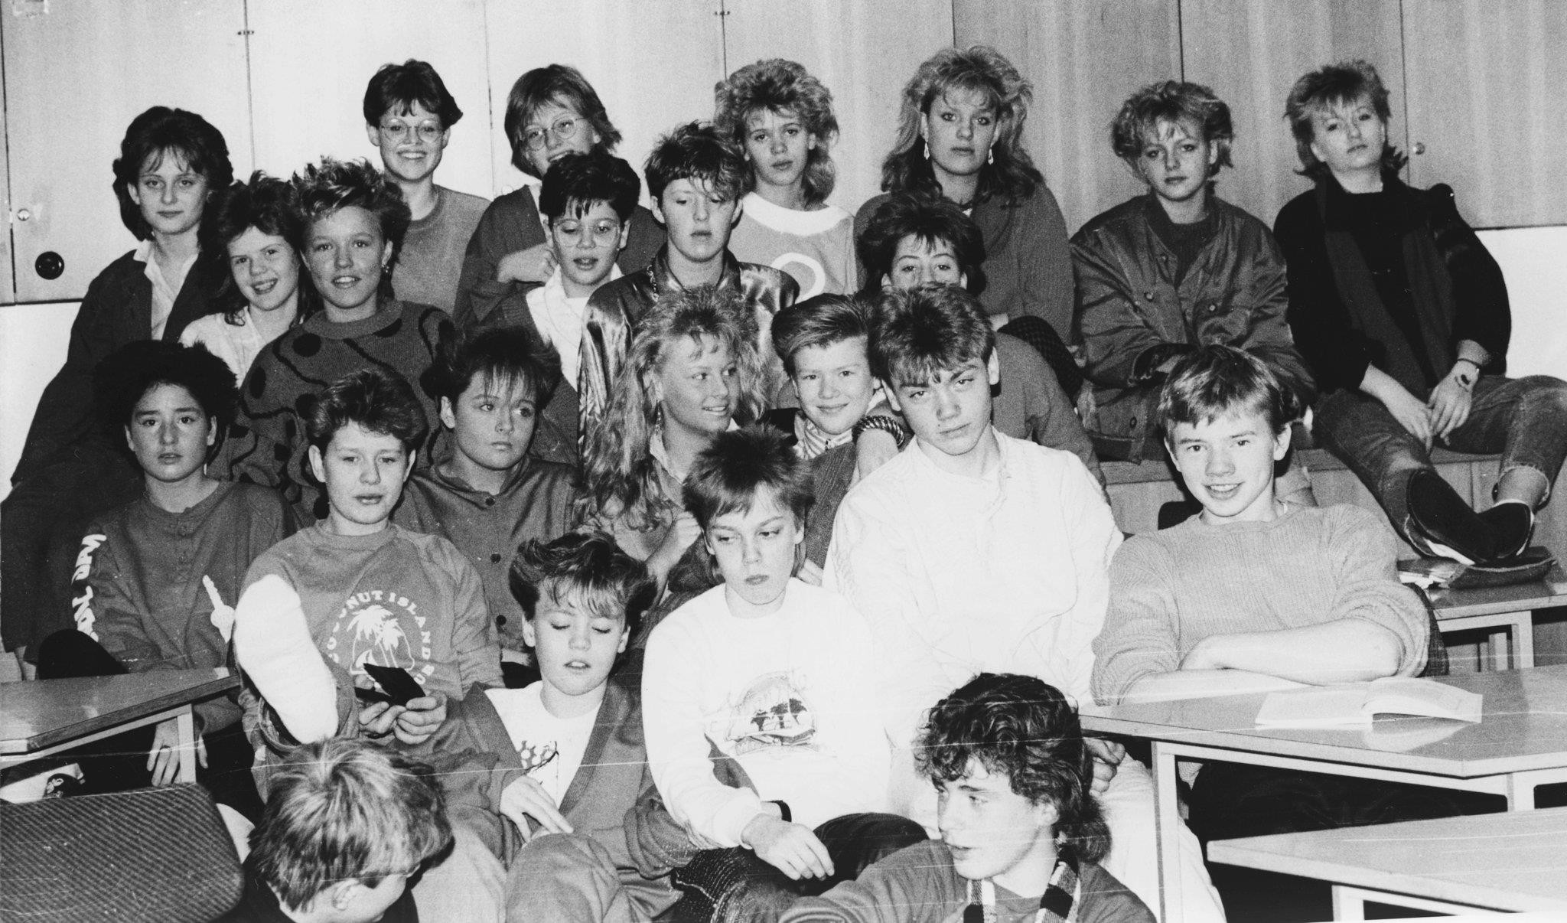

Slide 14
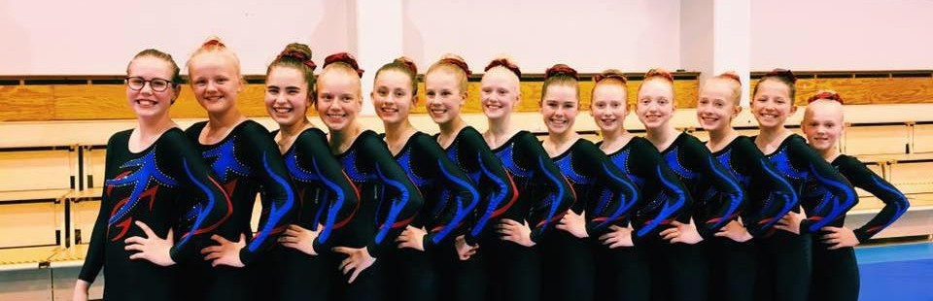
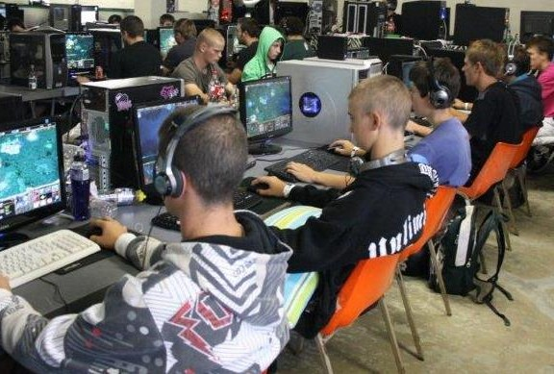
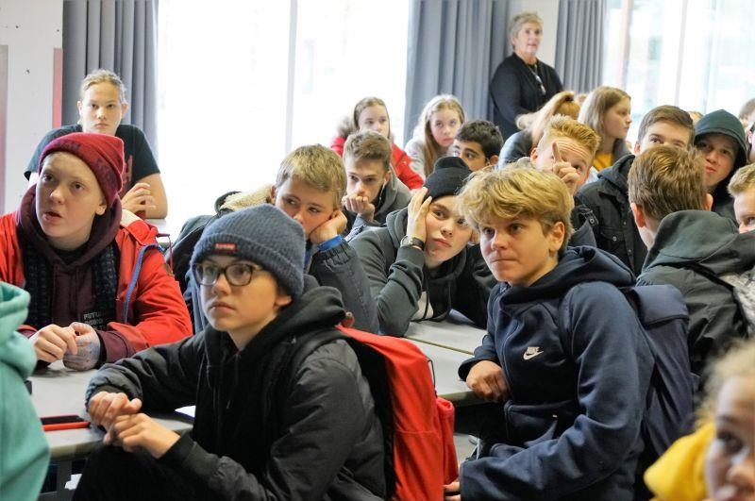
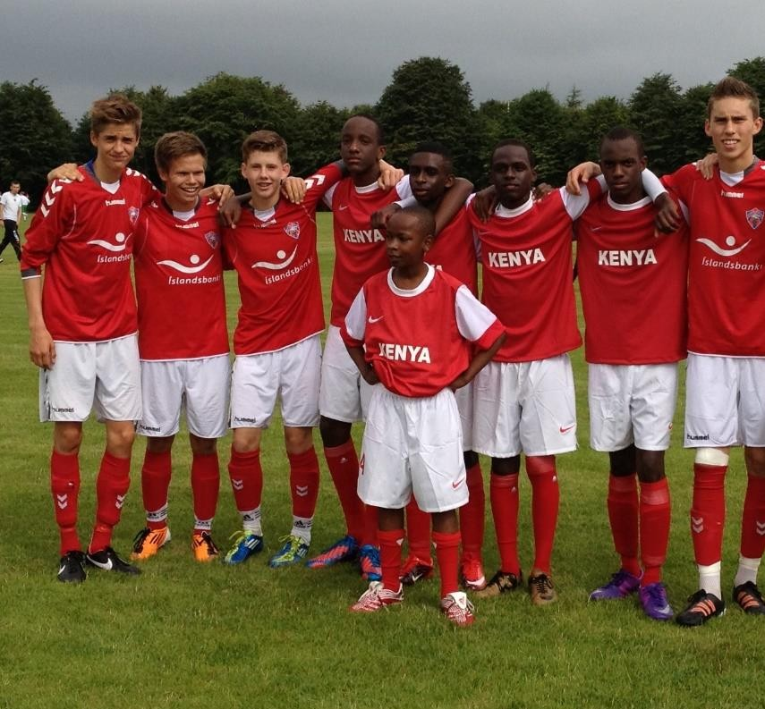

Slide 15
And analysing deeper
Time spent with parents
Support, Monitoring, Control
Organized activities vs.
unorganized
Family factors
Extracurricular activities, sports
Peer group effect
Positive and negative effects. How we as parents approach the peer group. Staying outside late. Hanging out in malls.
School
Inside and outside of school, at home, bullying e.t.c.

Slide 16
Building blocks

Slide 17
The three pillars of success
The Icelandic model is predicated upon three pillars:
Evidence-based practice
Using a community-based approach
Creating and maintaining a dialogue among research, policy and practice

Slide 18
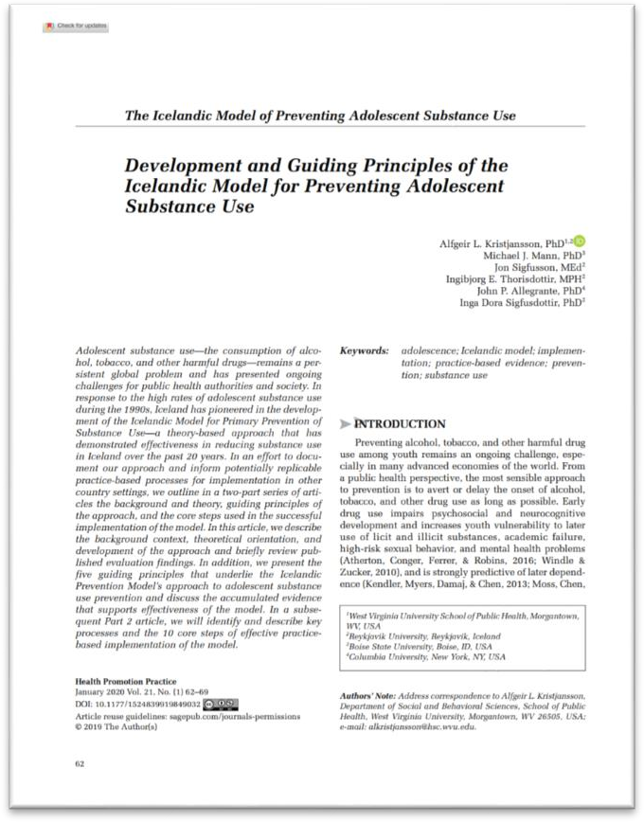
Published Articles
During the past 10 years more than 100 peer reviewed articles have been published by our scientists
All article can be found on our website (planetyouth.org)
The latest ones available in an open access online: Health Promotion Practice
Development and Guiding Principles of the Icelandic Model for Preventing Adolescent Substance Use

Slide 19
The practical role of research
Data collections on substance use regularly
Practical information immediately to the municipalities
Local information INTO all levels of prevention work is a KEY issue

Slide 20
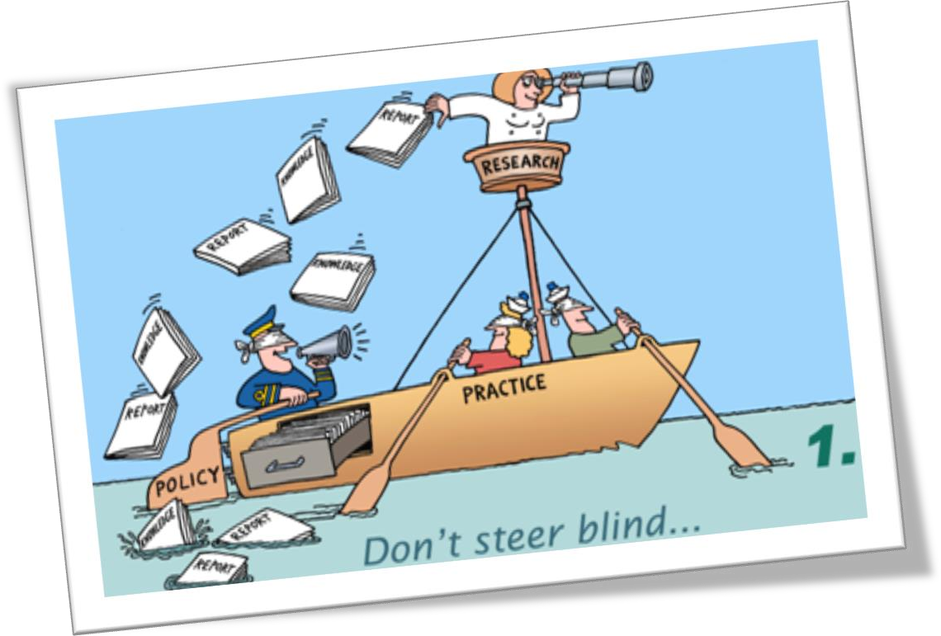
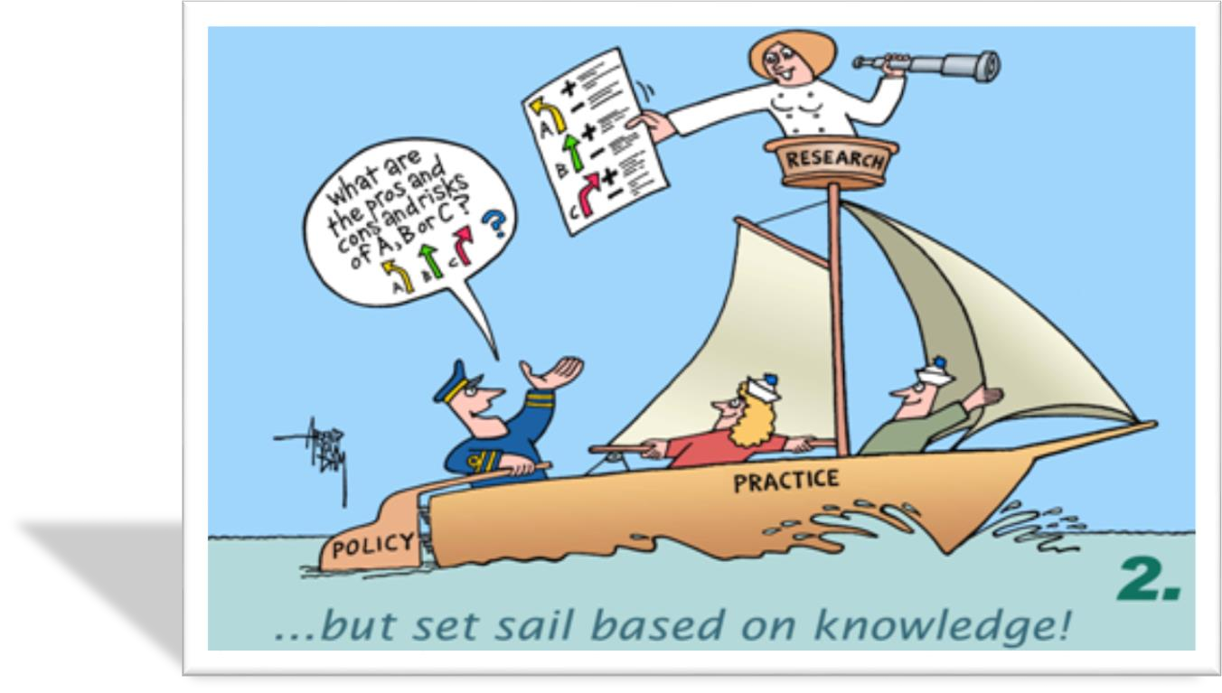
From research to practice

Slide 21



Our focus is primary prevention
Primary prevention, preventing the development of substance use before it starts
Secondary prevention, that refers to measures that detect substance use
Tertiary prevention efforts that focus on people already abusing substances

Slide 22
Focus on close community
How could an average figure on alcohol use in your country help prevention workers in your community/municipality?
“Average” doesn´t tell all the story!
close community

Slide 23

Let´s keep in mind
Time - We don’t
change things over night
Aim - Find the goal
Not a project - It´s
about changing the
way we think and then act in a different way

Slide 24

Thank you !

