Slide 1
Gender, drug use and death
Drug–Related Deaths among Women,
University of Stirling,
10 September 2018
Lee Barnsdale
Principal Analyst, ISD Scotland

Slide 2
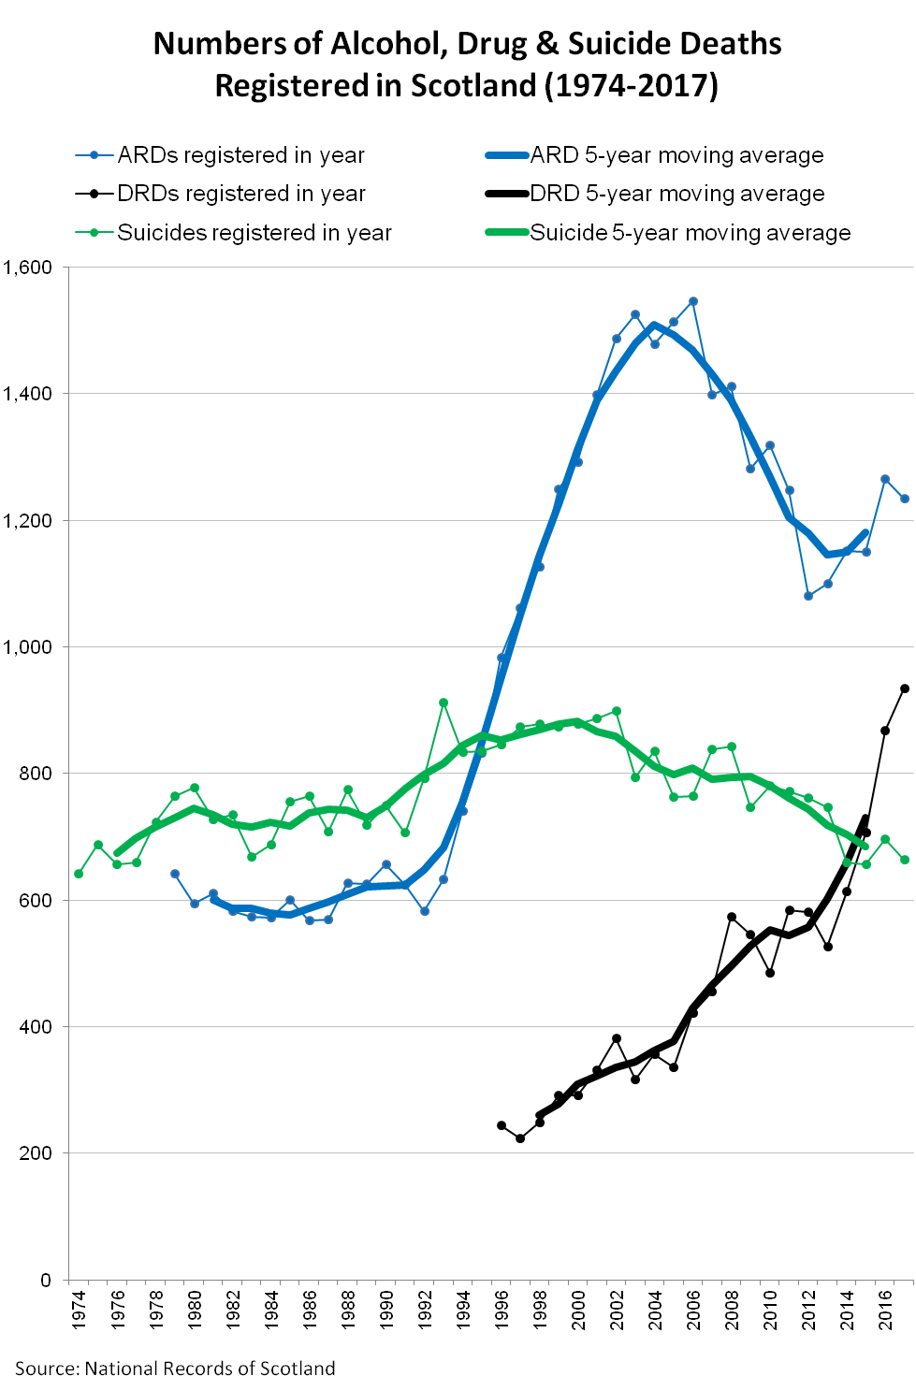
‘Drug use disorder’ deaths in
Scottish Burden of Disease study (2015)
Sex and Age Group | Years of Life Lost | Cause of preventable death (rank order)
Male 15-34 years | 7,017 | 1
Female 15-34 years | 2,467 | 1
Male 35-64 years | 10.759 | 3
Female 35-64 years | 5,344 | 6
EMCDDA Drug-induced death rates by UK country (2015)
Country | Rate per 100,000 population
Scotland | 11.9
Northern Ireland | 5.6
Wales | 5.4
England | 4.0
United Kingdom | 4.7
Source: UK Focal Point on Drugs
Notes:
Scotland is experiencing a record annual number of DRDs.
Comparison with other types of preventable deaths more DRDs than suicides and DRDs increasing at a faster rate than alcohol deaths
Scottish Burden on Disease Study 2015 shows DRDs were the leading cause of preventable death among 15-34 year olds and the third leading cause of preventable death among males aged 35-64
Comparing DRD rates with other UK countries, Scotland’s DRD rate was double that of any other UK country in 2015.
If compared with other European countries, Scotland has the highest DRD rates in Europe (2016: Scotland: 16.0 per 100K, Estonia (next highest): 13.2 per 100K).

Slide 3
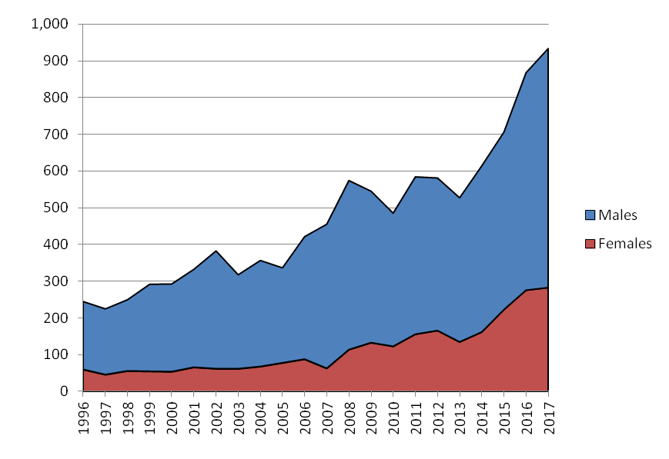
DRD trends (1996-2017)
DRD % change by sex
 | 2003-07 average | 2013-17 average | % increase
Males | 306 | 515 | 68%
Females | 71 | 215 | 203%
Source: National Records of Scotland
Notes:
There are more DRDs among men, but a particular pattern evident in recent years is the large percentage increase in the numbers of women dying of DRD.
If we compare annual average DRD numbers across 2 three year periods, we can see that % change among women is much larger than among men. 203% vs. 68%.
This observation in the 2014 NRS DRD report prompted us to include a section examining differences between male and female DRDs in our NDRDD report on 2014 deaths. This this led to the more thorough examination of females DRDs published recently – the work led by Dr Emily Tweed.

Slide 4
Key Questions
To what extent are DRDs among females increasing?
Does this reflect demographic changes in the population using drugs?
What are the other protective/risk factors for DRD and how do these differ between sexes?
What are the implications for research/policy/practice?
Notes:
Reflecting on this, I want to pose a some simple questions.
In answering these questions, I’m going to present some new analyses of:
NRS DRD data
NDRDD data
SDMD data
And also reflect on the potential for changing what we do in this area to address this issue more adequately
The first question is about the extent of the increase. You probably think I just answered this in the previous slide, but I want to go back and take another look.

Slide 5
DRD trends (1996-2017)
DRD % change by sex
 | 2003-07 average | 2013-17 average | % increase
Males | 306 | 515 | 68%
Females | 71 | 215 | 203%
Source: National Records of Scotland
Notes:
The main issue with this statistic on % change is that the definition of DRD includes deaths by suicides involving controlled drugs.

Slide 6
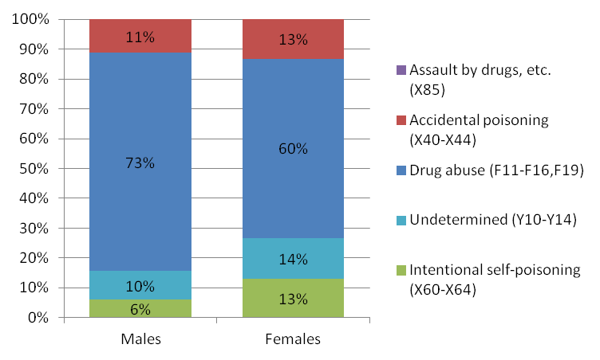
Deaths by Suicide involving controlled drugs
DRDs by Underlying cause of death by sex (2001-2017)
Source: National Records of Scotland
Notes:
Cause of death included in NRS publication since 2001
Over period 2001-2017 – percentage of suicides twice as high among females (13% of total) as among males (6%) – green section
(female suicides also increased more strongly (61%) than male suicides (23%))
Important to take suicides out because drug use prior to death lower in suicides
From NDRDD 2016, only 26% suicides were known to use drugs (compared to 88% of non-intentional DRDs).
While these deaths are very important and many of the victims share similar risk factors as people who died from accidental overdose, they largely appear to be a different group of people, to whom risk analysis of DRDs may not apply – by taking them out we reduce the noise in the data which allows better comparisons with other data sources.
% since 2012 is 42% of suicides vs 86% of non-intentional deaths (2009 onwards)

Slide 7
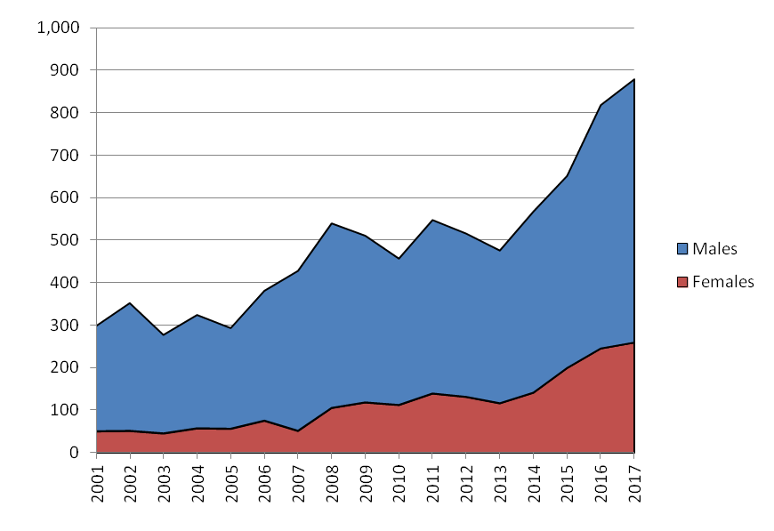
Non-intentional DRD trends (2001-2017)
Non-intentional DRD % change by sex
 | 2003-07 average | 2013-17 average | % increase
Males | 284 | 487 | 72%
Females | 57 | 192 | 238%
Source: National Records of Scotland
Notes:
When we take out the suicide deaths out of the statistics to focus on accidental overdoses
Trend looks similar but the % increase for women is larger than before.
238% increase vs 203% increase

Slide 8
Key Questions
To what extent are DRDs among females increasing?
Does this reflect demographic changes in the population using drugs?
What are the other protective/risk factors for DRD and how do these differ between sexes?
What are the implications for research/policy/practice?
Notes:
The changes I’ve highlighted might be due to changes in the population using drugs
It could be a function of population size:
More women may be dying of DRD because there has been an disproportionate increase in the numbers of women using drugs problematically?

Slide 9
Non-intentional DRD rates per 1,000 adults (general population)
 | 2008-12 | 2011-15 | 2013-2017
Male 15-24 | 0.14 | 0.09 | 0.08
Male 25-34 | 0.42 | 0.35 | 0.35
Male 35-64 | 0.20 | 0.24 | 0.32
Males | 0.23 | 0.23 | 0.28
Female 15-24 | 0.05 | 0.02 | 0.02
Female 25-34 | 0.10 | 0.10 | 0.11
Female 35-64 | 0.06 | 0.09 | 0.13
Females | 0.07 | 0.08 | 0.11
Source: National Records of Scotland
Notes:
To answer, I want to show you this table of accidental DRD rates per 1,000 general population over time
Rates based on mid-year population estimates for adults aged 15-64 in 2010, 2013 and 2015
Key points here are:
Males aged 25-34 have highest DRD rates
DRD rates level or decreasing over time among under 35s (both sexes)
Biggest rate increase seen in females aged 35-64
These rates are partly a reflection of the demographics of the PDP population

Slide 10
Drug Prevalence Estimates
Estimates of number of people with problematic opiate and/or benzodiazepine use.
Includes estimate of ‘hidden’ population.
Gradual increase in population since 2003
Approx 30% of ‘Problem drug users’ are female
Source: ISD Scotland
Notes:
2 ISD projects provide a perspective on the PDP population
First is drug prevalence estimation (opioids/benzos):
This shows most PDPs are men - Historically, % of women has been very stable at around 30% of estimated PDPs
No recent change in size of female pop evident in prevalence estimates

Slide 11
Specialist Drug Treatment Assessments
Scottish Drug Misuse Database (SMR25a) assessments
Numbers of individuals presenting for specialist drug treatment
Gradual decrease in size of treatment population since 2013/14
Approx 30% of individuals assessed for treatment are female
Source: ISD Scotland
Notes:
However, PDU estimates are somewhat out of date – last sweep was for 2012/13
More recent information is available from assessments for specialist drug treatment (SDMD)
If we can assume that population assessed for treatment is representative of wider population of PDPs, then it should indicate changes in size and composition of that population
Gradual decrease since 2013/14 (could indicate that fewer using treatment services)
Similar to overall prevalence, around 30% of entrants are female.
The 30% figure pops up across range of data sources (NESI 15/16 – also approx 30% (28% female))
If risk of DRD was equal across age and gender groups, increase in numbers of women using drugs would explain increasing DRD rates
No evidence of this, so we have to consider what other population factors may be influencing risk of DRD

Slide 12
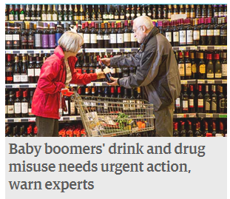
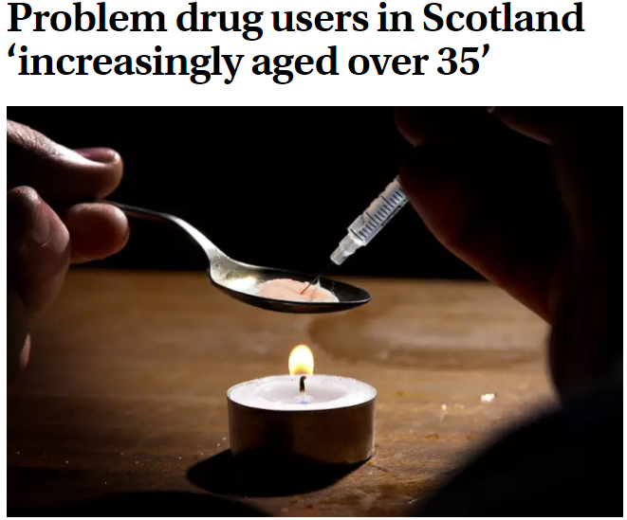
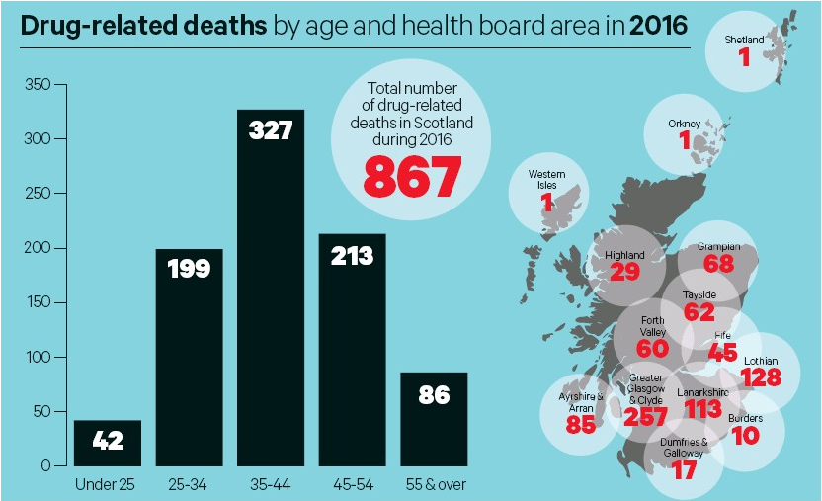
Herald, 15/11/09
BBC, 26/07/17
Scottish Daily Mail, 16/08/17
Holyrood, 15/08/17
Guardian, 23/08/17
Herald, 16/08/17
Scotsman, 05/04/17
Scotsman, 16/08/17
Notes:
The other population level variable that might influence DRD numbers is age
It’s been recognised for a few years that Scotland’s PDP population is aging. This has been evident across a range of data sources and seen as a key explanatory factor in increasing DRDs.
Underlying explanation is that continued drug use increases vulnerability –> morbidity, loneliness, isolation,
Manifests in increasing prescribing/admissions/DRDs

Slide 13
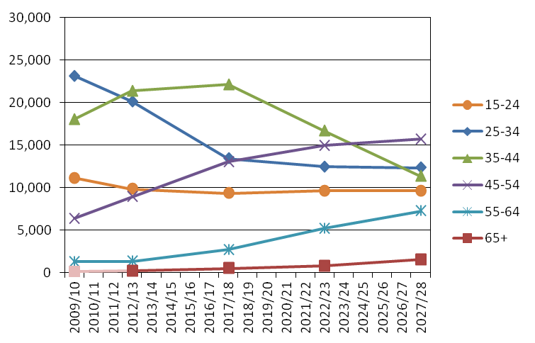
Older People with a Drug Problem: Population Projections (2009/10-2027/28)
Source: ISD Scotland
Notes:
In 2014 I participated in an expert Working Group on Older People with a Drug Problem
As part of this, we did some work on projecting the size and demographics of the PDP population over the next 15 years, incorporating factors associated with onset, cessation of drug use, relapse and survival,
This charts shows projections
Each age group is represented by a line on the chart. The red vertical line shows where we are now in the time series. The two points on the chart to the left of the red line are existing drug prevalence estimates and the points to the right are projections.
This estimates that, among the PDP population, the numbers of 15-34 year olds will continue to decrease and that numbers of 35 and overs will continue to increase.
Overall PDP population size decreases slightly over time, mainly due to higher mortality among older age groups.
Women would continue to represent around 30% of the PDP population.

Slide 14
Non-intentional DRD rates per 1,000 adults (PDPs)
 | 2008-12 | 2011-15 | 2013-2017
Male 15-24 | 6.0 | 5.0 | 4.1
Male 25-34 | 8.6 | 8.1 | 11.2
Male 35-64 | 11.5 | 11.5 | 13.1
Males | 9.3 | 9.4 | 11.2
Female 15-24 | 4.9 | 1.9 | 2.7
Female 25-34 | 4.8 | 5.1 | 7.5
Female 35-64 | 10.2 | 14.1 | 15.3
Females | 7.0 | 8.0 | 11.0
Source: National Records of Scotland/ISD Scotland
Notes:
The reason I’m telling you about this is because to see what’s going on with DRDs, particularly among women, you have to look more closely at ageing within the PDP population, rather just overall numbers and % female.
Unlike the table shown before, this table shows the rates of DRDs per 1,000 PDPs – the ‘at risk’ population
This is a new analysis:
These are non-intentional deaths only
Because drug prevalence estimates aren’t available for 15/16, NRS DRD stats don’t include rates that take account of 2016 and 2017 DRD
2013-2017 rates based on Older Drug User population projections - obviously, the rates in the last column are dependent upon the accuracy of those projections
The key messages here are that:
DRD rates are increasing over time
DRD rates increase with age, for both sexes
The highest DRD rate (and biggest rate increase) is among females aged 35-64
Among PDPs, DRD rates are now roughly equal for males and females

Slide 15
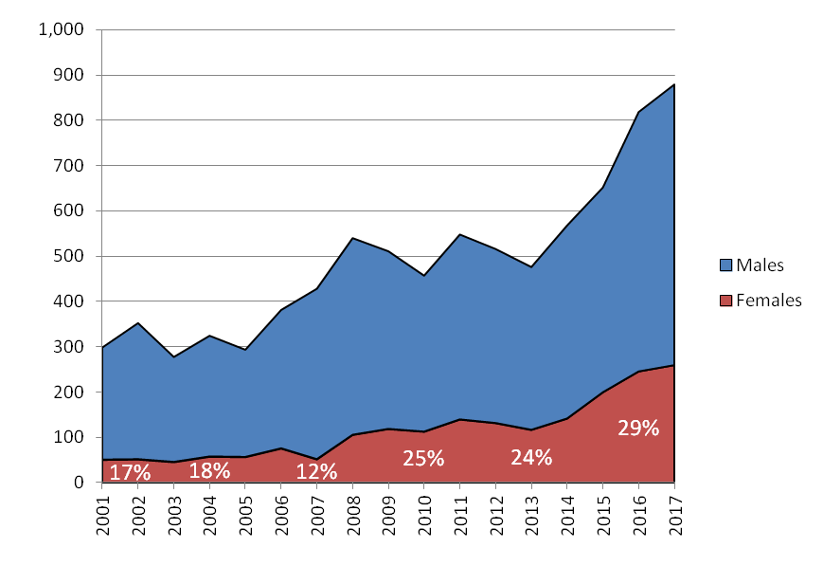
Non-intentional DRD trends (2001-2017)
Source: National Records of Scotland
Notes:
The net result of this change is that women now make up around 30% of DRDs, the same percentage of females observed in prevalence estimates and drug treatment assessments.

Slide 16
Key Questions
To what extent are DRDs among females increasing?
Does this reflect demographic changes in the population using drugs?
What are the other protective/risk factors for DRD and how do these differ between sexes?
What are the implications for research/policy/practice?
Notes:
No big increase in numbers of female PDPs.
However, women aged over 35 appear to be particularly vulnerable to DRD
Ageing is part of the explanation, but there are other risk factors which may explain increasing DRD rates

Slide 17
DRD risk factors
Frischer et al (2012) Preventing Opioid Overdoses in Europe
Review of literature on risk of fatal overdose in heroin users.
Four sets of factors involved in overdose:
Individual characteristics – age, duration/type of drug use
Situational factors – witnessed, THN availability
Treatment interventions – OST, treatment retention
Organisational response to OD – hospitalisation, police attendance at OD
Complex events with multiple, interacting factors
Greater the number of individual, situational and organisational risk factors, greater likelihood that overdose will be fatal
Notes:
There have been a number of reviews of DRDs risks and protective factors. Probably the most important general review was done by Frischer et al in 2012.
They noted that reviews of fatal overdose in heroin users tended to focus on 4 set of factors (listed here)
They emphasise these are complex events
Greater number of risks, higher likelihood of fatal OD
They concluded that many interventions may reduce risk overdose in context of treatment, but no single measure is likely to have a significant impact by itself – it’s the package of care and the context it’s delivered in that matters.
I’m going to look at a few of these risk/protective factors, using data from SDMD and NDRDD to describe how they affect men and women differently.

Slide 18
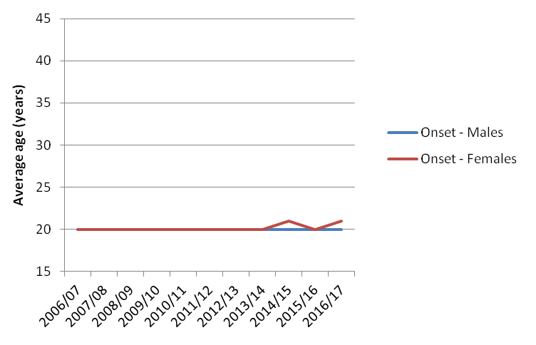
Age and substance use
(onset of problem drug use)
Source: SDMD (ISD Scotland)
Notes:
Thinking back to the age issue, it’s possible that DRDs among women could be increasing because their patterns of drug use are different or changing. Potentially:
Women may be using for longer periods of time (longer period at risk so experience greater cumulative harm)
Using more dangerous drugs
Or using in more risky ways
Looking at the first of these:
From SDMD (assessments for treatment) we can see that (on average) age of onset of problem drug use is approximately the same for men and women

Slide 19
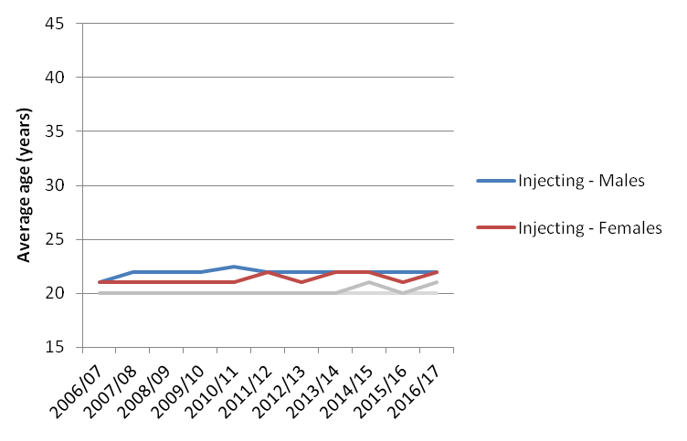
Age and substance use
(onset of injecting)
Source: SDMD (ISD Scotland)
Notes:
As is the age of initiating injecting

Slide 20
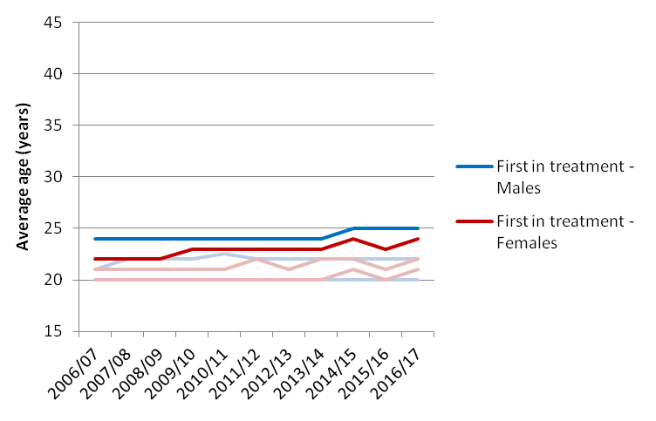
Age and substance use
(first treatment)
Source: SDMD (ISD Scotland)
Notes:
Among people who enter treatment, women tend to do so at a slightly younger age
Generally, patterns of initiating drug use are very stable over time

Slide 21
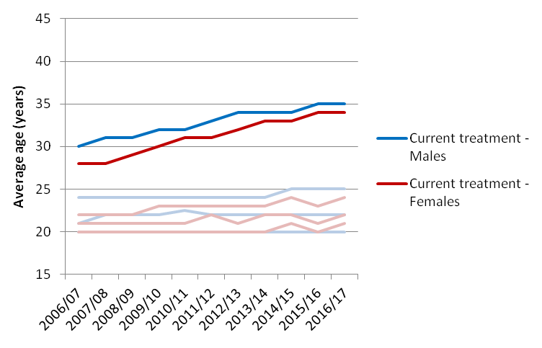
Age and substance use
(current treatment)
Source: SDMD (ISD Scotland)
Notes:
For both sexes, average age at current treatment (for SDMD) has increased over time
Again, women slightly younger at treatment entry
Unlikely that this is due to people waiting longer to enter treatment – represents multiple attempts at treatment among an ageing population with a chronic relapsing condition

Slide 22
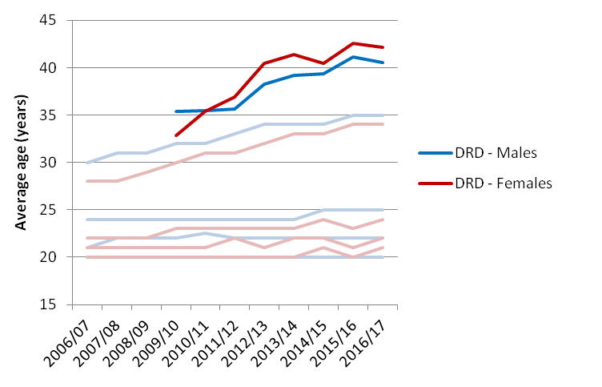
Age and substance use
(DRD)
Source: SDMD/NDRDD (ISD Scotland)
Notes:
By superimposing average age at DRD onto this chart, we can also see the significant increase in age at death and women tend to be older at death (over the time series for DRD data: 39.8 vs. 38.3).
Women’s average age at DRD overtook men’s in 2010
However, patterns of initiation of drug use between sexes are very similar, and have not changed over time.
On average Around 20 years between onset of problem drug use and DRD.
Period at risk is not significantly larger

Slide 23
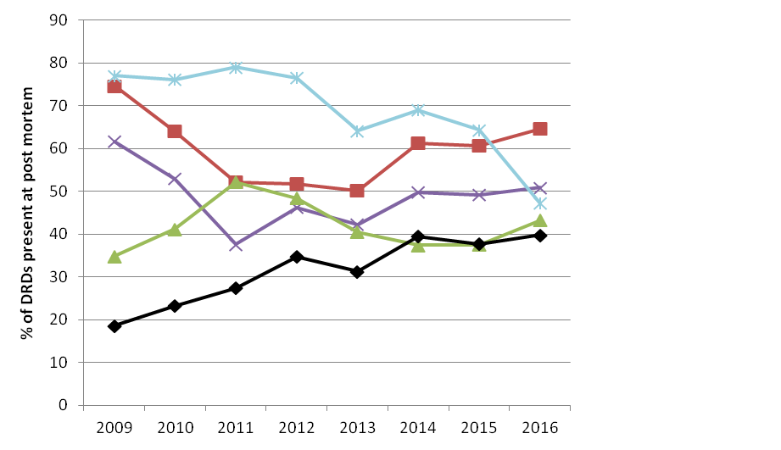
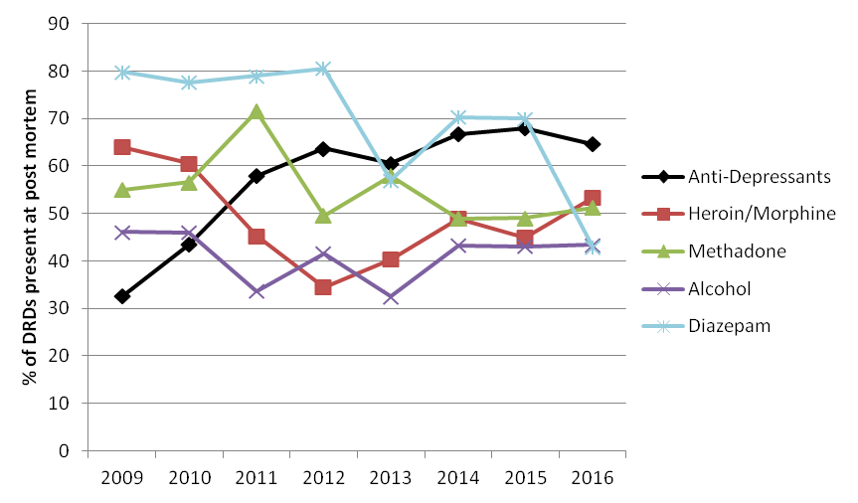
Drugs present at post mortem
Males (NDRDD; 2009-2016)
Females (NDRDD; 2009-2016)
Heroin/Morphine
Alcohol
Cannabis
Cocaine
Antidepressants
Methadone
Gabapentin
Pregabalin
Zopiclone
Source: ISD Scotland
Notes:
SDMD: Top 4 main drugs same for men and women, with little change over time
Heroin, Cannabis, Diazepam, Cocaine
Other: M; Methadone; W
Information in charts
NDRDD: Same top 5 drugs for both sexes present at post mortem
Males on left, females on right
Drugs listed with arrows were higher among that sex
Difference in prevalence (2016)
Women: Higher presence of antidepressants (65%), methadone (51%) (40%, 43% among men)
Men: Higher presence of heroin/morphine (65%), alcohol (51%) (53%, 43% among women)
Drug presence speak to wider prescribing among women:
Across time series, females more likely to have recent medical condition (72% vs 58%)
Across time series, females more likely to have recent psychiatric condition (70% vs 51%)
In 2016, 97% of both Ms and Fs had poly drug use prior to death
Frischer: Single most important factor is use of opioids and other depressant drugs
In 2016, 71% F 71% M had opioids/benzos present at death
In 2016 gabapentin (31%), pregabalin (23%) and zopiclone (10%) presence were all higher among females than males (21%, 16% and 3% respectively). Conversely, cannabis (33%) or cocaine (20%) were all more likely to be found present at post mortem among males than among females (53%, 43%, 23% and 14% respectively).

Slide 24
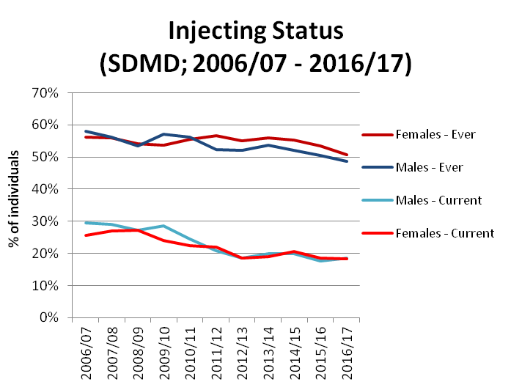
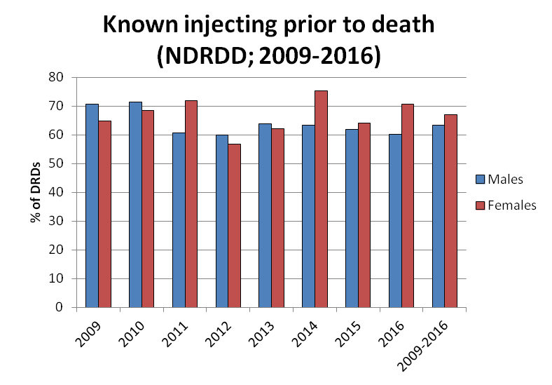
Injecting
Ever injecting - 2006/07-16/17:
F (55%) > M (54%)
2009-16: F (67%) > M (63%)
Source: ISD Scotland
Notes:
Injecting
Generally higher injecting prev among DRDs than among individuals in treatment SDMD
Variation across time series in DRD data
Female injecting prevalence higher than male injecting in both SDMD and DRD (but not by much)
So, thinking about drug use
women start using at same age,
use same types of drugs as men (but more prescribed, less risky drugs) and have
marginally higher injecting prevalence

Slide 25
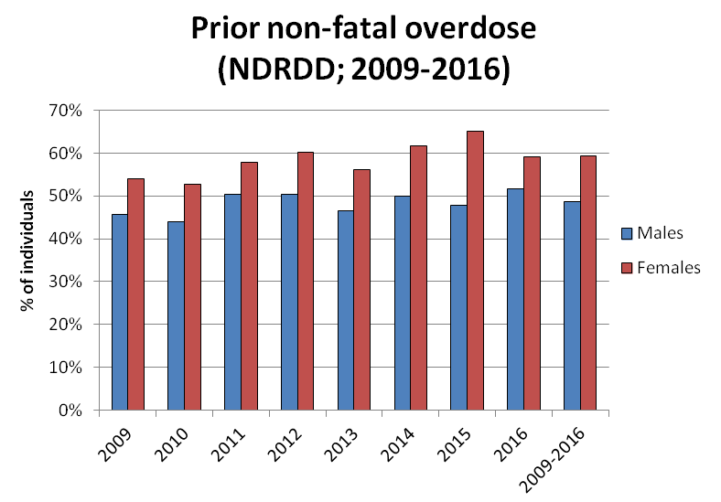
Experience of overdose
F > M in all years except 2011
2009-16: F (59%) > M (49%)
Source: ISD Scotland
Notes:
Previous non-fatal OD is highly predictive of fatal OD.
Work of Shane Drake and others shows risk of 1st OD being fatal is lower than for subsequent ODs. However, data is not great – subjective interpretation of events, self-reported data
Recording of known ODs higher among women than among men in DRD data
OD more likely because lower BMI?

Slide 26
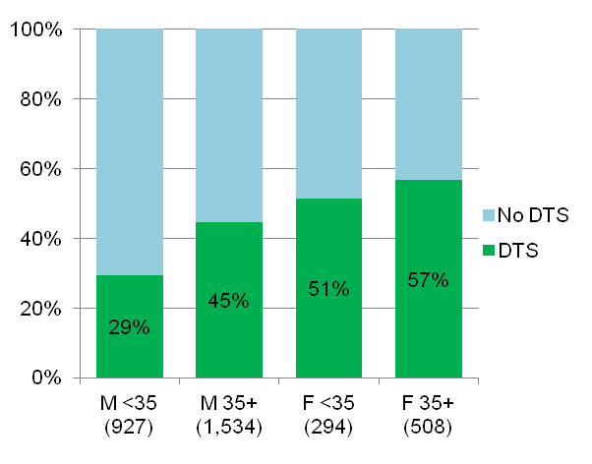
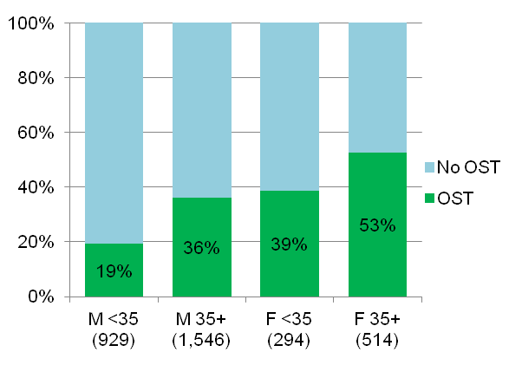
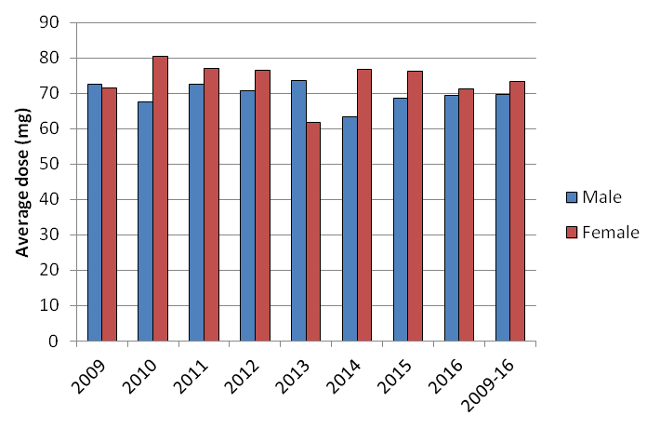
Treatment/OST
DTS by age group & sex (09-16)
OST by age group & sex (09-16)
Average methadone dose by sex (09-16)
2009-16: F (73.4) ~> M (69.6)
Gao et al (2016): DRD risk among methadone prescribees > w age
Source: NDRDD (ISD Scotland)
Notes:
These charts focus on Opioid-Related Deaths (ORDs).
Retention in treatment is regarded as protective against DRD because of access to support and prescribing for OST
OST is effective at reducing opioid use and protective against DRD if prescribed within recommended guidelines.
NDRDD data - Among ORDs in all years combined (2009 to 2016), contact with a drug treatment service and OST at the time of death were both observed more often among people aged 35+ and females.
Women were significantly more likely than men to be in treatment or on OST
Older women were significantly more likely to be in treatment or on OST than younger women.
Over 90% of OST prescriptions (in general population and among DRDs) are for methadone.
Women were prescribed roughly similar amounts of methadone to men.
Average dose for both sexes was in recommended range.
Studies have shown that methadone prescribing is associated with increased DRD for both sexes among people aged 35 and over. However, they provide no insight into why that is – association with other risks needs to be explored.

Slide 27
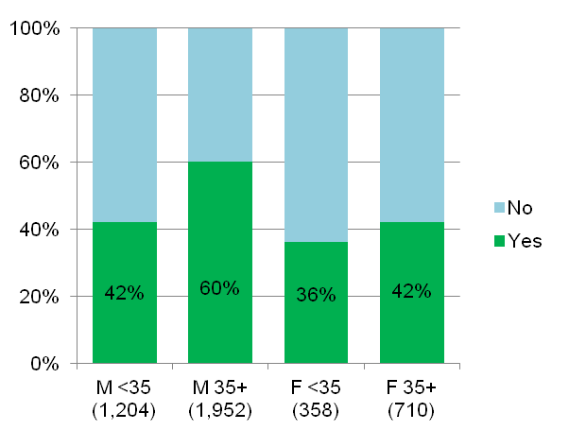
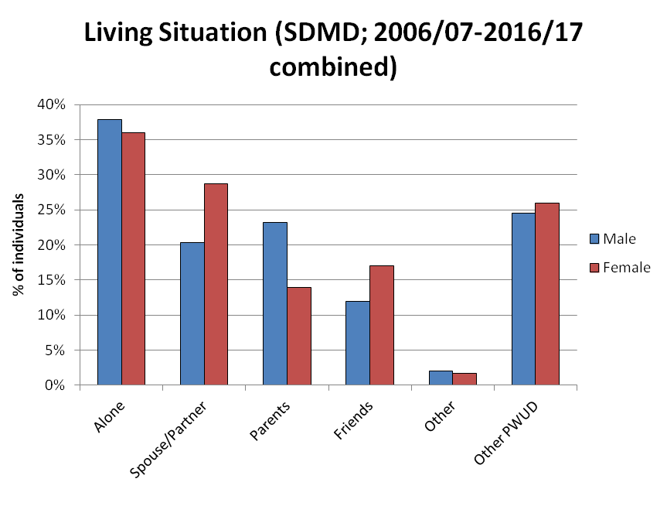
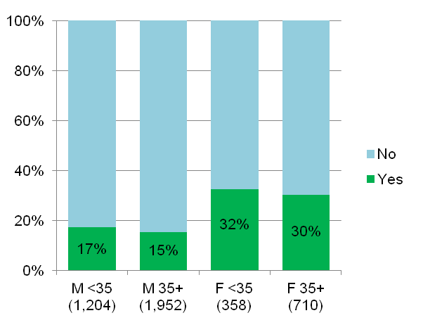
Living Circumstances
Living Alone by age group & sex (NDRDDD: 09-16)
Living w Spouse by age group & sex (NDRDD: 09-16)
Source: ISD Scotland
Notes:
Looking at living circumstances
From SDMD data, women are significantly more likely to live with a partner or to live with friends when assessed for treatment.
From DRD data, women are significantly less likely to live alone at death than men (men over 35 are significantly more likely than any other group to do so)
Women are significantly more likely to live with a partner at death than men

Slide 28
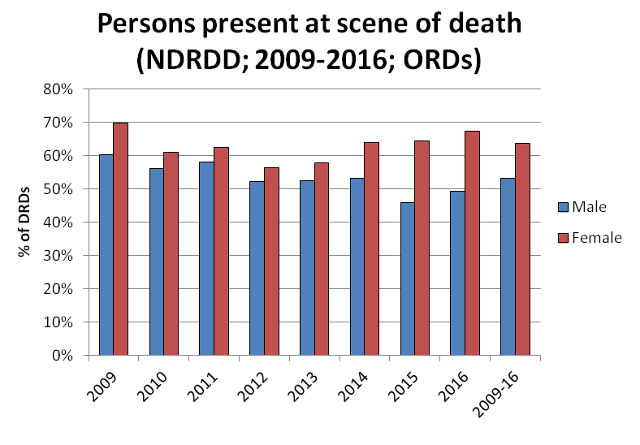
Others present at death
NDRDD: 2009-16 ORDs:
Presence at scene of death:
F (64%) > M (54%)
Where others present, naloxone availability at scene of death:
F (6%), M (6%)
Where available, naloxone use:
F (70%), M (79%) (small numbers)
Source: ISD Scotland
Notes:
Living situation, particularly living with others, is strongly associated with presence of others at death
Presence of others means someone can call ambulance or help
Presence of others at death was significantly higher for women than men
In 4 out of 5 deaths among women who lived with a partner, someone else was present at the time of death (83% compared to 50% of women who did not)
– so why are more women dying?
Capacity – if there is drug use within relationships, witnesses may under influence and unable to save life
Take Home Naloxone – opioid antagonist – reverses opioid overdoses.
Dependent upon:
Opportunity – you cannot administer THN to yourself; someone else with capacity must be there to do it
Availability – If others present, was there a THN kit available?
In spite of >THN supply, THN availability at time of death was low (6%)
Sizeable number of preventable DRDs among women
Could be argued that that finding is related to the outcome (death) and that THN availability among living would be higher
However, needle exchange survey findings shows THN carriage is low among living opioid users (6%)

Slide 29
Risk factor analysis
Factor | Type | Male | Female | +/- DRD risk
Age at DRD | Risk | 38 years | 40 years
PDU duration | Risk | 18 years | 19 years
Opioid & benzo presence | Risk | 71% | 71%
Injecting | Risk | 63% | 67%
Prior overdose | Risk | 49% | 59%
Drug Treatment | Protective | 39% | 55%
OST | Protective | 30% | 48%
Living alone | Risk | 53% | 40%
Persons present at OD | Protective | 53% | 64%
THN available | Protective | 6% | 6%
Source: SDMD/NDRDD (ISD Scotland)
Notes:
ODs are complex events with multiple interrelated elements.
Explored a small number factors, concentrating on areas that relate to probability of OD and likelihood of fatality & where we have good data
No attempt to weight risks
Have not included some factors which may increase likelihood of drug use (i.e. Sex/dom vio, kids in care).
This is not because I don’t think they’re important, it’s because we don’t have good data on these factors
Table summarises factors & shows effect on DRD risk relative to men
Women are more likely to possess specific demographic/background characteristics that elevate DRD risk
For treatment and situational components of DRD, they have a higher prevalence of protective factors (treatment contact, living with others, witnessed ODs)

Slide 30
Key Questions
To what extent are DRDs among females increasing?
Does this reflect demographic changes in the population using drugs?
What are the other protective/risk factors for DRD and how do these differ between sexes?
What are the implications for research/policy/practice?

Slide 31
Implications for research
Rethink DRD risks – gendered analysis
Collect DRD data that addresses female-specific risks
Drug use within relationships/partner-administered injection
Experience of trauma
Relationships with children
Cohort-based analysis of PDP population
Treatment pathways
All-cause mortality
Evaluate women’s experience of treatment via DAISy
Notes:
Female DRDs, particularly those aged 35 and over don’t fit with conventional explanations of DRDs.
Conventional thinking about DRD risks has not been gendered – probably because most DRDs are among men, male-focused explanations have done a pretty good job of explaining most DRDs.
Also need to enhance our understanding of role of ageing
Risk analysis has to keep pace with PDP population change
Address gaps in data collection - drug use within relationships, potential role of partner-administered injection, relationships with children, quality/fit of drug treatment services – all may influence risk of DRD and we have poor or no data on them.
Improve understanding of prescribing risks – examine > methadone DRD risk in relation to age, for women
Broaden analysis of risks beyond DRDs – DRD is only one outcome but is well recorded and its the most obvious, negative outcome. Need to look at all-cause mortality - there are many possible outcomes for this population,
Cannot evaluate risk of DRD by studying DRDs – some living people may have an equal or higher prevalence of some risks.
Understand care pathways and mortality among PDPs via cohort approach, linking drug-related data from multiple datasets
Need better data on treatment outcomes in Scotland – we failed with SDMD, we need to succeed with DAISy
Services understand their clients and where the gaps are, but DAISy outcome data is important because:
highlight differences in effectiveness and
Highlight unmet needs to ADPs and to Government

Slide 32
Implications for policy/practice
Evidence into Action:
Female-specific/-friendly services
Reflect on prescribing risks
Responsible prescribing
Multiple OST options
Focus harm reduction on situational aspects of overdose
Highlight potential risks of drug use in relationships
Dose awareness
Staggering drug use
Increase THN supply – emphasise GP/hospital supply
OD awareness among friends/family
Notes:
Service provision, prescribing and methadone are some of the areas of concern identified – we need more evidence about the risks for women in relation to these components of care.
ODs are complex events and there is no magic wand, but services designed around the needs of women, with responsible prescribing and non-methadone OST options may help to reduce DRD risk.
More research is needed and practice needs to continue to respond to emerging evidence.
Some of the contextual OD factors provide a clearer basis for intervention:
Lower prevalence of living alone among women means OD prevention opportunities exist –
We need to promote a better understanding of risks of drug use – highlight risks of DU within relationships, awareness of drug combinations & dose
High prevalence of witnessed OD means OD awareness among family/friends important–
Importance of staggering use to ensure witness capacity , >THN availability (partic. via GPs/hospitals),

Slide 33
Questions?
leebarnsdale@nhs.net

