Slide 1
Long-acting injectable buprenorphine: experience from a prison pilot in Scotland
Tom Byrne
National Prisons Pharmacy Adviser, Healthcare Improvement Scotland.

Slide 2
Proposal for a pilot of long-acting injectable buprenorphine in Scottish prisons
Long-acting injectable buprenorphine (LAIB; Buvidal®) approved for use in Scotland by the SMC in August 2019
Highest drug-related deaths in Europe
Late 2019: prison pilot proposed
20 patients from 5 sites
Evaluate after 3 months
SMC, Scottish Medicines Consortium

Slide 3
Rationale
Increased choice
Patient safety
Increased nursing time for patient-facing activities
Increased operational time for purposeful activities
Potentially reduce diversion
Reduce bullying & intimidation

Slide 4
COVID-19 Continuity of ODT
Outbreak coincided with pilot submission to Scottish Government
Recognition from SG that pilot rationale even more applicable in a pandemic
Request from Scottish Government to scale up pilot

Slide 5
Pilot service overview
“Buvidal is to be considered for all patients in custody with a minimum of 6 months of a sentence left to serve for a 3- to 4-month period of the pandemic”
Scottish Government funding: £1.9m May–June

Slide 6
NHSFV Challenges introducing Buvidal®
Challenge
Ethical
Is it fair to ask patients to convert from their current ODT preparations to Buvidal®, only to return to their previous ODT weeks/months later?
Financial
Scottish Government is funding Buvidal® until end of August 2020 – what then?
Operational
Accessing patients to discuss Buvidal® as an option while operating a lockdown regime
Healthcare team
No personal experience with Buvidal® among the healthcare team
Patients
No peer group to discuss treatment experiences
ODT, opioid dependence treatment

Slide 7
NHSFV Challenges introducing Buvidal®
Challenge
Solution
Ethical
Is it fair to ask patients to convert from their current ODT preparations to Buvidal®, only to return to their previous ODT weeks/months later?
Reassurance to all converting to Buvidal® that there would be no forced discontinuation of treatment
Financial
Scottish Government is funding Buvidal® until end of August 2020 – what then?
Agreement from NHS Forth Valley to maintain funding for all patients on treatment when Scottish Government funding ceased
Operational
Accessing patients to discuss Buvidal® as an option while operating a lockdown regime
Governors of all three local prisons agreed to allow access to consult with all potentially suitable Buvidal® candidates on the prison wings
Healthcare team
No personal experience with Buvidal® among the healthcare team
Buvidal® representative attended each prison to demonstrate routes and method of administration using demonstration devices
Patients
No peer group to discuss treatment experiences
Prisons to develop peer support groups, facilitated by addiction workers
ODT, opioid dependence treatment

Slide 8
Buvidal® uptake in Forth Valley prisons
Eligible patient group
Identified 93 potential Buvidal® candidates
Methadone
(n=82)
9 women
73 men (1 youth)
Patients receiving ODT
(n=93)
Buprenorphine
(n=11)
2 women
9 men
ODT, opioid dependence treatment

Slide 9
Buvidal® uptake in Forth Valley prisons
Eligible patient group
Converted to Buvidal® (n=40)
Identified 93 potential Buvidal® candidates
40 requested conversion from their current ODT
Previous ODT
Methadone
(n=82)
Consultation
about
Buvidal®
Methadone
(n=35)
9 women
7 women
73 men (1 youth)
28 men (1 youth)
Patients receiving ODT
(n=93)
Buprenorphine
(n=11)
Buprenorphine
(n=5)
2 women
2 women
9 men
3 men
ODT, opioid dependence treatment

Slide 10
Forth Valley -Reasons patients did not want to convert to Buvidal®
I just want to reduce off my treatment
I’ve been on subbies before and can’t handle the clear head just now
I don’t like needles
I’ll wait and see how others get on with it first
I’m not being your guinea pig

Slide 11
Increasing Buvidal® uptake
Eligible patient group
Converted to Buvidal® (n=40)
Later conversions (n=21)
Total conversions (n=61)
Previous ODT
Previous ODT
Previous ODT
Methadone
(n=82)
Consultation
about
Buvidal®
Methadone
(n=35)
Methadone
(n=10)
Methadone
(n=45)
9 women
7 women
73 men (1 youth)
28 men (1 youth)
None*
(n=11)
None*
(n=11)
Patients receiving ODT
(n=93)
Buprenorphine
(n=11)
Buprenorphine
(n=5)
Buprenorphine
(n=5)
2 women
2 women
9 men
3 men
*Patients receiving Buvidal® as primary ODT.
ODT, opioid dependence treatment

Slide 12
Converting patients from daily buprenorphine to Buvidal®
5 patients converted to Buvidal®
Previous ODT
Converted to Buvidal®
Buvidal® treatment ongoing
1 patient requested to return to sublingual buprenorphine after 2–3 months of treatment with Buvidal® due to increased anxiety
Declined a dose increase
No “top-up” doses required for patients still receiving Buvidal®
Buprenorphine
(n=11)
Buvidal®
(n=5)
Buvidal®
(n=4)
2 women
2 women
9 men
3 men
Discontinued
Requested return to sublingual buprenorphine
(n=1)
ODT, opioid dependence treatment

Slide 13
Converting patients from daily methadone to Buvidal®
Gradually reduce methadone dose (~5 mg/week) to 30 mg/day if currently on higher dose
Initiate buprenorphine
Initiate weekly Buvidal®
#Initiate monthly Buvidal®
Methadone
>30 mg/day
Methadone
30 mg/day
No methadone
1 day
Sublingual buprenorphine
8 mg♦
1 hour
Buvidal®
16 mg
Buvidal®
64 or 96 mg Q4W*
Continue monthly Buvidal®
Withdrawal symptoms**
Withdrawal symptoms**
♦The product SPC requires a sublingual buprenorphine 4 mg dose and observation for 1 hour before the first administration of weekly Buvidal to confirm tolerability in patients not previously exposed to buprenorphine
# The recommended dose for the 2nd treatment week is the total dose administered during the week of initiation. Treatment with monthly Buvidal can be started after treatment initiation with weekly Buvidal once patients have been stabilised on weekly treatment (4 weeks or more, where practical)
Titrate with 8 mg Buvidal® weekly dose
(maximum of 2 x 8 mg/week, at least 1 day apart)
Supplemental 8 mg dose
Consider monthly Buvidal® 128 mg if supplemental doses required over consecutive weeks/months
*Patients receiving ≤30 mg/day methadone, or initiating Buvidal® as a #primary ODT initiated monthly Buvidal® at 64 mg Q4W; all other patients initiated monthly Buvidal® at 96 mg Q4W.
**Withdrawal symptoms may be evaluated using COWS.¹
COWS, Clinical Opiate Withdrawal Scale; ODT, opioid dependence treatment; Q4W, every 4 weeks.
1. Scottish Government. COVID-19 Guidance for the use of Buvidal for Opiate Substitution Treatment in Prisons during the Covid-19 Pandemic. Available at: https://www.gov.scot/publications/coronavirus-covid-19-clinical-guidance-on-the-use-of-buvidal-in-prisons/. Accessed 16 Nov 2020.

Slide 14
Requirement for “top-up” doses each month
Month 1
Month 2
Month 3
Monthly Buvidal®
(n=61)
Monthly Buvidal®
(n=61)
Monthly Buvidal®
(n=61)
Continue monthly Buvidal®
13
(21%)
2
(3%)
0
(Ongoing)
Number of patients requiring supplemental Buvidal®* each month:
*Supplemental Buvidal® (maximum of 1 x 8 mg weekly dose per month).
ODT, opioid dependence treatment; Q4W, every 4 weeks.

Slide 15
Buvidal® monthly dose disposition
Initial dose of monthly Buvidal®
Buvidal®
64 mg Q4W
(n=17)
Prior <30 mg methadone
Buvidal® 64 mg Q4W
(n=24)
(n=7)
Buvidal®
96 mg Q4W
(n=39)
(n=32)
Prior 30 mg methadone
Buvidal®
96 mg Q4W
(n=37)
Buvidal® 128 mg Q4W
(n=5)

Slide 16
NHSFV Seems to be going well?
61 patients initiated Buvidal® ODT
1 patient requested to return to previous ODT
Remaining patients satisfied with Buvidal®
ODT, opioid dependence treatment

Slide 17
NHSFV Seems to be going well?
61 patients initiated Buvidal® ODT
Ongoing challenges
Other health board areas not as receptive to the Scottish Government recommendation
1 patient requested to return to previous ODT
Remaining patients satisfied with Buvidal®
3 patients transferred to other establishments, resulting in treatment discontinuation
ODT, opioid dependence treatment

Slide 18
Feedback from individual NHSFV patients who converted to Buvidal®
I’m not getting hassled for my meds any more
I’ve never been so rich
My family are wondering what’s happened to me – they’ve never seen me so sharp
I’m back at the gym and feel like I’ve got more energy
I don’t have to get up first thing every day now

Slide 19
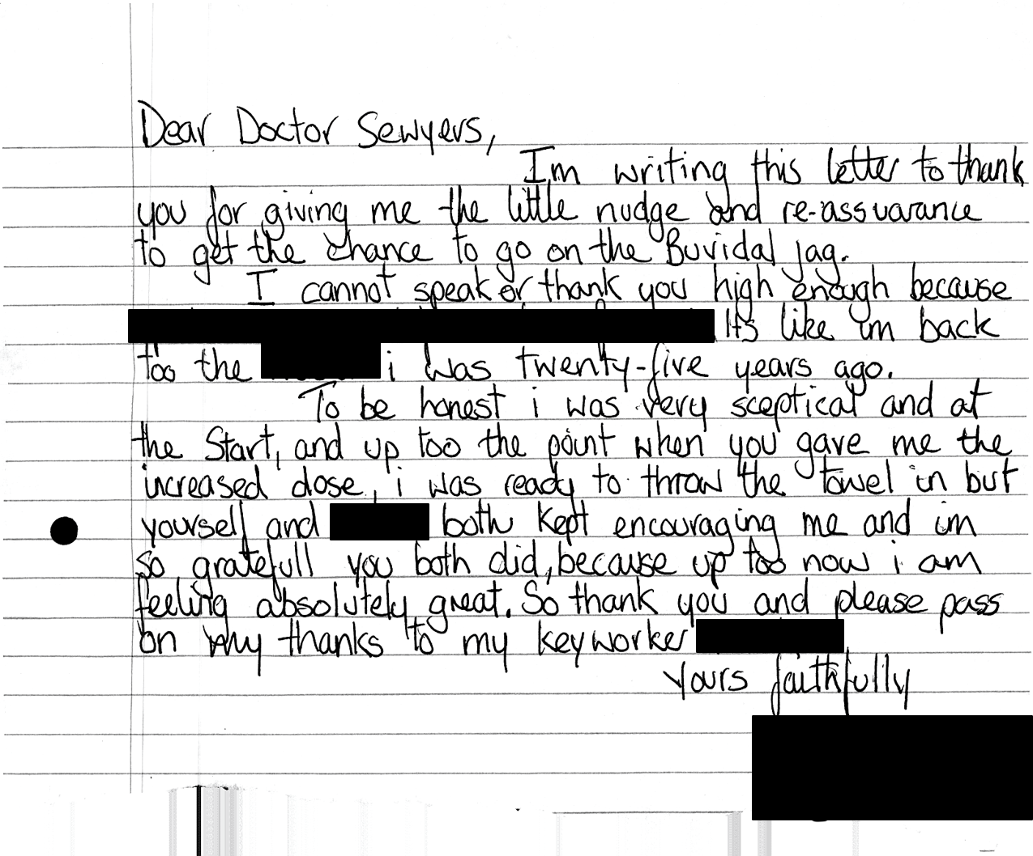

Slide 20
HMP Shotts -Transferring from daily sublingual to long-acting injectable buprenorphine
Prison environment
Drug of choice
Currency
Diversion
Bullying
18 prescribed SL buprenorphine
3 chose to convert to LAIB*
16 converted from methadone
1 ODT-naïve patient
Reasons for declining
Fear of needles
“Don’t fancy being experimented on”
Claimed to be reducing SL buprenorphine dose
*2 mg (n=1) and 16 mg (n=2) LAIB, long-acting injectable buprenorphine; OAT, opioid dependence treatment; SL, sublingual

Slide 21
Patient RW – HMP Shotts
Never been on opioid agonist treatment
Recent heroin habit, developed in prison
Methadone stigma
Daily SL buprenorphine (8 mg) → weekly LAIB (16 mg) → top-up LAIB (8 mg) → monthly LAIB (96 mg)
Patient is currently maintaining on 96 mg LAIB
LAIB, long-acting injectable buprenorphine; SL, sublingual

Slide 22
Patient GMcC – HMP Shotts
2 mg daily SL buprenorphine
Actively reducing towards cessation of ODT
Planning to stop
64 mg monthly LAIB
Fully detoxed
LAIB, long-acting injectable buprenorphine; OAT, opioid agonist treatment; SL, sublingual

Slide 23
Patient AS – HMP Shotts
SL buprenorphine (16 mg) → LAIB (96 mg)
Swapped back to daily SL buprenorphine
Claimed LAIB produced instant withdrawal
According to patient, they felt “normal” after taking a single dose of daily SL buprenorphine
LAIB, long-acting injectable buprenorphine; SL, sublingual

Slide 24
Patients switched from methadone – HMP Shotts
High-dose methadone: >50 ml
Slightly different protocol – typically higher dose of SL buprenorphine prior to initiation of LAIB
Dose range of patients switched to LAIB: 14–30 ml methadone
1 patient had not previously received opioid agonist treatment
LAIB, long-acting injectable buprenorphine; SL, sublingual

Slide 25
Transfer from high dose methadone – HMP Shotts
Missed 1 dose of methadone
If experiencing withdrawal
Single dose of 8 mg sublingual buprenorphine
Further doses if needed
Next day: weekly LAIB
8 mg LAIB top-up doses if needed
1 week later: monthly conversion
LAIB, long-acting injectable buprenorphine; SL, sublingual

Slide 26
Clinical experience of long-acting injectable buprenorphine HMP Shotts
2/16 patients switching from methadone experienced significant withdrawal
No patients have returned to methadone
4 used LAIB as detox as means to end ODT; all remain well
5 top-up requests; 1 patient twice
No significant drug-related adverse events
Most patients reported injection site pain (“it nipped a bit”), but did not cause any patients to cease LAIB
Headache (n=2) and insomnia (n=1)

Slide 27
Patient experience of long-acting injectable buprenorphine – HMP Shotts
“It’ll stop people bugging me for my Espranor” – Patient AS
“I’m sick of running around looking for it” – Patient RW
“This is a game changer” – Patient CP
1 patient claimed to experience withdrawal and switched back to SL buprenorphine (Patient AS)
SL, sublingual

Slide 28
Learnings & Tips
Address staff concerns
New formulation of existing ODT.
Provide suitable training.
Arrange experience in administering the depot.
Peer groups and lived experience feedback
Increase access to treatment,
Share successes.

Slide 29
THANKS
Dr Craig Sayers NHS Forth Valley
Dr Steve Conroy NHS Lanarkshire

