Slide 1
Kirsten Horsburgh
Strategy Coordinator (drug death prevention) Scottish Drugs Forum

Slide 2
Kirsten Horsburgh
Strategy Coordinator (drug death prevention) Scottish Drugs Forum

Slide 3
40,000+ naloxone kits is no small feat

Slide 4
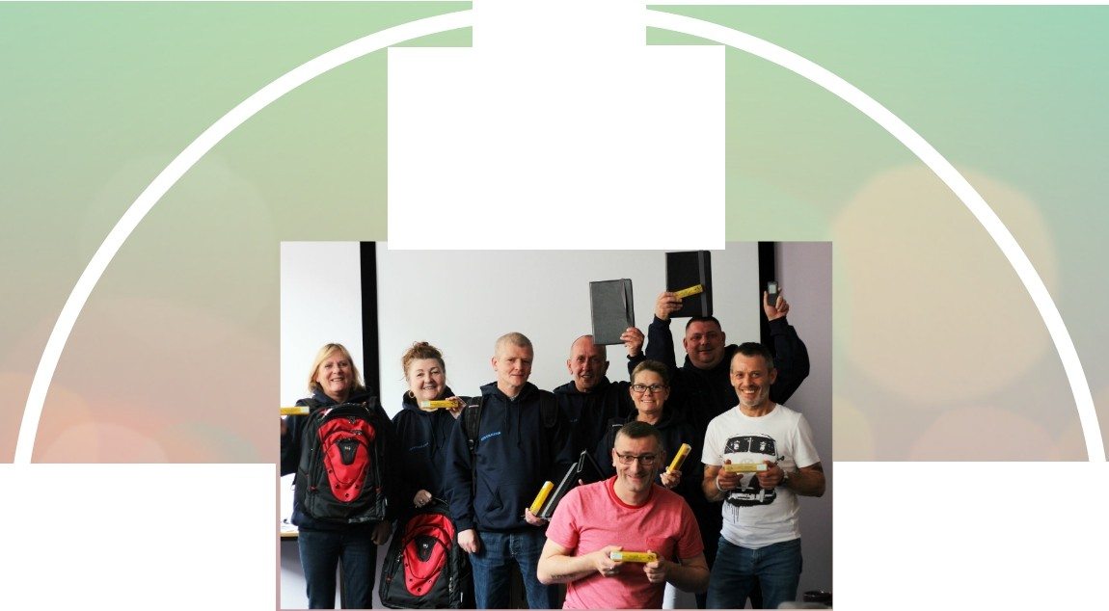
Peer Supply
From September 2017- May 2018
903 people trained
635 individuals supplied
892 kits supplied

Slide 5
Scottish Prison Service
300+ prison officers trained
s
SCOTTISH
PRISON SERVIC
Scottish Ambulance Service
Paramedics and technicians are attending hundreds of non-fatal overdose incidents
Police Scotland
Police are very often first on the scene of an overdose

Slide 6
Scottish Ambulance Service
Paramedics and technicians are attending hundreds of non-fatal overdose incidents

Slide 7
Police Scotland
Police are very often first on the scene of an overdose

Slide 8
ANYONE WHO IS LIKELY TO WITNESS AN OVERDOSE SHOULD HAVE ACCESS TO NALOXONE

Slide 9
Kirsten Horsburgh
Strategy Coordinator (drug death prevention) Scottish Drugs Forum

