Slide 1
Emily Tweed
Rebekah Miller
Catriona Matheson
Drugs Research Network for Scotland event
10th September

Slide 2
Acknowledgements
All the participants and peer researchers in the Older People with Drug Problems project
All the stakeholders interviewed for this project
Mark Lawson, Fran Warren, Fiona Fraser, Maggie Page, Carol Brown, Elinor Dickie
Scottish Government Library Services
Frank Dixon, Lee Barnsdale, Xenia Gounari, Jaroslaw Lang, Andy McAuley
Project undertaken for SG Substance Misuse Unit whilst on secondment from NHSGGC
Sara Davies and Emilia Crighton

Slide 3
Outline
Aim and methods of project
General findings relating to gender, drug use, and drug-related harms
Examining explanations
Limitations
Summary & implications

Slide 4
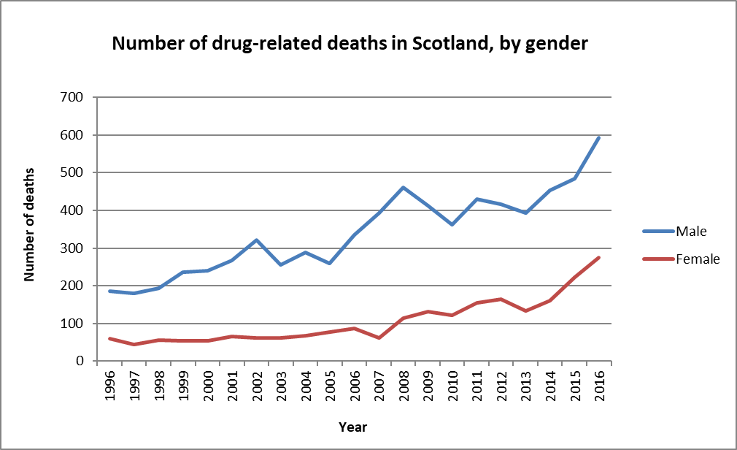
Aim
Rapid scoping project to:
examine potential explanations
identify implications for policy
Source: NRS
Notes:
Motivated by the observation that % increase among women has been much greater than among men – as Lee has demonstrated
Trend even more marked in most recent data
Also observed in E&W

Slide 5
Methods
Review of existing data sources
Engagement with professional stakeholders
Overview of published literature
Analysis of interviews from OPDP project
Notes:
Four strands to this project. Really difficult “why” question – need to triangulate multiple sources
REVIEWED RELEVANT ROUTINE DATA SOURCES – NRS and ISD data on deaths, SDMD data, NESI data, drug-related hospital stays
OVERVIEW OF PUBLISHED LITERATURE – aimed to identify relevant reviews plus “snowball” from there to other relevant papers – plus evidence mentioned by informants
PROFESSIONAL STAKEHOLDERS – statutory services, third sector, academia – 15 interviews, two focus groups, and one meeting observation. Undertaken by Rebekah. Notes taken, coded using thematic matrix. Iterative approach.
ANALYSIS OF OPDP INTERVIEWS – by Catriona – 28 women over 35 who use drugs who were interviewed as part of OPDP project – re-analysed using thematic matrix

Slide 6
Gender, drug use, and drug-related harms
Notes:
Describe findings from literature review, supplemented by stakeholder input and lived experience – general background to issues around gender and drug use
Provides backdrop for then considering what might have changed in recent years

Slide 7
Prevalence, motivations, and antecedents
“See what’s happened from I was, from I was a young age, I sort of like, take drugs to block all that out, but it doesn’t work, it blocks it out for one day and then when you wake up the next day, it’s still there, so you’re going to have to repeat, and repeat, and repeat myself every single day, trying to block this out.”
(Interviewee 303)
Notes:
Population surveys – consistently find that lifetime drug use lower among women than men, esp. for intensive and regular use
In Scotland, men are estimated to account for 70% of those with problem drug use
Some evidence that women tend to start using drugs and older ages and more likely to have partner or family member who uses drugs
Some evidence to suggest that women are more likely to have non-medical use of prescription drugs – but not conclusive, may relate to higher prescription rates for women
Some evidence of gender differences in motivations for substance use – women more likely to cite alleviation of physical/emotional pain or having drug using partner, men more likely to cite pleasure or novelty seeking. But – motivations are diverse and important to acknowledge complexity and nuance across genders
Experience of physical or sexual abuse high among people who use drugs of both genders, but particularly so among women. Both historical and ongoing.
Role in initiation, maintenance, relapse of drug use.
Common among women interviewed as part of OPDP.
References in literature to telescoping – shorter period between initiation and problems. Widely cited but relatively limited empirical literature. Unclear if biological/social/both.
Similarly, often cited that women respond differently to drugs or experience of recovery because of influences from hormones, menstruation, fertility, pregnancy, menopause etc – again relatively little evidence, mostly cocaine and at individual level – unclear if meaningful at population level.

Slide 8
Physical and mental health
“My partner, he’s saying to me, I think I’ve got that COPD [chronic obstructive pulmonary disease] or something, at night, it’s all bubbling and he said, he says it’s really scary, but, and I know I am, I get out of breath so easy, and it’s just wheezing...”
(Interviewee 421)
Notes:
Women who use drugs more likely than male peers to have concurrent mental health problems – though we also know that MH problems more common in general population, and women more likely to seek help
Some limited evidence from UK that women who use drugs more likely to have concurrent physical health problems than men.
OPDP – found that comorbidity common – types of conditions varied by gender e.g. women more likely to have lung disease, depression, men - hep C, liver disease/psychosis

Slide 9
Engagement with treatment services
“My mum’s been wanting me to go to the doctor for a while, but na, you see and I was worried what that would, because I had to sign an agreement wi’ the social work, so if I go to my doctor they get to see everything.”
(Interviewee 508)
Notes:
Mixed evidence about whether more or less likely to access treatment.
Pregnancy and parenthood often necessitate/motivate help-seeking
Some sources suggest that women may be more likely to seek help in other services e.g. primary care, MH
Certainly know there are lots of barriers
Stigma – exacerbated by societal gender roles
Fear of losing custody of children
MH problems
Caring responsibilities
Travel to treatment sites
Advances or harassment in treatment settings
Lack of social support or being in relationship with someone not wishing to seek treatment
Experiences of trauma and abuse
Some evidence from US that women who do enter treatment have similar/better outcomes than men – limited evidence from UK on this
Has been observed that women often have many assets in relation to recovery capital – often greater practical/emotional support from family members, more stable housing, greater ease in establishing new social networks

Slide 10
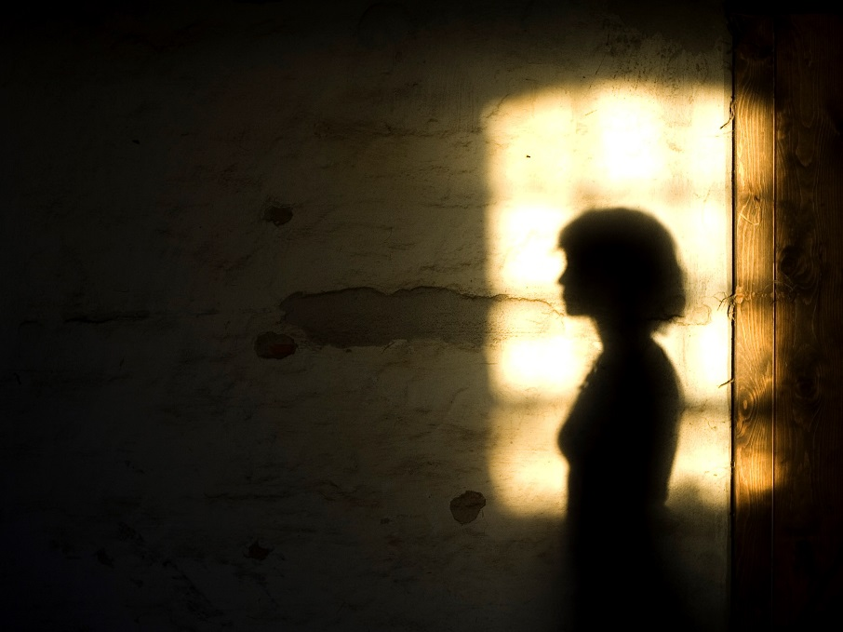
Life circumstances and family relationships
“I mean I think I would have stopped wi’ the methadone if there hadn’t been so many up and downs with the children getting taken off me and such, and there’s been so much, and then, I went through. My kids got taken off me, beatings from the ex, so, Women’s Aid people were involved, come up to talk to me, things like that. So there had been a lot of things that, not made me take drugs but, I chose to take them to help. But then it doesn’t help.”
(Interviewee 402)
Notes:
Again, women tend to have more stable housing – though may fail to capture hidden homelessness, living situations contingent on abusive relationships
Less likely to depend on criminal activity
Some reviews from outwith UK find that women less likely to be employed and have lower income than male peers – in UK found that women often fare better in terms of material cirucmstances because of support from family and better access to social housing
Women who use drugs in Scotland more likely to be parents and have childcare responsibilities than men who use drugs
Responsibility but also positive influence
Some concerns about trauma and “disenfracnhsed grief” associated with child removals and multiple child removals. Exacerbating drug use and risky use

Slide 11
Rates of drug-related death and risk factors
Cohort studies of people who use drugs find that:
Absolute rates of death - men > women
Relative rates (i.e. comparing to rest of population) – men < women
Partly but not fully explained by contextual & behavioural factors
Imprisonment
Injecting
Effect of known risk factors varies by gender
Age – greater increase in risk among women
Time out of treatment – lesser increase in risk among women
Notes:
Also some differences in substances im;ocated – lee has described
More likely to involve methadone, DHC or codeine, antidepressants

Slide 12
Examining explanations
Notes:
Preceding section - relatively static description of some of the commonalities and differences in drug use by gender
This section – attempts to go beyond that to understand trends – why has there been a change in recent years?
Difficult
Limited up to date evidence on relevant factors
Doesn’t lend itself to formal hypothesis testing
True cases likely to be multiple/interacting
Go through several explanations – starting with those to do with data, then individuals, community, social

Slide 13
Measurement issues?
Unlikely to be explained by:
Changes in recording practices
Changes in mortality trends among women more generally
Changes in number of women at risk?
Routine surveillance – population of women who use drugs ↔ or ↓
Limitations of existing data sources

Slide 14
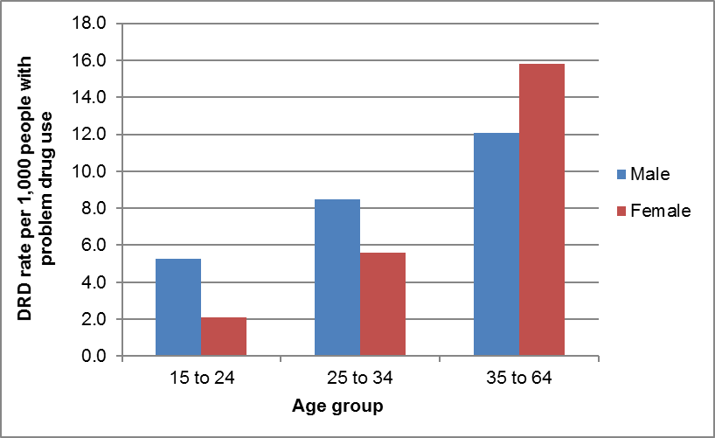
An ageing population?
Average age of women who use drugs is increasing
May be more pronounced among women than men
Ageing may be associated with greater DRD risk for women than men
Source: NRS
Notes:
Increasing age = increasing risk of DRD
Ageing phenomenon appears to be slightly more pronounced among women, based on NESI, SDMD, OPDP
Ageing associated with greater risk of DRD among women than among men
e.g. NRS data – try to calculate death rate among population of PDU – among younger ages, rates of death lower among women than men, but over 35s, rate of death higher – but caveats as estimates of # people with PDU

Slide 15
An ageing population?
But…
‘Ageing’ is relative
Population DRD rates increasing within almost all age groups
Not just inevitable chronological vulnerability…
“I think it’s got quite a lot to do with mental health, but sometimes I don’t know, I just, I’ve given up just now, because everybody’s been dying round about me, just giving up.”
(Interviewee 303)
“…now that I’m 35 I’m thinking “Oh my God, I’m nearly hitting 40, I’m still using gear, I haven’t got a job, a lot of mental illness, I haven’t got any kids, I’m not married. My Mum and Dad wanted more for me than that and I feel, they make me feel guilty about that you know.”
(Interviewee 503)
Notes:
But – several factors suggest that ageing is not in itself a sufficient explanation for phenomenon
Ageing relative – over 35
DRD rates increasing in almost all age groups
Ageing is a marker rather than cause in itself
Social isolation
Life transitions
Personal circumtances
Cohort effects
Age not necessarily an explanation in itself – need to understand mechanisms. In many cases may be a proxy for other fac tors which affect DRD risk
Many of these factors amenable to support and intervention

Slide 16
Changing patterns of drug use?
Among those who use drugs:
SDMD data
NESI data
Among those who have died:
Opioids still dominate
Higher % of female deaths involve multiple substances
Increase in recent years in:
Codeine/dihydrocodeine
Benzodiazepines
Cocaine
GABA-ergic drugs
Anti-depressants and anti-psychotics
Polysubstance combinations
Notes:
Could be changes in type, quantity, combination, frequency of drugs consumed
Similar trends between genders in main illicit drug of use in SDMD data – opioids by far most common, more common among women
Both genders showed increase in sedatives
Similar results from NESI
Women more likely to have received prescribed methadone
Deaths data – need to recall that based on element of subjective judgements to some extent as to which drugs implicated in deaths.
Opiates still by far most commonly implicated drugs and account for substantial proportion of recent increase
Higher % of female deaths involve methadone – but higher % of women who inject drugs are prescribed OST
Both genders – upward trend in # & % of deaths in which methadone is implicated
Increase in recent years
CODEINE/DHC
Both – benzos, cocaine
Both – GABA-ergic drugs, though started earlier in women than men
Women who die – higher proportion have multiple substances.
Prescription drug use – often higher rates of prescription among women, not deteceted on urine screen
Not clear to what extent these trends are due to higher use of these mediations (prescribed or illicit) or greater vulnerability to effects

Slide 17
Changes in relationships?
Increasing social isolation – a recurring theme
Difficulties in family relationships
Deaths within peer group
Multiple child removals
Mental health problems & trauma
Impact of drug use on social networks
Notes:
Relationships broadly construed – parental, family, intimate
Child removals – traumatic episode, grief, social isolation, exacerbated by menopause/life transitions – though may facilitate engagement with treatment. Limited routine data available does not suggest increase in child removals in general across Scotland during this period, but could not look specifically at child removals among women who use drugs.
May be more impactful than women – drug use more highly stigmatised, more closely linked to intimate relationships
On other hand, women who use drugs retain more support from family and easier to establish new social relationships

Slide 18
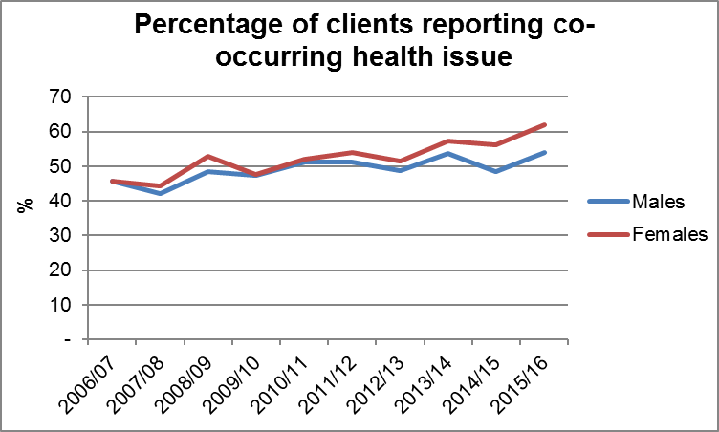
Co-occurring physical and mental health issues?
Consistent with:
Analysis of DRDs data
Older People with Drug Problems
Stakeholder input
Source: Scottish Drugs Misuse Database
Notes:
MH problems are risk factors for DRDs, as are some physical health conditions
May be one of the mechanisms by which ageing cohort = greater DRDs
Among those who have died, women had greater prevalence of long-term physical/MH conditions & recent hospitalisation
% of those who died who had recent physical health/MH condition increased – somewhat more pronounced than women
But OPDP – type of comorbidity varies with gender and age
Difficulties in accessing treatment – stigma, confidentiality, access to services (e.g. appointments), diagnostic overshadowing
Close link between life circumstances and physical/mental health – all three closely intertwined
Increase in DRDs doesn’t seem to be drivn by icnreaes in suicides – but intentionality hard to defineKnow that MH has declined in recent years among population on lowest income and on benefits – overlap with people who use drugs

Slide 19
Treatment & harm reduction services?
Comparing prevalence and treatment data
Among those who have died, women more likely to have had:
Recent contact with services
Current OST prescription
Previous overdoses
Someone else in room at time of death
Naloxone supply & carriage – trends similar by gender
Missed opportunities?
Notes:
Engagement with harm reduction and retention in treatment services = protective against DRD
Compare gender profile of those in treatment to wider population of people believed to use drugs – similar or slightly higher % of women
May suggest that women more or equally likely to access treatment – but perhaps ongoing missed opportunities within treatment, or not meeting needs
Interviews – perceived under-dosing, reluctance to reduce dose, being on OST too long, lack of support, lack of time.
Naloxone – trends in supply/carriage in NESI similar by gender – if anything slightly higher supply among women, esp. in prisons

Slide 20
Treatment & harm reduction services?
Changes in services:
Treatment services
Allied health services e.g. mental health
Broader support e.g. employability
Experiences in prison
Less common among women who die than men
Questions about continuity of treatment & throughcare
Naloxone uptake - high
Notes:
PHE, ACMD in England
Stakeholders in Scotland
Changes to treatment services and cuts – disruption to continuity of relationships and of services provided,
Potential for women to be more vulnerable – stigma, relational factors, greater MH need

Slide 21
Economic and social trends?
Greater vulnerability to welfare reform and austerity measures?
Socioeconomic deprivation
Gender
Complex health and social needs
Notes:
Growing evidence that economic shocks and policy repsonses such as austerity impact on heatlh, and that these impacts are gendered
Women disproportionately likely to be affected by cuts to public services and to changes in welfare benefits
People who use drugs likely to be disproportionately affected – more likely to live in most deprived areas (most affected) and to be on precarious incomes, with high prevalence of complex health/social care needs – more likely to need social security provided by benefits system and to need support from statutory services
Intersection of structural factors = women who use drugs may be especially vulnerable to welfare reform and austerity measures
May exacerbate other factors e.g. abusive relationships
Has been identified by PHE and ACMD, as well as by local stakeholders

Slide 22
Synthesis of explanations
Ageing – range of mechanisms
Physical & mental health problems
Barriers to engaging with services
Gendered stigma
Changing patterns of drug use
Changes in relationships
Ongoing risk whilst in treatment
Changes to drug and allied services
Welfare reform
Previous or ongoing trauma
Drug use within relationships
Notes:
Complex web of factors which interact
Background of factors which affect women’s experience of drug use
Changing factors superimposed on top
In combination may explain trend

Slide 23
Limitations
Overview of literature rather than systematic search
Purposive and convenience sampling of informants
Nature of data sources
Limited descriptive analysis
Definition of drug-related deaths

Slide 24
Implications
“The starting point in developing gender-sensitive drug policy must be
to recognise points of similarity and difference between the lives of
female and male drug users. Intersectional approaches are useful here
which do not assume that gender is the most important factor in shaping
the experiences of drug users and provide space to consider the role of
other factors - individual, social and cultural - which may be related to drug use. The latter involves recognition that drug users’ experiences are
shaped, but crucially are not determined by, structured inequalities.”
Wincup (2016)
Notes:
ADVOCATING GENDER-SENSITIVE OR GENDER-INFORMED, RATHER THAN GENDER-SPECIFIC APPROACH
Recognising commonalities and diversities
Intersection
Many of areas identified – require cross-sectoral collab
Opportunities for policy synergy

Slide 25
Implications for policy & practice
Gender mainstreaming
Involvement of those with lived experience
Co-ordination across services
Child & family-sensitive provision
Trauma-informed practice
Low-threshold & crisis provision
Family-sensitive services & support
Mitigating social & financial disadvantage
Enhanced support at vulnerable times
Access to wider opportunities

Slide 26
Implications for future analysis & research
Prescription drugs and polysubstance use
Gender, substance use & welfare reform
Mixed methods
‘Hidden populations’
Population-based cohorts
Longitudinal studies
In-depth qualitative work
Child protection & custody processes
Changes in population, risk factors, mortality
Experiences in treatment
Naloxone supply & use

Slide 27
Thanks for listening. Comments and questions welcome!

Slide 28
Changes in the number of women at risk?
Self-reported drug use
Needle Exchange Surveillance Initiative
Initial assessments for treatment
Drug-related hospital stays
Limitations to these data
Potential hidden population(s) – esp. for prescription drugs?
Suggest population of women who use drugs stable or decreasing
Notes:
Did rule out changes in definition or recording practices
Could be more people at risk, or greater risk among same size group of people, or both
Really difficult to get a clear idea of size of population of people who use drugs
Do estimate prevalence every few years but differences in methods – can’t be used for calculating trends over times in rates
Most sources suggest that population of women who use drugs stable or decreasing
However, these data aren’t perfect – largely relate to people seeking treatment for drug problems, which may misrepresent people at risk
OPDP project – group of people with problem benzo use but not opioid use – women more prevalent among this group than among entire OPDP cohort. Many did not have any drug treatment or hospital activity in the study period.
Declining proportion of women who die of DRD are known to have drug problem
A few stakeholders raised concerns about deaths among women not fitting typical profile of those considered to be at risk – esp. benzos and other prescription drugs

