Slide 1
Trina Ritchie, Lead Clinician
Jennifer Kelly, Pharmacist Prescriber
NHS GGC Alcohol Drug Recovery Services

Slide 2
Disclosures:
Speakers fees and advisory board fees from Camurus
Grants from Indivior

Slide 3
Current progress in Greater Glasgow and Clyde
Patient-centred care prioritising ethos of: “right medication, right product, right dose”
Exclusion criteria* (although not absolute):
Prefers treatment with methadone or transmucosal buprenorphine
Has other pharmacy instalment dispensing i.e. HIV anti-retrovirals
Is pregnant
Currently over 200 patients in treatment with Buvidal®
*In addition to contraindications listed in the Buvidal® (buprenorphine) SmPC. Camurus AB. 18 June 2020.

Slide 4
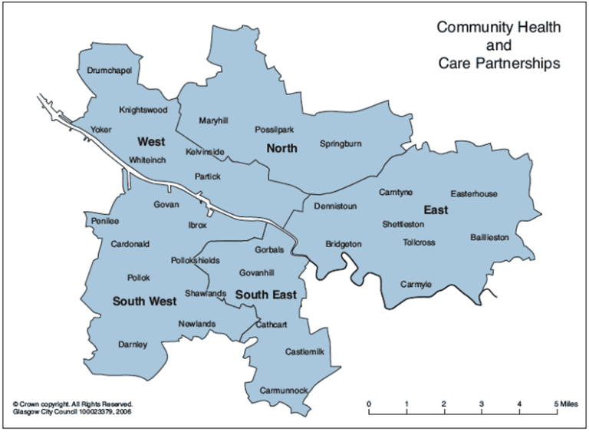
Pilot Injectable Prolonged Release Buprenorphine
Two CAT teams in South Glasgow
500 individuals on OAT
19% prescribed buprenorphine
Identified 20 individuals on sublingual buprenorphine
Excluded recent problematic drug use, non-fatal overdose, physical health issues, other instalment medications
Notes:
Two CAT teams in SW buildings
March 2019
20 identified by MDT discussion SMO / MO / PIP / care managers
Maintenance sublingual buprenorphine
Attending appointments – wanted experience of use of new medication, not study who does well.
Variety operational issues to consider before commenced pilot

Slide 5
Buvidal pilot outcomes at six months
Drug screening for opiates, cocaine, benzodiazepine and amphetamine*
Engagement with structured daily activity†
9/13
4/13
4/13
9/13
12/13
1/13
13/13
Positive drug screen
Missing test at 6 months
Engaged with structured daily activity
Negative drug screen
Not engaged with structured daily activity
*Near patient urine drug screening was completed at commencement of Buvidal® and after 6 months of treatment; †Structured daily activities measured included employment, recovery community, occupational therapy, jobs and business training. Middleton L, et al. Improved recovery outcomes with injectable prolonged-release buprenorphine in an opioid agonist therapy clinic in Glasgow. Poster presented at: Drugs Research Network Scotland Annual Conference. 2019; Glasgow, UK.

Slide 6
Our experience of patient groups who may benefit
Patients with first treatment episode opioid dependence
Patients with opioid dependence caused by pain medications
Young people and children using heroin
Patients who frequently miss days at pharmacy
Patients resistant to optimal methadone dosing
Patients progressing in recovery
Patients living with children potentially at risk of medication ingestion
Patients who are frequently remanded
Patients who feel “stuck” or stigmatised on OST

Slide 7
Up-take in South Glasgow community team
7 Buvidal®
June/July 2020:
32 patients started OST
50% chose Buvidal®
44% chose methadone
6% chose transmucosal buprenorphine
88% 1st-time OST chose Buvidal®
65% who previously had methadone chose to return to methadone
8 (25%) 1st-time treatment
1 methadone
Previous OST
6 methadone
32 OST starts
9 Buvidal®
3 buprenorphine
11 methadone
24 (75%) treatment restarts*
13 methadone
2 buprenorphine
2 buprenorphine
2 buprenorphine
*’New-to-treatment’ patients with a new OST episode following at least 1 month off OST.

Slide 8
Patient satisfaction with medication
 April 2020 – questionnaire¹ completed by 34 of 40 patients in treatment for more than 3 months
Average age | 43 years | Range 25–63 years
Sex | 74% male
Average time on OST pre Buvidal® | 8.5 years | Range 0–25 years
Average time on Buvidal® | 27 weeks | Range 13–52 weeks
Satisfaction | 85% extremely satisfied | 15% very satisfied
Side effects | 85% no side effects | 15% much less side effects
Prefer Buvidal® to previous OST? | 31* (100%) yes
Positive comments from others? | 12 (35%) yes
OST, opioid substitution treatment. 1. Kalali A. Patient satisfaction with, and acceptability of, atypical antipsychotics. Curr Med Res Opin. 1999;15(2):135–7.
* 3 patients had no previous treatment experience for comparison
Notes:
In April 2020 the South team had 40 people who had been using buvidal for more than 3months- we contacted them by telephone and asked to take part in a patient satisfaction questionnaire called the PMSQ-M.
And 34 agreed to take part
The age and sex of this group were representative of our OST population
The average time on treatment prior to buvidal was 8.5 years
3 patients had no previous experience treatment
They scored saftisfaction on a Scale of 1-6 with extremely satisfied being 1 and very satisfied being 2 through to 6 being Extremely dissatisfied – all patients scored 1 or 2 so 100% were satisfied with treatment
All patients with previous experience of OST reported a preference for buvidal
Finally, 1/3 of patients reported spontaneous comments from family on various positive changes since starting on buvidal

Slide 9
Experience of tapering to abstinence
Minimum 3 months on maintenance dose
3 months on each tapered dose
3 months monitoring after final Buvidal® 64 mg monthly dose
12 patients have completed planned detoxification
No withdrawal symptoms reported
No top-ups or symptomatic relief required
2 patients relapsed and quickly returned to Buvidal

Slide 11
