Slide 1
Scotland’s national naloxone programme (NNP): what have we learned?
Dr Andrew McAuley
Principal Scientist, Health Protection Scotland
Senior Research Fellow, Glasgow Caledonian University

Slide 2
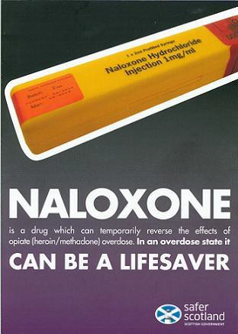
National Naloxone Programme (NNP): 2011 - present
“The aim of this national programme is to increase the availability and awareness of naloxone across Scotland, in order to increase the chance of it being
administered during an opiate overdose… I hope that the impact of increased naloxone availability will contribute to a reduction in fatal opiate overdoses in Scotland and I am very grateful for your support in taking forward this important
initiative.”
Fergus Ewing, Minister for Community Safety, 01/11/10

Slide 3
Naloxone in Scotland: 5 Key questions
Did the NNP reach those most at risk of opioid overdose?
Who engages most with the NNP?
Are PWID in Scotland following the NNP training protocol?
Did the NNP have an impact on opioid-related overdose?
What are the priorities for the NNP moving forward?

Slide 4
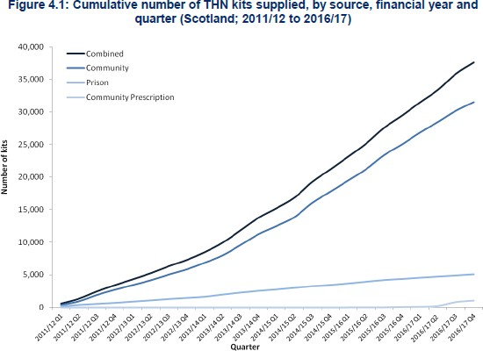
1a. Did the NNP reach those most at risk of opioid overdose?
85-91% per year supplied to
‘persons at risk of opioid
overdose’
Source: ISD (2017)

Slide 5
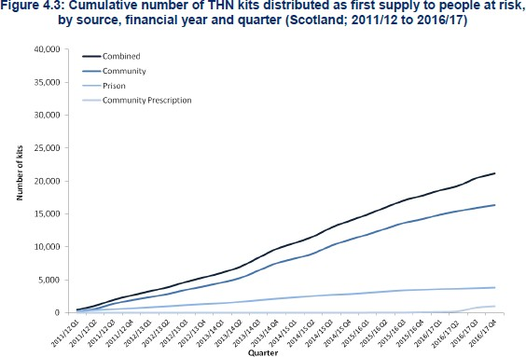
1b. Did the NNP reach those most at risk of opioid overdose?
Estimated reach among PWUD: 345 kits per
1,000 ‘problem drug users’
Source: ISD (2017)

Slide 6
1c. Did the NNP reach those most at risk of opioid overdose?
Engagement in the NNP by people who inject drugs (PWID)
70
60
50
percentage
40
Supplied with naloxone in last 12 months
Carrying naloxone
30
20
10
0
2011-12
(n=2146)
2013-14
(n=2331)
2015-16
(n=2696)
2017-18
(n=1581)
Source: McAuley et al, 2016 / Bird et al, 2017 / NESI 2017-18 (provisional)

Slide 7
“…Cos they don’t even carry needles in their bag. You know, they’ve usually got a stash for that sort of stuff. So if someone OD’s and the other one is doing something for a quick hit, none of them is gonna have naloxone on them because the police stop them and check them. They find a needle on them, that’s enough to take them all the way back to the station for a full body search, strip search…they’re like that. So that’s all it takes.
They find naloxone, they’ll say, ‘oh right he’s a
junkie’ [clicks fingers], ‘right down the station, full
body search’”.
‘Andy’, 45-54 years old, injecting > 10 years

Slide 8
2. Who engages most with the NNP?
Percentage of NESI respondents supplied with naloxone in the past year, 2017-18 (n=1581)
80
70
60
50
40
30
20
10
0
percentage
Source: NESI 2017-18 (provisional)

Slide 9
3a. Are PWID in Scotland following the NNP training protocol?
Basic life support
Naloxone administration
Call an ambulance
Between 2011/12 and 2016/17, a total of 3,088 repeat supplies were issued due to the previous kit being used for the purposes of saving a life...

Slide 10
3b. Are PWID in Scotland following the NNP training protocol?
“Yeah I think it’s [naloxone] pretty useful to have around. In fact I don’t like being, not having it around. But, I
didn’t know you were only supposed to give the little bit.
But I’ll continue to give the whole lot [laughs], do you know what I mean? Cos I want them around completely.
I’m not wanting to put half in and then the guy, poor guy stops breathing again. And it’s like put another wee bit
in. No, by the time you’ve finished giving him the whole
lot, five injections, the poor guy’s deid. Ken what I mean? So I still inject the whole lot into him.”
‘Walter’, 45-54 years old, injecting 3-5 years

Slide 11
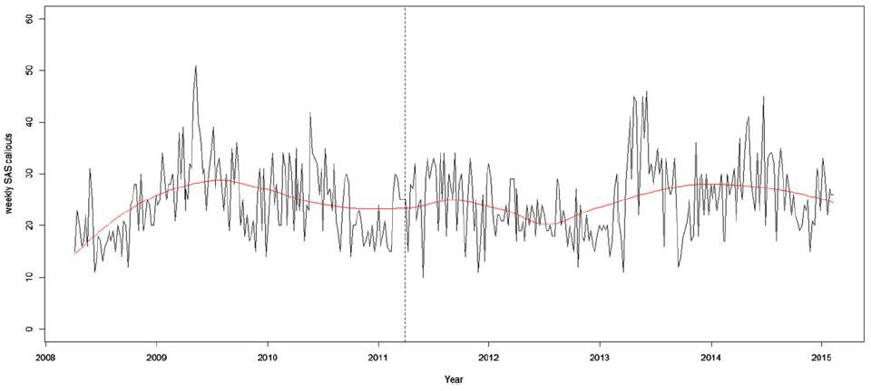
3c. Are PWID in Scotland following the NNP training protocol?
Weekly ambulance callouts to opioid-related overdose incidents, Scotland, 2008-2015
P = 0.39
Source: McAuley et al (2017)

Slide 12
3d. Are PWID in Scotland following the NNP training protocol?
“When they came they were like, ‘you’ve saved that guy’s life like’...If it wasn’t for you, you
really did, saved his life, well done’. Ken that, I got the big heid after that, you know? You
know what I mean? There’s him telling me I could do his job, you know that type thing.”
‘Andy’, 45-54 years old, injecting > 10 years

Slide 13
4a. Did the NNP have an impact on opioid-related overdose?
Opioid-related deaths, Scotland, 2000-2016
900
800
700
600
500
^{n} 400
300
200
100
0
Source: NRS(2017)

Slide 14
4a. Did the NNP have an impact on opioid-related overdose?
Opioid-related deaths, Scotland, 2000-2016
900
800
700
600
500
^{n} 400
300
200
100
0
Source: NRS (2017)

Slide 15
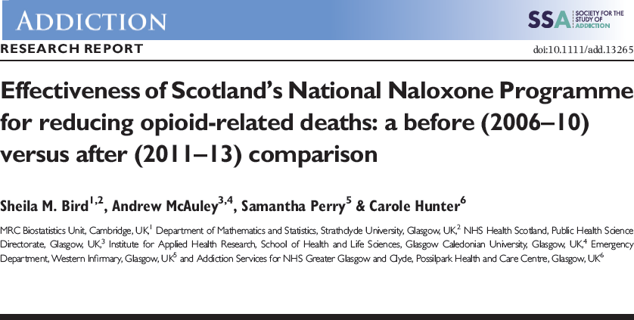
4b. Did the NNP have an impact on opioid-related overdose?
Percentage of opioid-related deaths within 4-weeks of prison release
2006-10
9.8
2011-13
6.3
2014-15
3.9
“This reduction in the proportion of prison release ORDs translates into 42 fewer prison release ORDs (95% CI = 19–65) during 2011 –13, when 12 000 naloxone kits were issued at current prescription cost of £225 000.”
2016
3.5
0
5 10
percentage
15
Source: ISD (2016)

Slide 16
4. Did the NNP have an impact on opioid-related overdose?
Percentage of opioid-related deaths within 4-weeks of hospital discharge
2006-10 9.7
2011-13
9.2
2014-15
9.6
2016
9.4
0
2
4
6
percentage
8
10
12
Source: ISD (2016)

Slide 17
650
NALOXONE
HEROIN DROUGHT
IEP
OST
600
550
500
450
400
350
300
250
200
150
100
50
AGEING COHORT
HEROIN DROUGHT BBV INFECTION
1996 1997 1998 1999 2000 2001 2002 2003 2004 2005 2006 2007 2008 2009 2010 2011 2012 2013 2014
NPS
0
registered in year 3-year average 5-year average Likely lower Likely upper

Slide 18
Thank you
andrew.mcauley@nhs.net @arjmcauley
References
McAuley, A., Munro, A., & Taylor, A. (2018). “Once I’d done it once it was like writing your name”: Lived experience of take-home naloxone administration by people who inject drugs. Int J Drug Policy. May 23;58:46-54. doi: 10.1016/j.drugpo.2018.05.002. [Epub ahead of print]
Bird, S., McAuley, A., Munro, A., Hutchinson, S.J., & Taylor, A. (2017). Prison-based prescriptions aid Scotland's National Naloxone Programme. The Lancet, Vol. 389(10073), 1005 – 1006.
McAuley, A., Bouttell, J., Barnsdale, L., Mackay, D., Lewsey, J., Hunter, C., et al. (2016). Evaluating the impact of a national naloxone programme on ambulance attendance at overdose incidents: a controlled time series analysis. Addiction, doi: 10.1111/add.13602.
McAuley, A., Munro, A., Bird, S.M., Hutchinson, S.J., Goldberg, D.J., & Taylor, A. (2016). Engagement in a National Naloxone Programme among people who inject drugs. Drug Alcohol Depend., Vol. 162, 236-240.
Bird, S., McAuley, A., Perry, S., & Hunter, S. (2015). Effectiveness of Scotland’s National Naloxone Programme for reducing opioid-related deaths: a before (2006-10) versus after (2011-13) comparison. Addiction, Vol. 111, 883– 891.

